Slide 1
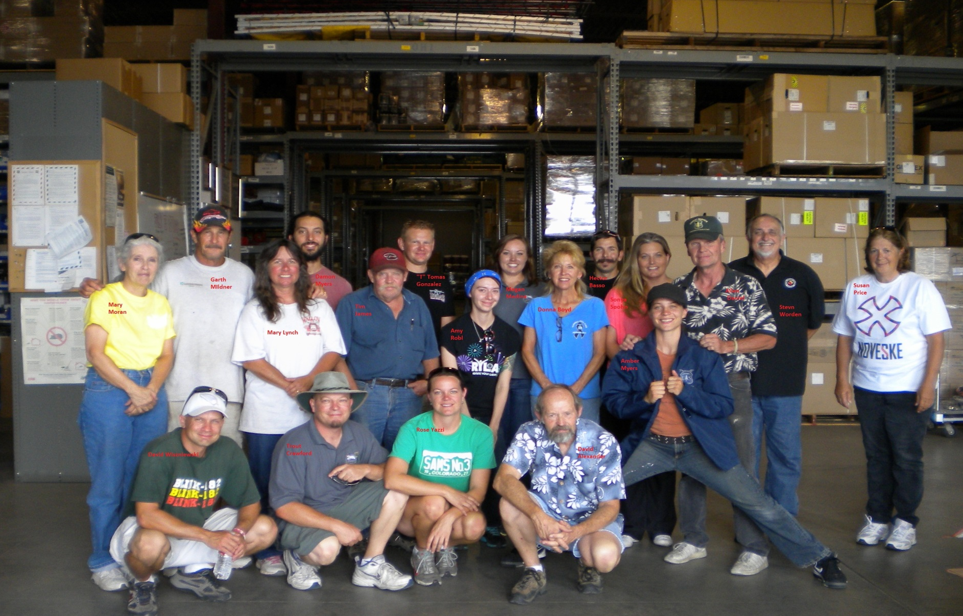
2015 Region 3
NATIONAL INTERAGENCY SUPPORT CACHE PRESENTATION

Slide 2
2015 NATIONAL INTERAGENCY SUPPORT CACHE PRESENTATION
The National Interagency Support Cache System is made up of 15 caches in strategic locations throughout the United States. Ft. Wainwright, AK; Boise, ID; Missoula, MT; Redmond, OR; Redding, CA; Ontario, CA; Denver, CO; Prescott, AZ; Silver City, NM; London, KY; Grand Rapids, MN; LaGrande, OR; Wenatchee, WA; Billings, MT & Coeur d’ Alene, ID. The caches are operated under the direction of federal and state agencies, including the US Forest Service; Bureau of Land Management and various states including Alaska, Minnesota and Idaho.
The above 15 caches are connected by the common inventory software system (ICBS) Interagency Cache Business System that is interfaced with the Dispatch (ROSS) Resource Ordering & Status System. This allows the electronic transfer of data from Supply and Equipment orders between the two systems. This allows individual cache managers to access and share inventory information electronically, enabling an efficient transfer of critical supplies and equipment between areas less affected by incidents to those in critical need. This, in conjunction with support from the GSA Wildland Fire Equipment program and those commercial vendors supporting incident related programs make up the backbone of the incident supply system.
Each cache is located within an area controlled by a (GACC) Geographic Area Coordination Center(Zone of Influence). Cache managers work with the GACC’s to manage the storage and distribution of communication systems and cache vans within their areas.

Slide 3
2015 NATIONAL INTERAGENCY SUPPORT CACHE PRESENTATION
New LED Headlamps: NFES 000718 The SDTDC has worked to bring a more up to date headlamp into the system. This LED headlamp takes 3 AA batteries. No financial credit will be given for returned 000667 (yellow) lamps.
Volume Pump Kits: NFES 006041 This kit is not new to the NISC but a new item at AZPFK. 4cycle engine using unleaded fuel and 30WT oil only.
Brushed Pigskin Gloves: NFES 001640-001643 Currently sizes S-XL. NFPA 1977, 2011 edition approved.

Slide 4
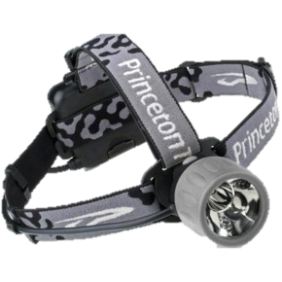
Headlamp
Purchased 6,000 units under current contract
DLA is working on a 5 year contract
Replacing yellow 000667 headlamps in Cache Vans
Unit Price is $58.16

Slide 5
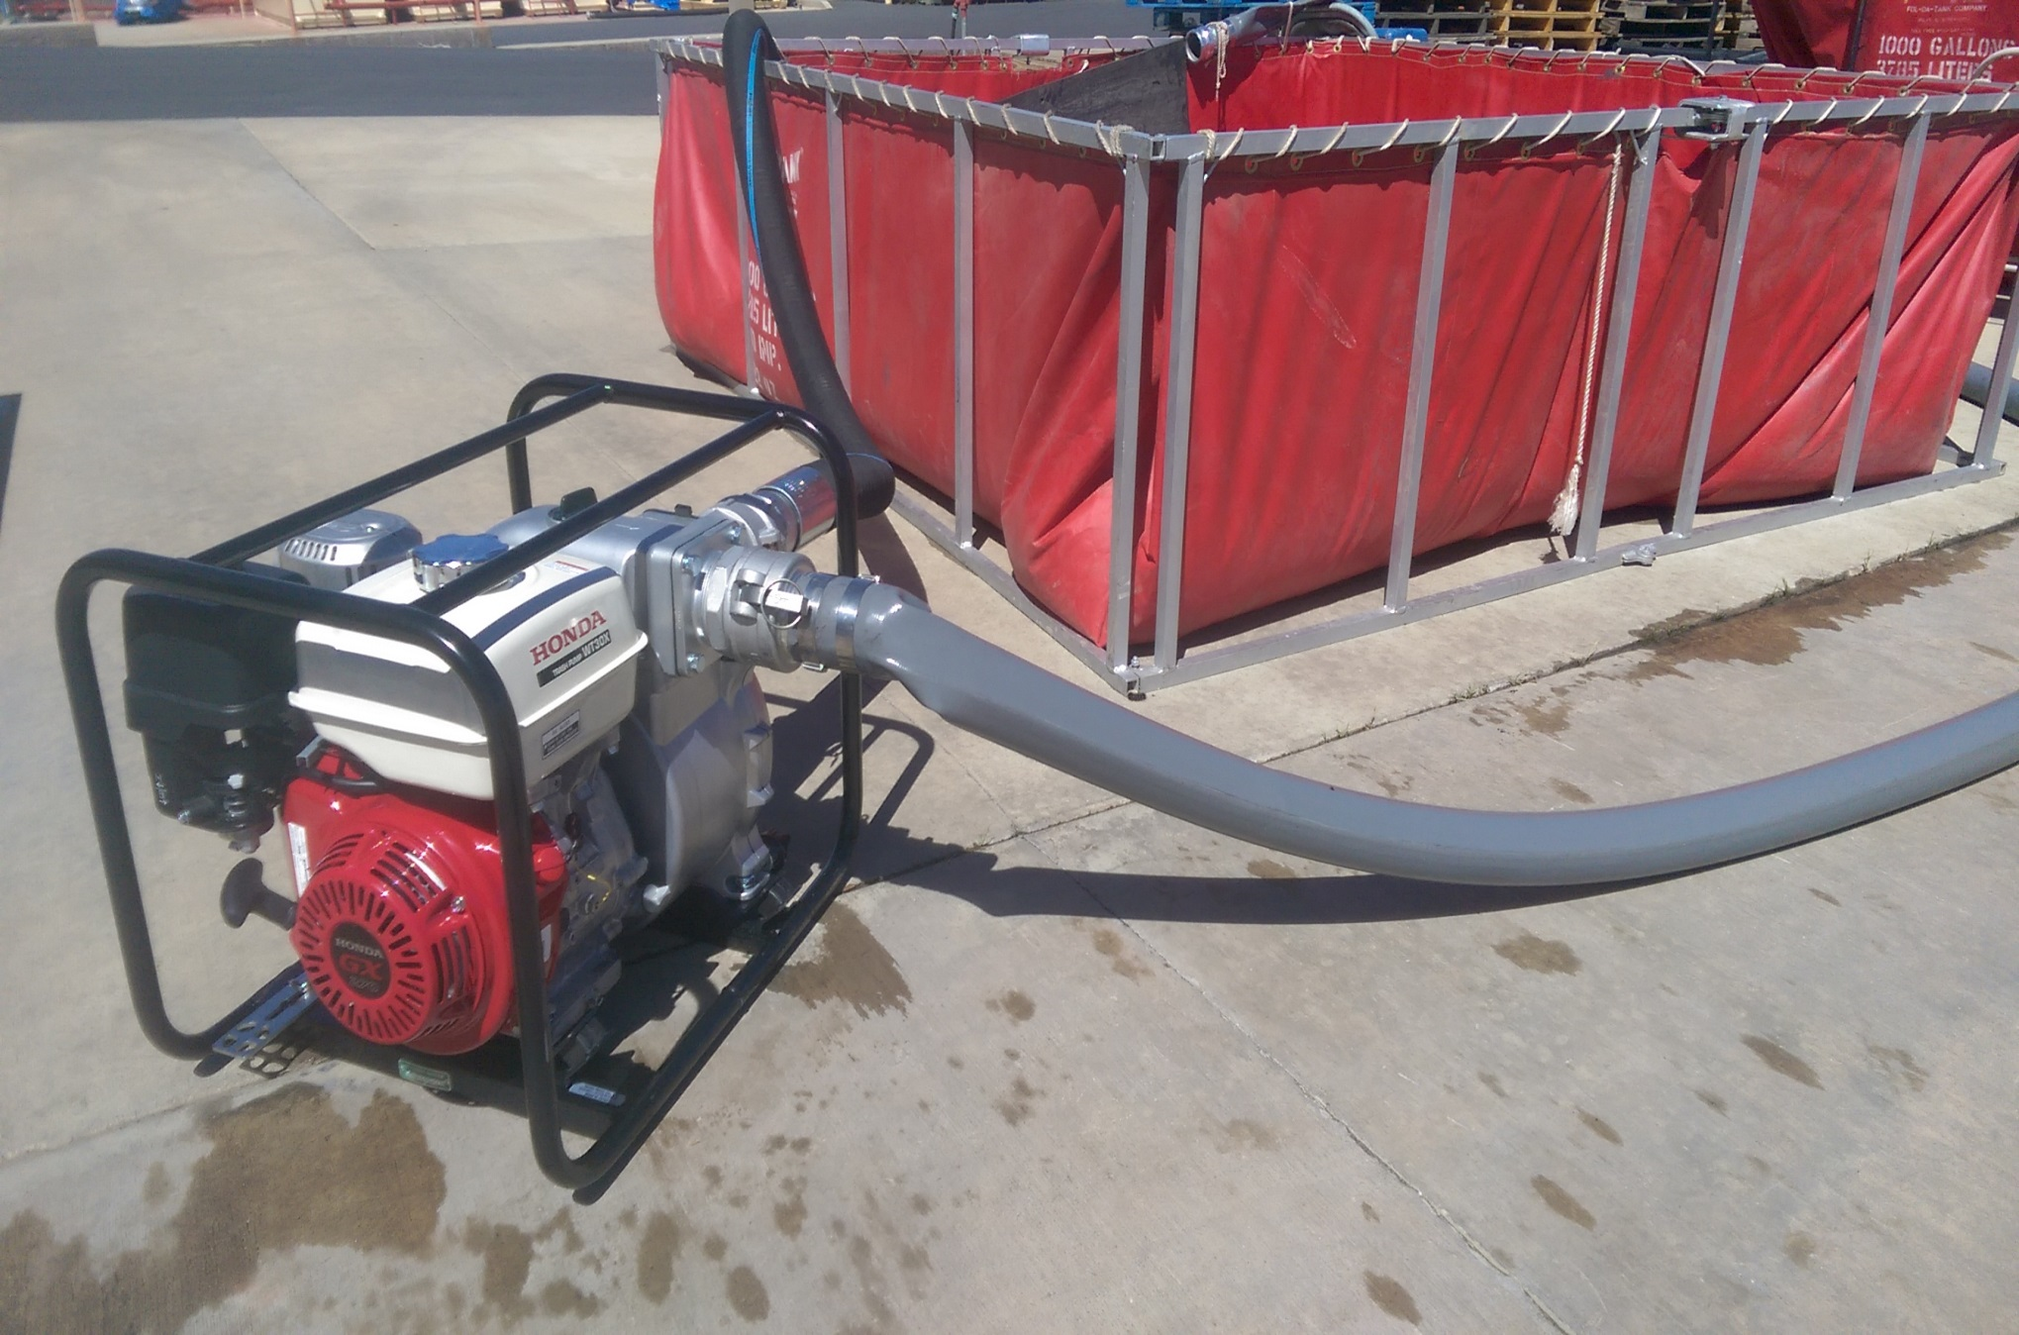
Volume Pump Kit with accessories: NFES #006041
Notes:
New bag is NFES 000128 35 x 81
Old bag is NFES 000022 34 x 76

Slide 6
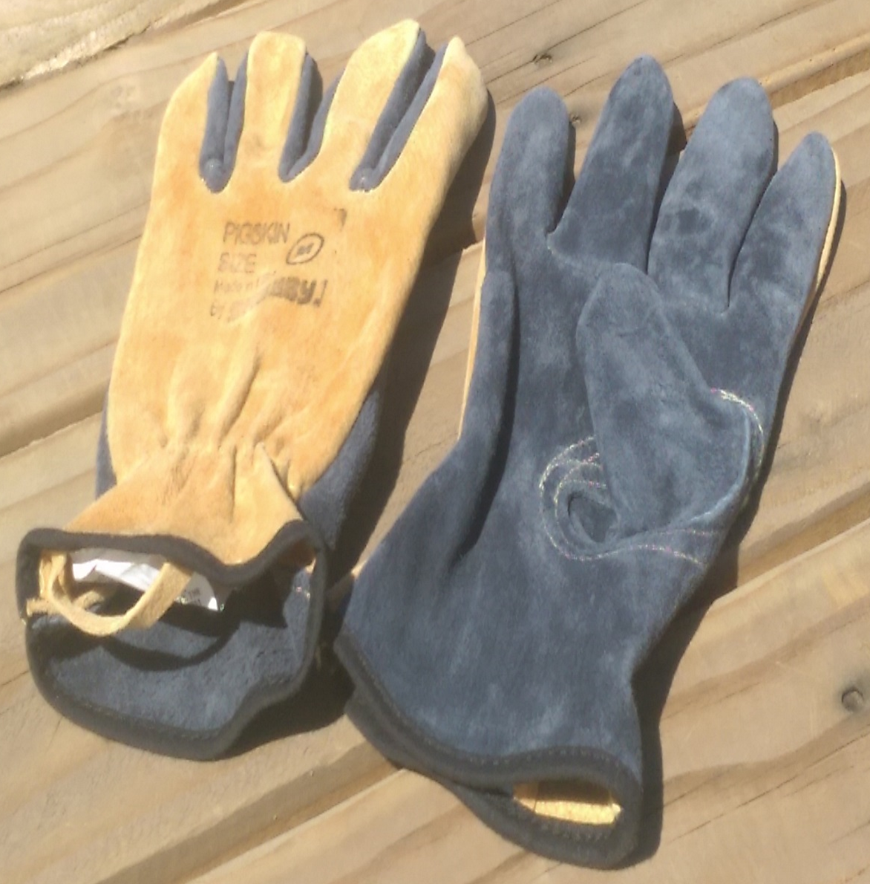
NFES 001640-001643
NFPA 1977 2011 edition approved.
Sizes: Small – X-large
Softer leather for quicker break in period.
Longer fingers and increased comfort.
$1.47 more expensive than cow hide gloves.
Standard pack of 12 PR.

Slide 7
2015 NATIONAL INTERAGENCY SUPPORT CACHE PRESENTATION
NFES 000371 & NFES 000687 Flares: Flares continue to be ordered without cartridges. NFES 000372 & NFES 000689 Cartridges must be ordered separately.
Contagious Disease Warnings: Request IMT notification to the caches and other entities that there may be a contagious disease outbreak (i.e. Norovirus) at fire camp. This would alert the servicing caches or other entities that they should be aware and use caution when receiving incident backhaul.
Hazardous Materials handling: Any clothing or materials known to contain bio-hazard fluids or waste must be properly disposed of at the incident. Clothing or materials exposed to poison ivy, poison oak, sumac, etc. should be bagged and disposed of at incident. A count of clothing disposed of by the incident should be forwarded to the cache to give proper credit to the incident.

Slide 8
2015 NATIONAL INTERAGENCY SUPPORT CACHE PRESENTATION
KIT CHANGES FOR 2015
000970 Security Fence Kit
Changing from 6 posts and 50’ of fencing to 10 posts and 100’ of fencing and increase nylon ties to 100 EA. Cache vans will reduce from 5 kits to 3.
001040 Crash Rescue Kit
Adding a Blade to NFES #001095 Hack Saw Frame.
Doesn’t change overall QTY of 11 blades in the Kit.
000650 SKED Kit
Replace 000667 Headlamp (2 EA) with 000718 LED Headlamp.

Slide 9
2015 NATIONAL INTERAGENCY SUPPORT CACHE PRESENTATION
KIT CHANGES FOR 2015
0002069 Mobile Cache Van
Removal of 000667 Headlamps (48 EA) and replaced with 000718 LED Headlamp (50 EA)
Removal of 000943 5 GL insulated jugs.
Removal of 000673 Lid Removers. There are no remaining 000073 Food Containers in the NISC.
-Reduce 000970 Security Fence Kits from 5 to 3 while increasing overall fencing on the van to 300’.

Slide 10
2015 NATIONAL INTERAGENCY SUPPORT CACHE PRESENTATION
Revised Incident Summary & Fire Loss Reports: In response to comments that the Incident Summary Reports and Fire Loss Reports were not user friendly, the cache community in conjunction with our ICBS technical experts have developed improved versions of these reports that will enable field users to more easily understand the status of supplies and equipment issued and returned from incidents.
Updated Interagency Business Management Handbook:
New verbiage with respect to Property Management and Incident Replacement Policies. Chapter 30 for Property Management.

Slide 11
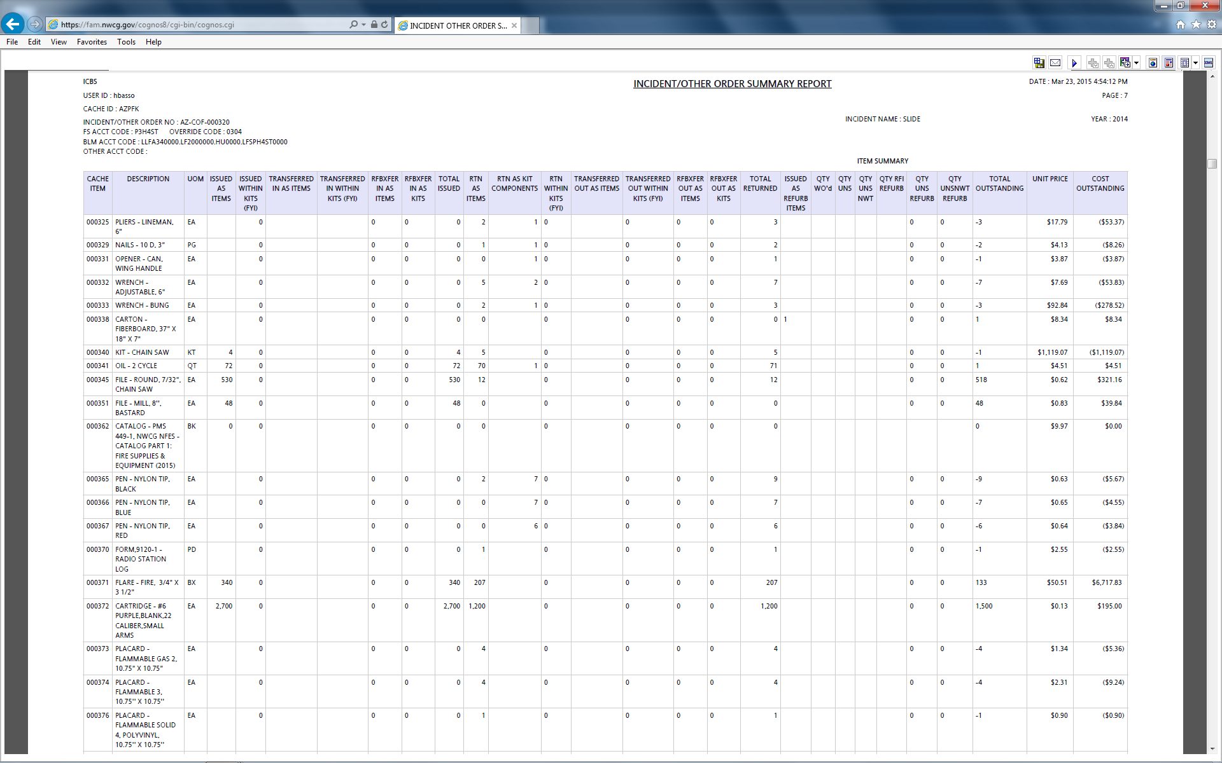

Slide 12
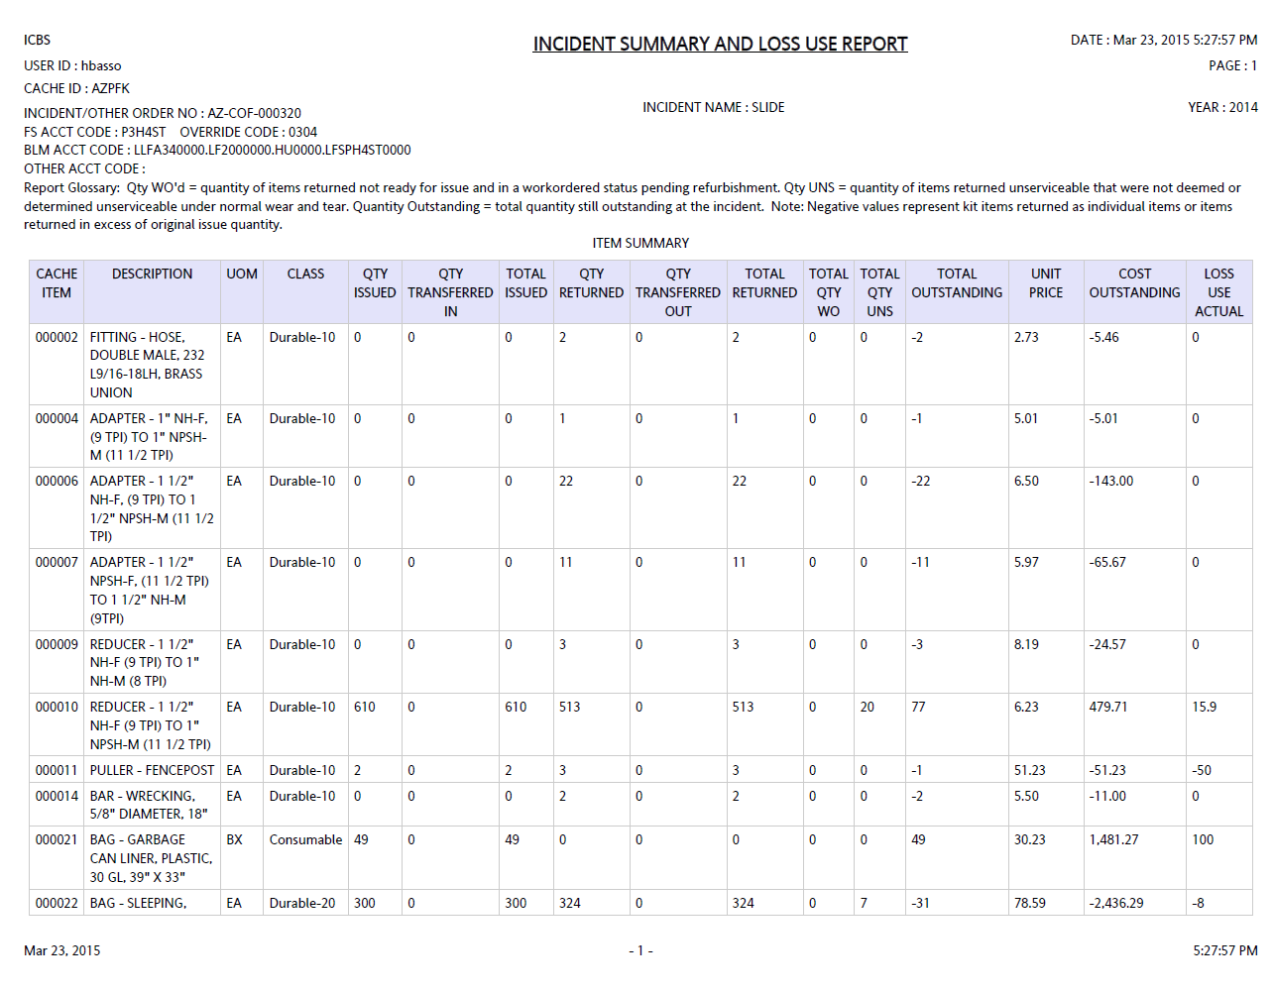

Slide 13
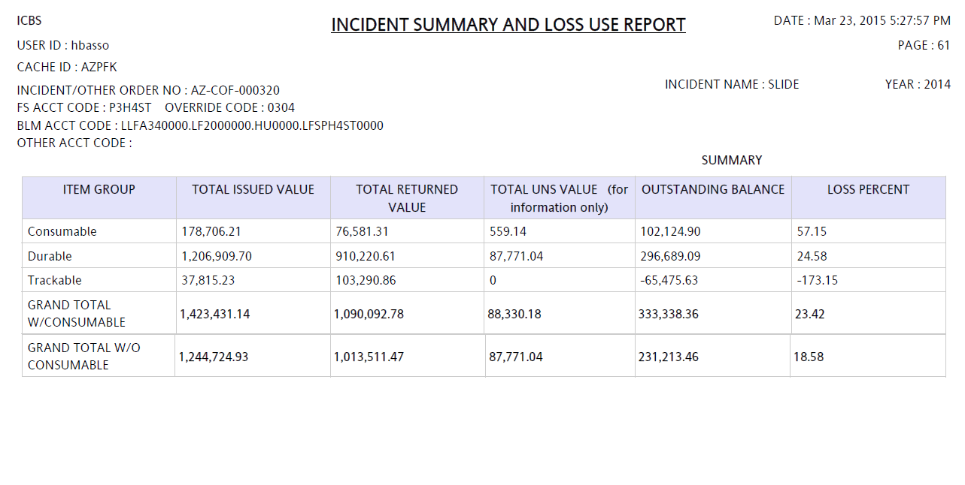

Slide 14
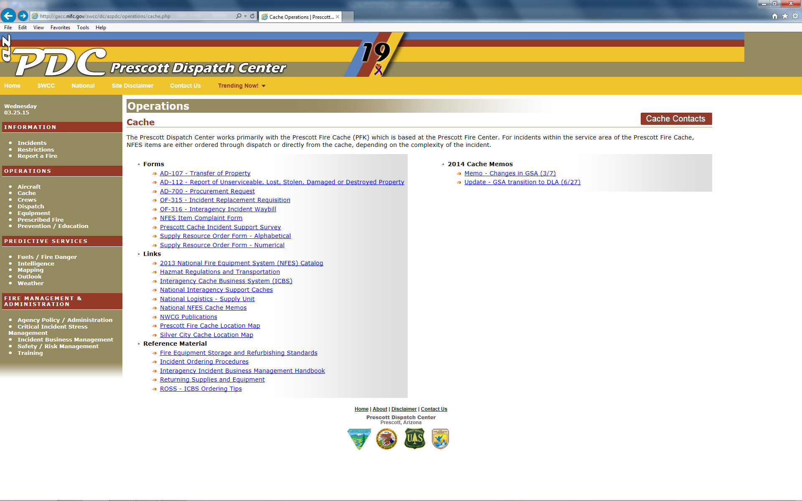

Slide 15
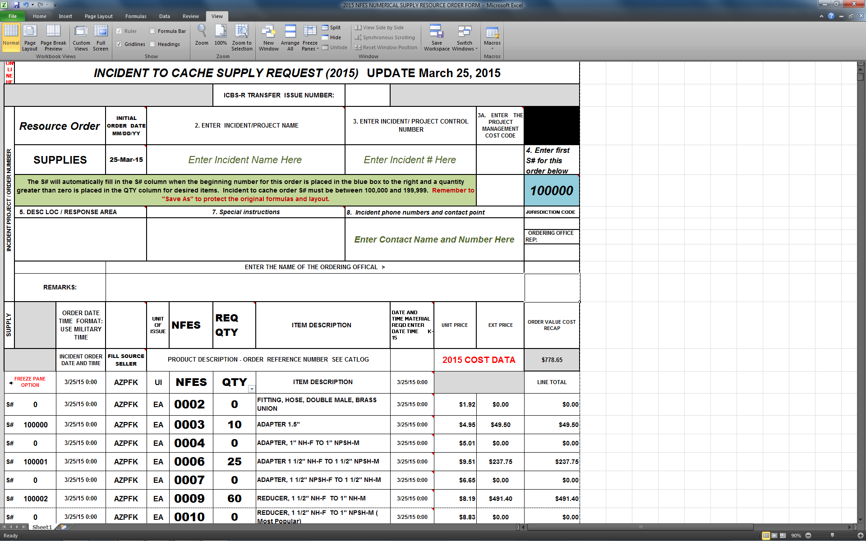

Slide 16
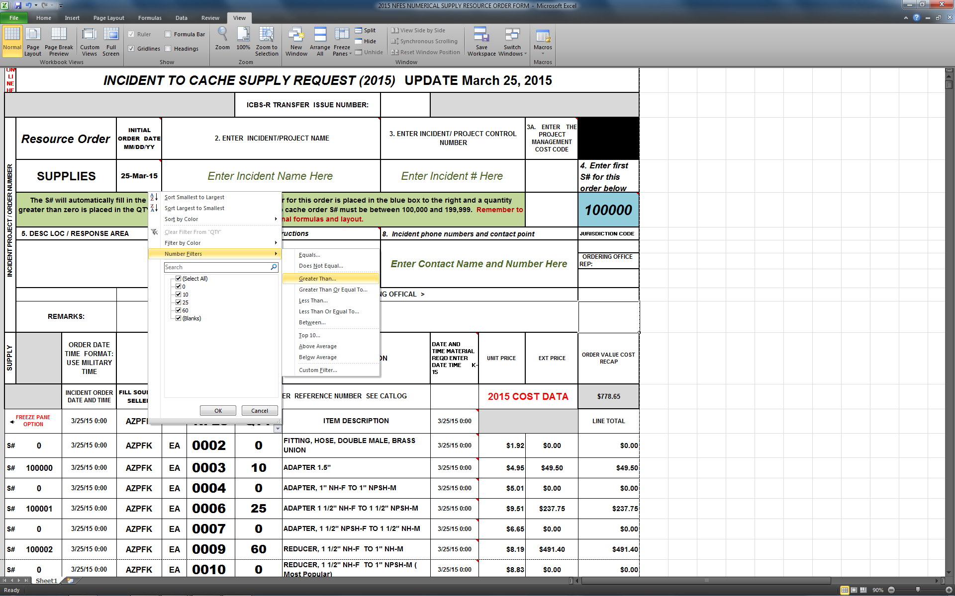
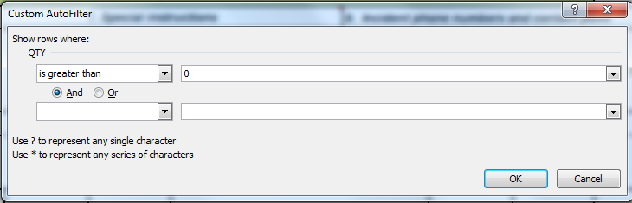

Slide 17
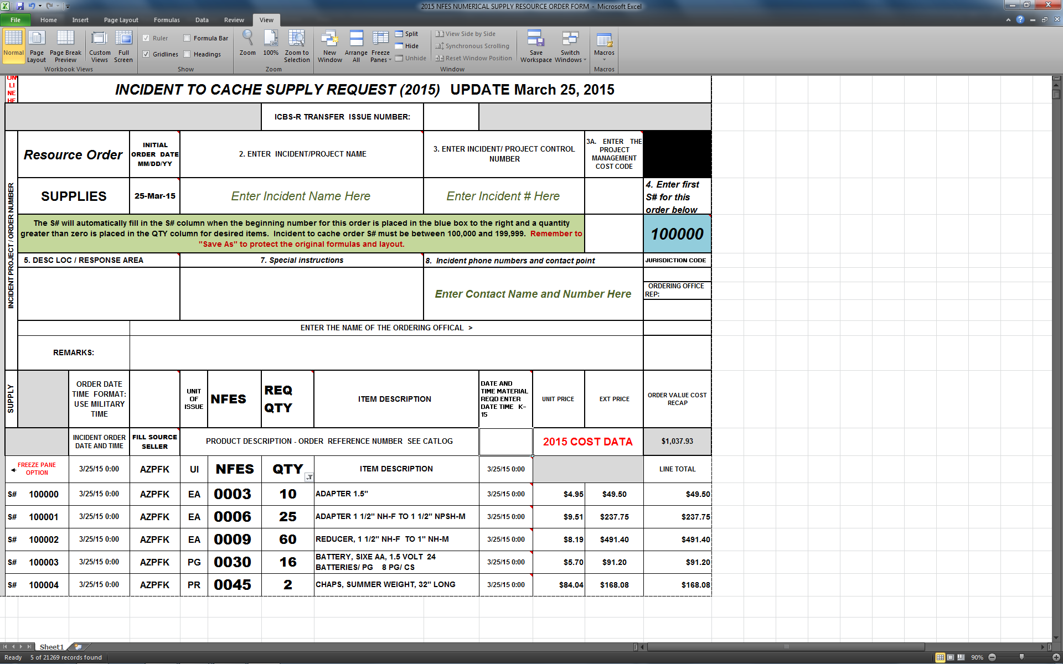

Slide 18
NATIONAL LOGISTICS WEBINAR NATIONAL INTERAGENCY SUPPORT CACHE PRESENTATION
INSTRUCTIONS FOR NFES INCIDENT REPLACEMENT
TYPE 1 & 2 INCIDENTS
The incident Supply Unit Leader (SPUL) will be responsible for handling incident replacement requisitions when a Type I or Type II incident management team is assigned. The SPUL approves replacement requests based on Engine Accountability sheets or other fire equipment inventory documents approved by the requesting resource's home unit. The use of the Incident Replacement Requisition Form (OF-315) is requested.
If equipment and supplies are available at the incident for replacement, the request is filled at the incident supply unit.
If equipment and supplies are unavailable at the incident for replacement, AND the requesting resource is not being immediately demobilized, the Supply Unit will place a resource order for needed items through appropriate channels to the servicing fire cache. The order will be shipped to the incident and replacement will take place at the Supply Unit.
If equipment and supplies are unavailable at the incident for replacement, AND the requesting resource is being demobilized, an Incident Replacement Requisition will be completed by the Supply Unit and forwarded to the incident servicing cache. The servicing cache will then determine if the order should be forwarded on to the requesting resources geographic area cache for delivery.
Authorized approvals and signatures MUST be included on the requisition. For Type I and II incidents, these approvals are limited to: Incident Supply Unit Leader, Logistics Section Chief, Support Branch Director, Incident Commander or Agency Administrator or Representative.

Slide 19
NATIONAL LOGISTICS WEBINAR NATIONAL INTERAGENCY SUPPORT CACHE PRESENTATION
INSTRUCTIONS FOR NFES INCIDENT REPLACEMENT
TYPE 3 & 4 INCIDENTS
The hosting unit agency administrator or representative, such as the Fire Management Officer, will be responsible for handling incident replacement requisitions on Type III and IV incidents. The agency representative approves replacement requests based on Engine Accountability sheets or other fire equipment inventory documents approved by the requesting resource's home unit.
If equipment and supplies are available at the incident for replacement, the request is filled at the incident host unit.
If equipment and supplies are unavailable at the incident for replacement, AND the requesting resource is not being immediately demobilized, the hosting unit will place a resource order for needed items through appropriate dispatch channels to be inputted into the ROSS/ICBS interface to the servicing fire cache. The order will be shipped to the incident and replacement will take place at the host unit.
If equipment and supplies are unavailable at the incident for replacement, AND the requesting resource is being demobilized, an Incident Replacement Requisition will be completed by the host unit and forwarded to the local dispatch unit for input into the ROSS/ICBS interface and sent to the servicing cache. The servicing cache will then forward to the requesting resources geographic area cache if applicable.
Type 3 and 4 incident approvals are limited to the Agency Administrator or Representative (i.e., Fire Management Officer).

Slide 20
Helicopter External water delivery systems (Blivet)
Recently the suspension/attachment system on a NFES 000423, 72 gallon slingable bag commonly referred to as a “blivet” failed during flight. A helicopter was transporting the slingable bag to a remote fire location and while in flight the attachment straps on the slingable bag failed. The slingable bag impacted the ground in an area free of any personnel and was destroyed. The attached SAFECOM describes the event including several photographs of the slingable bag after failure.

Slide 26
Reminders
When property is damaged or lost, it is the responsibility of the Incident Supply Unit Leader to make sure AD-112 forms are completed and delivered to Cache Managers, prior to demob.
Surveyed hose ends do not need to be sent to the cache, unless there is no recycling of those items at the incident.
Hose – we require hose to be rolled up and not sent in otherwise, hose rollers are available at your request.

Slide 27
2015 NATIONAL INTERAGENCY SUPPORT CACHE PRESENTATION
ISSUES AND CONCERNS
Excessive losses of medical kit equipment at incidents.
Use of IMT pre-orders when taking over for an existing team.
Use of Cache Liaison and Cache Demob positions.
Use of current catalogs and information.
Compliance with DOT Hazardous Material Shipping Guidelines.
Consistent guidelines for Incident Replacement of NFES supplies and equipment. We continue to work on merging the same information between the NFES Catalog, Geographic Area Mob Guides, National Mob Guide and Interagency Incident Business Management Handbook.

Slide 28
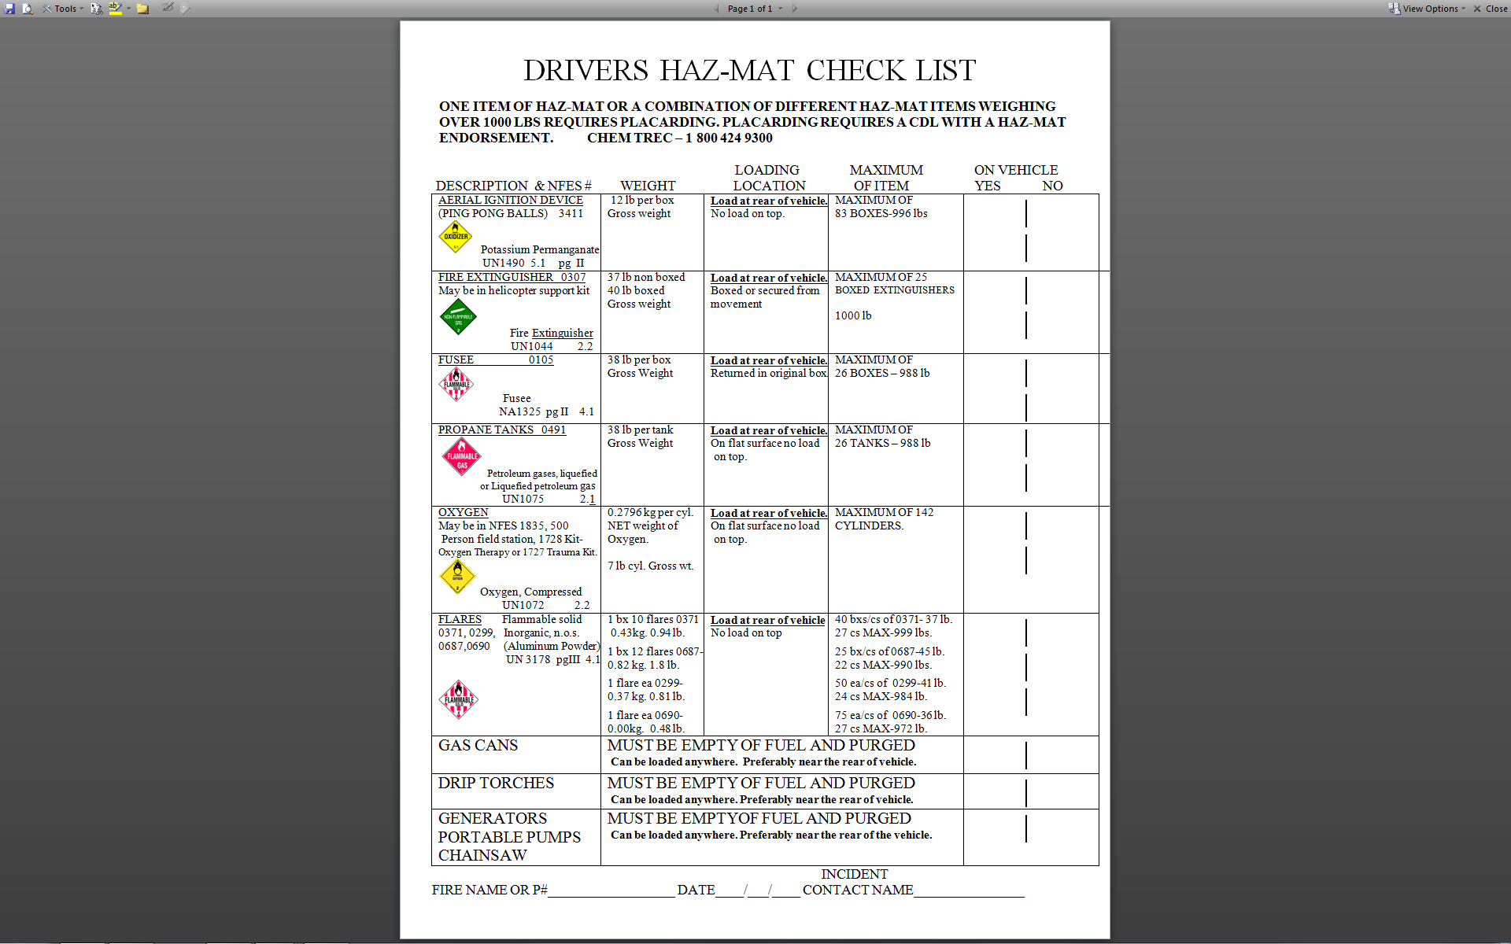

Slide 29
2015 NATIONAL INTERAGENCY SUPPORT CACHE PRESENTATION
Prescott Cache Contact Info
2400 Melville Rd.
Prescott, AZ 86301
General Information: 928-777-5632
Fax:928-777-5608
prescottfirecache@gmail.com
STEVEN WORDEN
Prescott Fire Cache Manager
928-777-5630 OFFICE
928-231-3651 CELL
shworden@fs.fed.us
HECTOR BASSO
Assistant Cache Manager
928-777-5631 Office
928-848-6951 Cell
hrbasso@fs.fed.us

Slide 30
2015 NATIONAL INTERAGENCY SUPPORT CACHE PRESENTATION
Silver City Cache Contact Info
158 Airport Rd.
Hurley, NM 88043
General Information: 575-538-5611
Fax: 575-388-5672
DOTTIE CLARK
Silver City Fire Cache Manager
575-534-0453 OFFICE
575-534-5257 CELL
dclark03@fs.fed.us
(Vacant)
Assistant Cache Manager
575-534-1076 Office

Slide 31
Silver City Fire Cache
Silver City Fire Cache mirrors roles, responsibilities and practices similar to Prescott Fire Cache, when in question please call Cache Manager at 575-534-0453.
When visiting the Silver City Fire Cache, please pay particular attention to signage on the highway, as we are in the process of making some travel management changes.
Have a Safe Fire Season, and please let us know how we can be of service.

