Slide 1
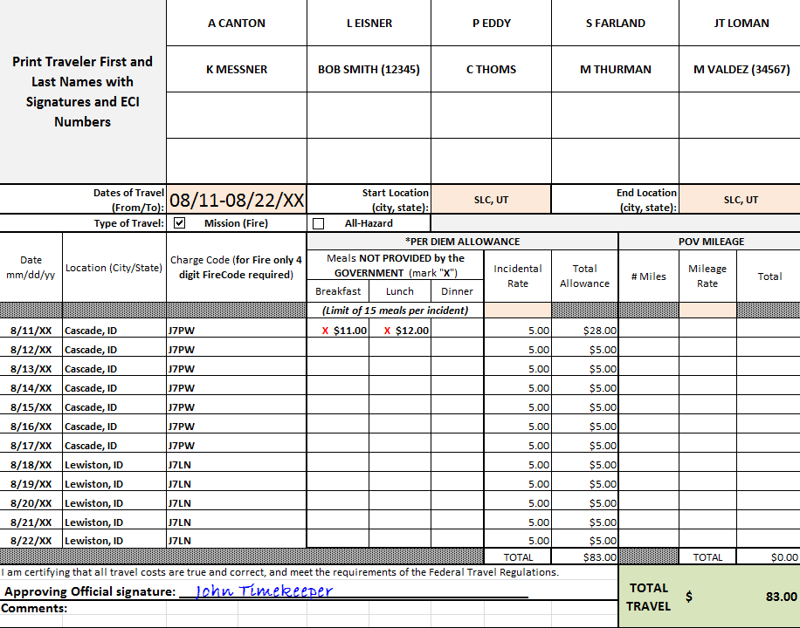
Travel Reimbursement Options-Crew
Travel Worksheet
Attach to Batch Memo (crew reimbursement).
Indicate ECI numbers only for
ADs with common or similar names.
Indicate AD names.
Indicate Dates& Type of Travel.
Ensure reimbursement amount for
M & I/E
is indicated.
Indicate dates to be reimbursed for M & I/E and the four digit FireCode.
Ensure
Approving Official signature is indicated.

Slide 2
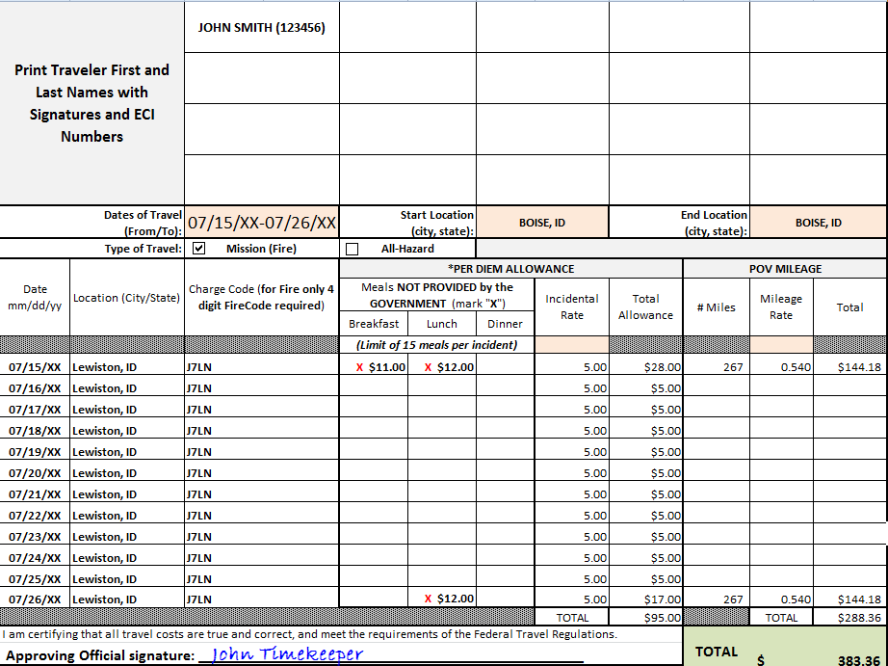
Travel Reimbursement Options Individual
Travel Worksheet
Attach to OF-288 (individual reimbursement).
Ensure reimbursement amount for
M & I/E is indicated.
Indicate AD name & ECI.
Indicate Dates& Type of Travel.
Ensure POV Mileage is indicated.
Indicate dates to be reimbursed for M & I/E and the four digit FireCode.
Ensure
Approving Official signature is indicated.

