Slide 1
Intent, Policy, and Guidance for Fire Danger Rating and Implementing NFDRS2016
Northern Rockies Dispatch Workshop
April 15-18, 2019
https://sites.google.com/firenet.gov/nfdrs
Notes:
Slide # 1
Lesson #1: Intent, Policy, and Guidance for Fire Danger Rating and Implementing NFDRS2016
Lesson Time: 60 minutes (followed by a 15-minute break)
Facilitator Notes:
Don’t forget to fill in the “Workshop Dates” and “Workshop Location” on the bottom right of this title slide.
This opening presentation is intended to provide the participant an overview of the next few days.
DO NOT get “into the weeds” with the topics in this lesson (or you’ll never finish on time).

Slide 2
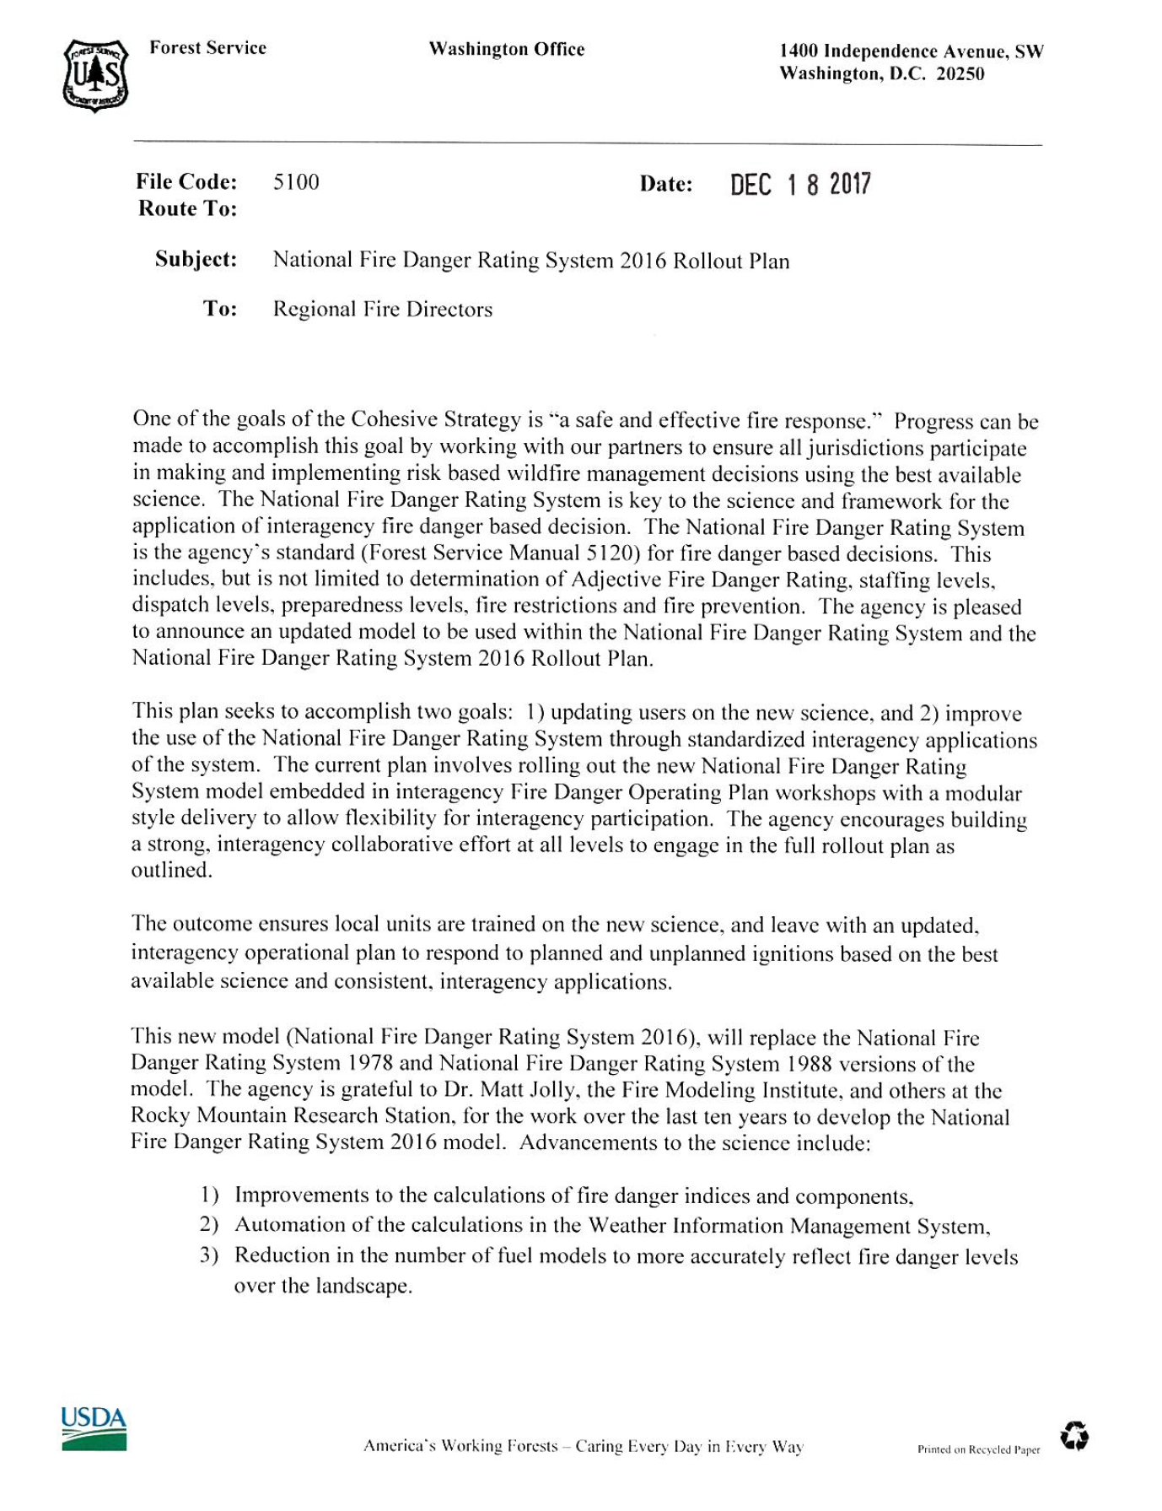
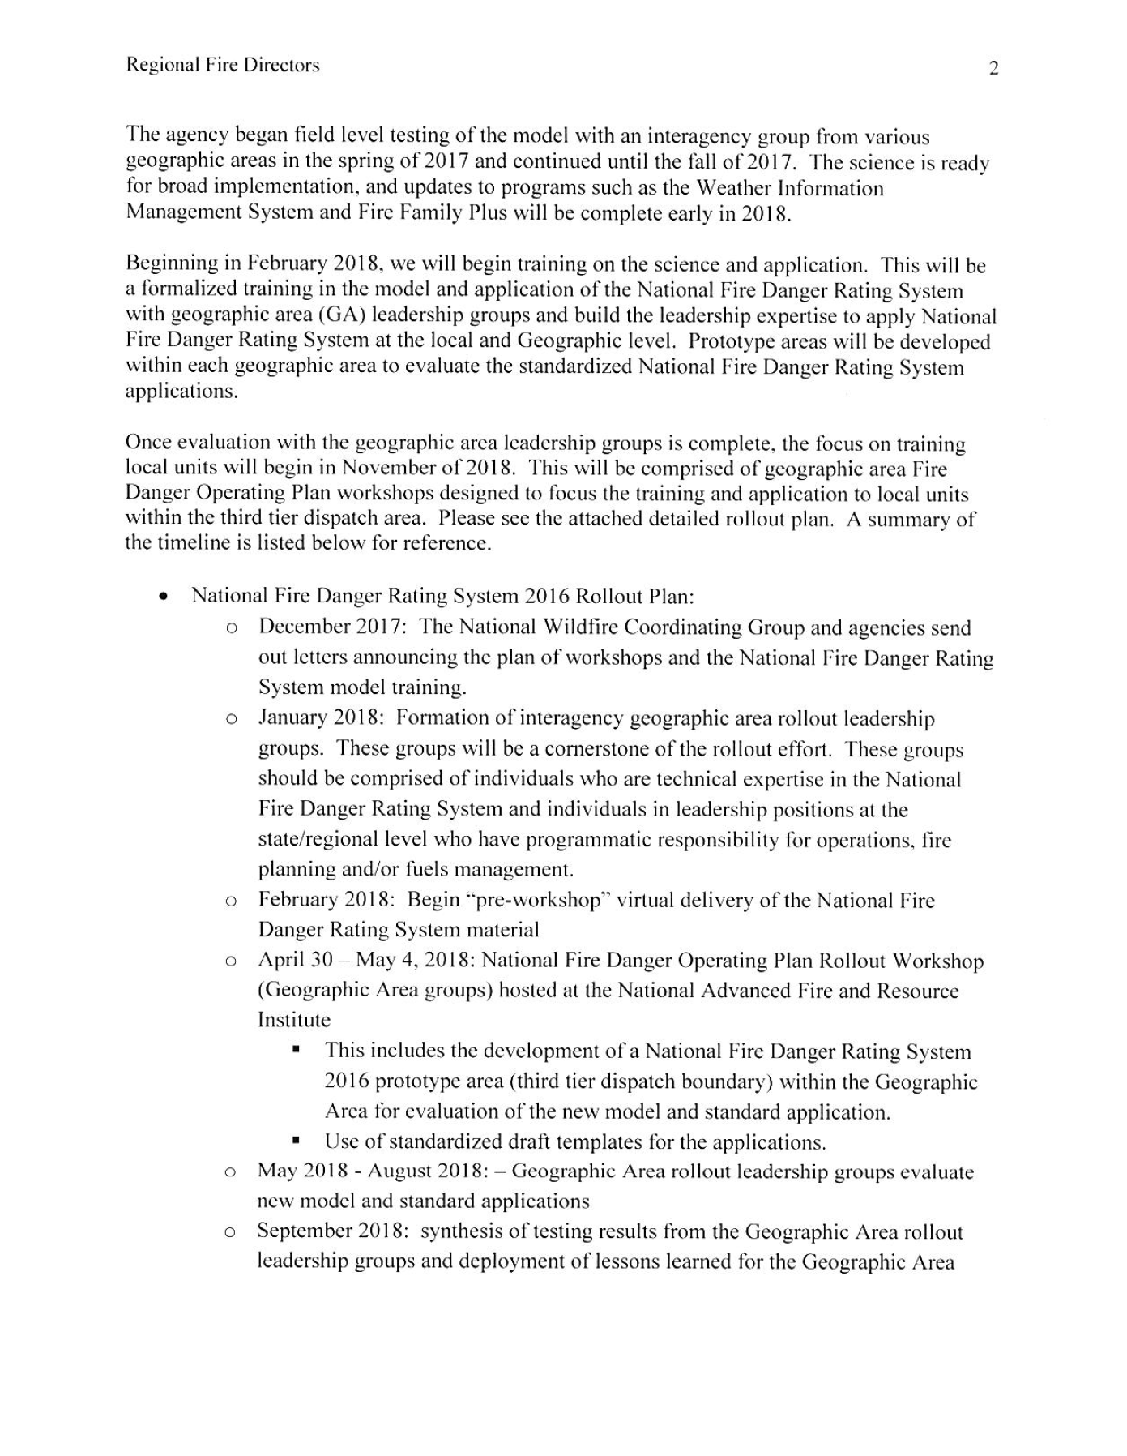
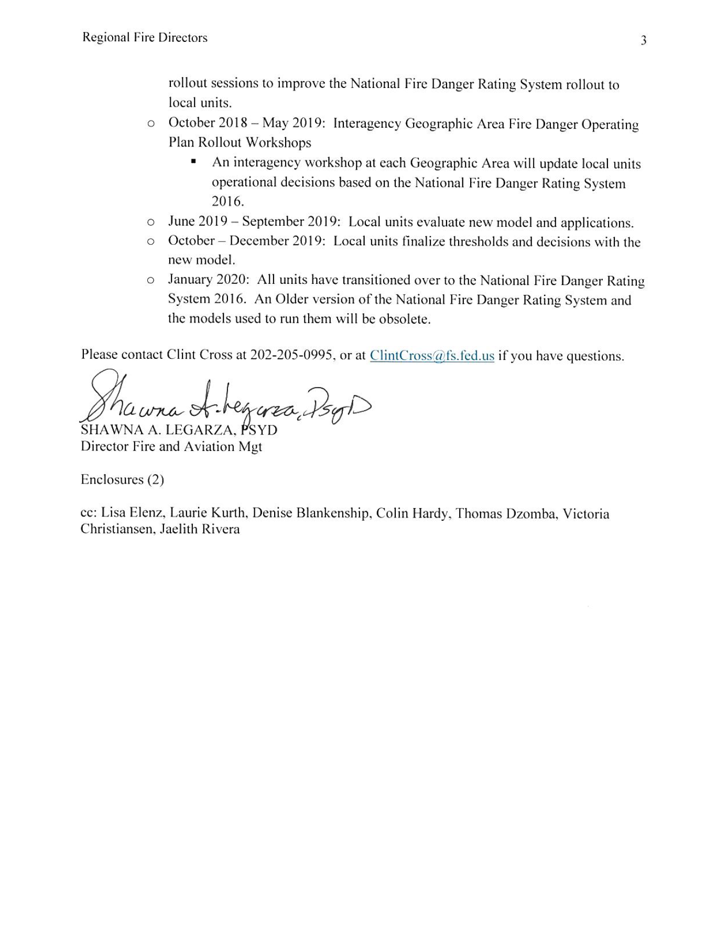
U.S. Forest Service December 2017
The NFDRS2016 Rollout Plan seeks to accomplish two goals:
updating users on the new science
improve the use of the National Fire Danger Rating System through standardized interagency applications of the system
Notes:
Slide # 2
U.S. Forest Service Rollout Plan
In December 2017, the Forest Service Fire Director issued guidance and direction to Regional Fire Directors regarding the initial implementation (or “rollout”) plan in preparation for the transition to NFDRS2016.
In December, three documents were issued by the Forest Service:
Letter from the Forest Service Fire Director (KEY POINTS):
The National Fire Danger Rating System is the agency's standard (Forest Service Manual 5120) for fire danger-based decisions.
The Forest Service NFDRS2016 Rollout Plan (attached to the letter) seeks to accomplish two goals:
updating users on the new science, and
improve the use of the NFDRS through standardized interagency applications of the system.
NFDRS2016 Initial Rollout Plan (KEY POINTS):
Provided a detailed initial plan for the phased rollout of the NFDRS 2016 model and applications
Outlined roles for the Fire Danger Sub-Committee, GA Leadership Groups, and General Users
Included objectives and critical needs to achieve expected outcomes.
Briefing Paper to State and Private Forestry (KEY POINTS):
Summarized the previous key points and timeline
Recommended that the USFS lead the overall effort, “collaborating closely with interagency partners”
Point out to participants that these documents are posted under the NWCG Fire Danger Subcommittee Home Page: https://www.nwcg.gov/committees/fire-danger-subcommittee

Slide 3
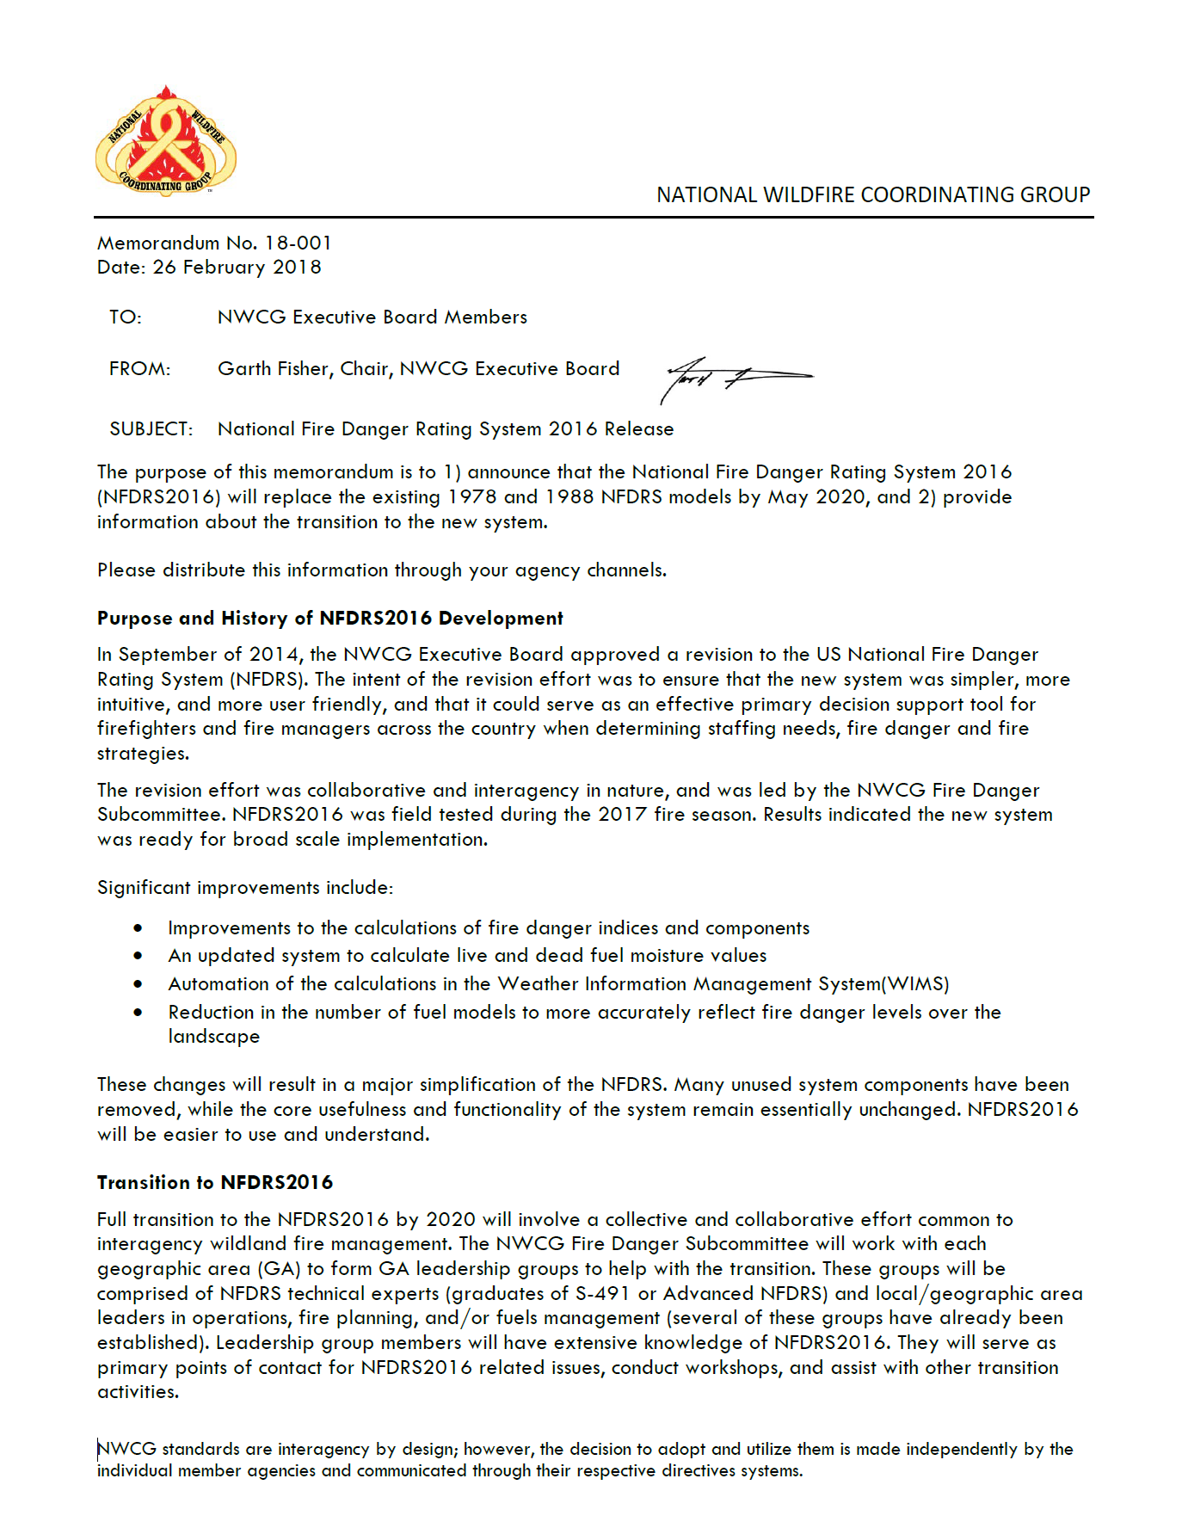
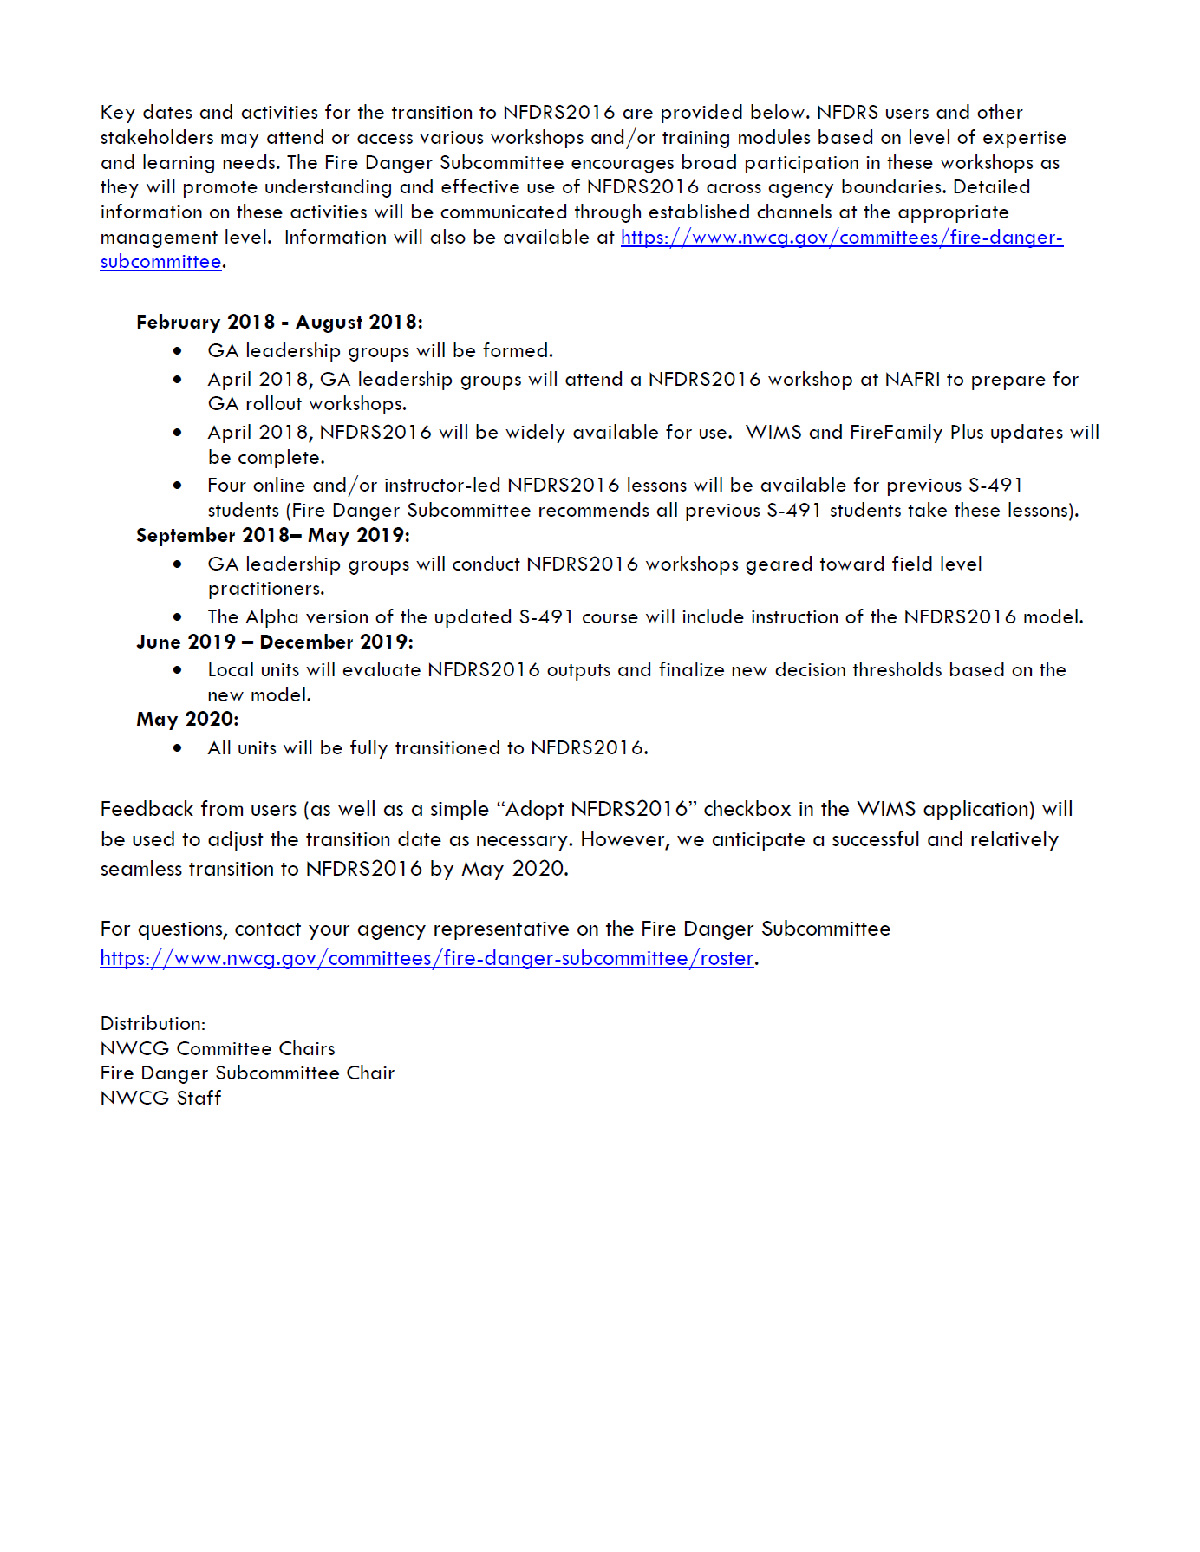
National Wildfire Coordinating Group February 2018
“Full transition to the NFDRS2016 by 2020 will involve a collective and collaborative effort common to interagency wildland fire management.
Notes:
Slide # 3
NWCG Memorandum (18-001)
Two purposes of the NWCG IM:
Announced that the NFDRS2016 will replace the existing 1978 and 1988 NFDRS models by May 2020, and
Provide information about the transition to the new system.
The IM stressed interagency collaboration.
The IM established a deadline of May 1, 2020 for complete transition to NFDRS2016.
(Note: the USFS letter issued in December suggested a due date of January 1, 2020),

Slide 4
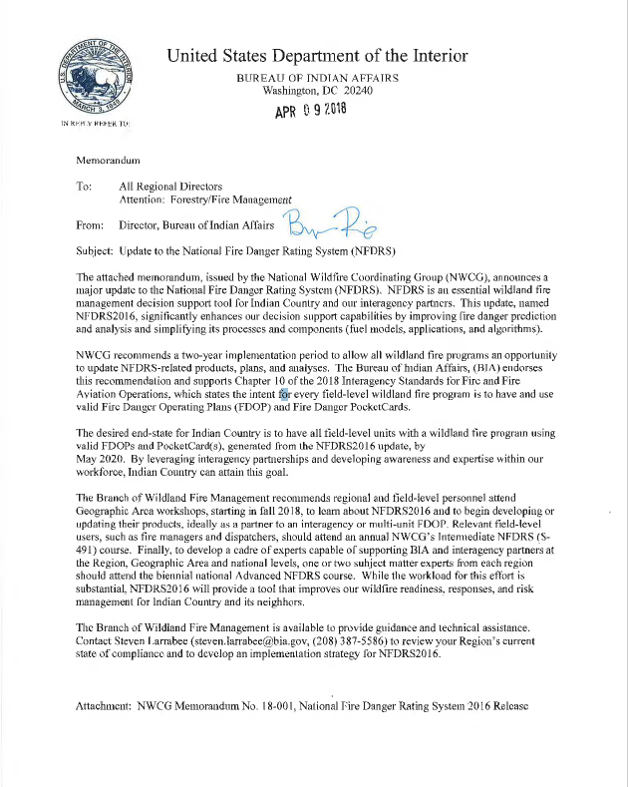
Bureau of Indian Affairs April 2018
“The desired end-state for Indian Country is to have all Field-level units with a wildland fire program using valid FDOPs and PocketCard(s), generated from the NFDRS2016 update…”
Notes:
Slide # 4
BIA Endorsement --

Slide 5
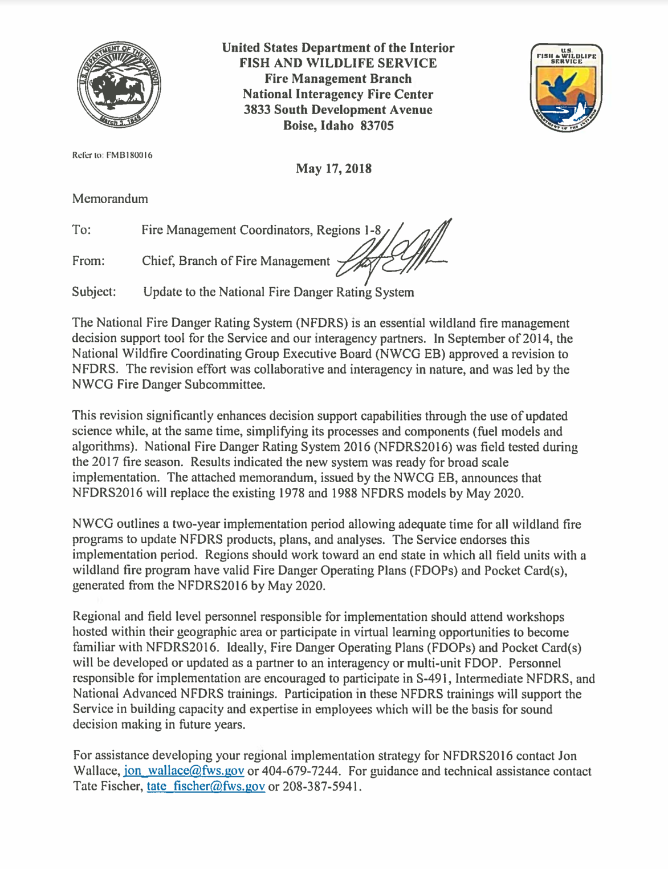
U.S. Fish & Wildlife Service May 2018
“Regions should work toward an end state in which all field units with a wildland fire program have valid Fire Danger Operating Plans (FDOPs) and Pocket Card(s), generated from the NFDRS2016 by May 2020.”
Notes:
Slide # 5
US F&WS Endorsement --

Slide 6
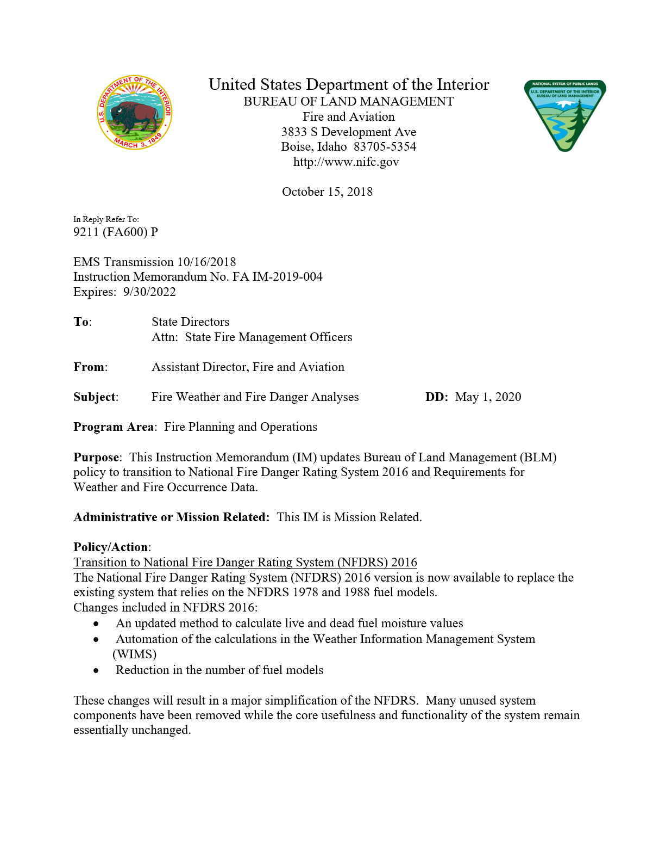
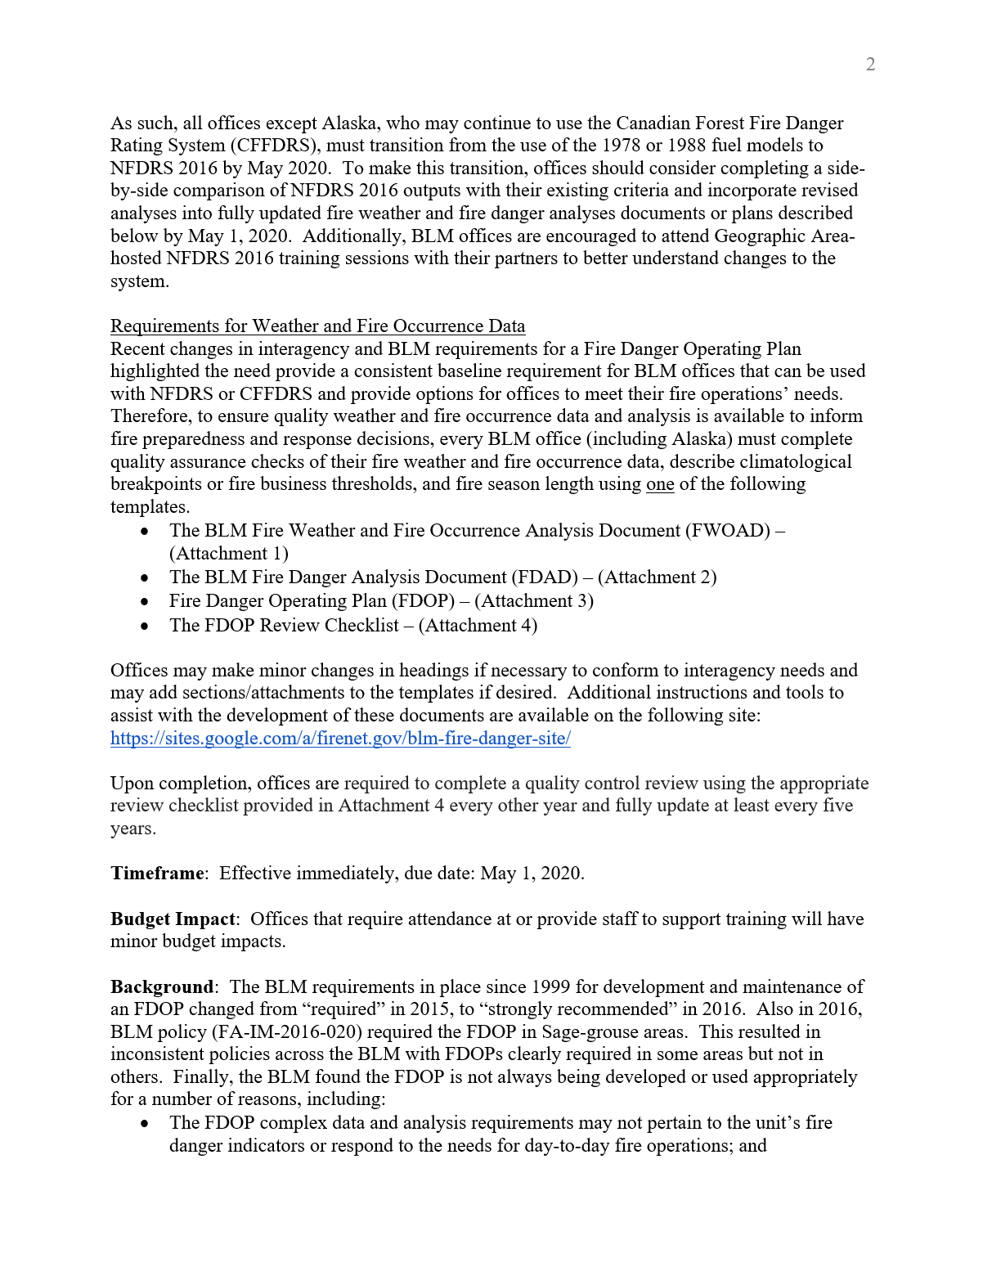
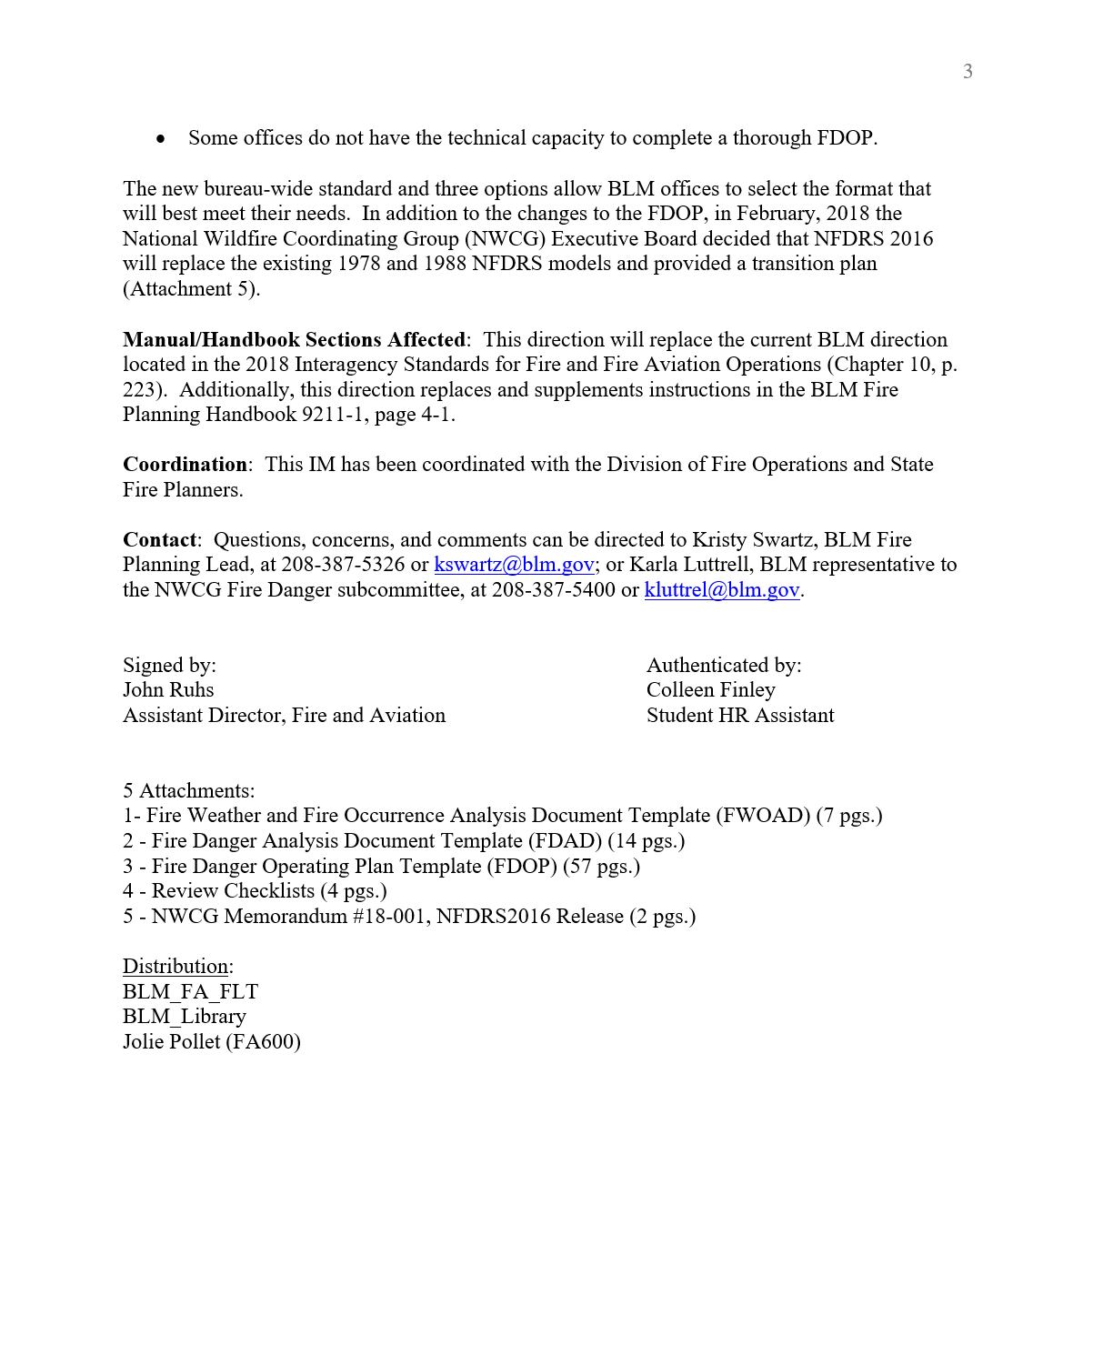
Bureau of Land Management October 2018
“ . . . all offices except Alaska . . . must transition …to NFDRS 2016 by May 2020. Additionally, BLM offices are encouraged to attend Geographic Area-hosted NFDRS 2016 training sessions with their partners to better understand changes to the system.”
Notes:
Slide # 6
BLM Endorsement

Slide 7
Notes:
Slide # 7
NWCG’s NFDRS2016 Rollout Plan Timeline
February 2018 - August 2018:
GA leadership groups will be formed.
April 2018, GA leadership groups will attend a NFDRS2016 workshop at NAFRI to prepare for GA rollout workshops.
April 2018, NFDRS2016 will be widely available for use. WIMS and FireFamilyPlus updates will be complete.
Four online and/or instructor-led NFDRS2016 lessons will be available for previous S-491students (Fire Danger Subcommittee recommends all previous S-491 students take these lessons).
September 2018– May 2019:
GA leadership groups will conduct NFDRS2016 workshops geared toward field level practitioners.
The Alpha version of the updated S-491 course will include instruction of the NFDRS2016 model.
June 2019 – December 2019:
Local units will evaluate NFDRS2016 outputs and finalize new decision thresholds based on the new model.
May 2020:
May 1st 2020 is the deadline for complete transition to the NFDRS2016 system.
Note today’s date on the timeline.

Slide 8
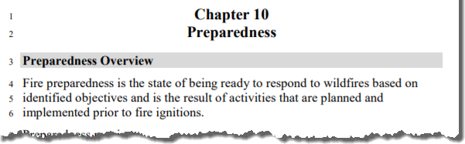
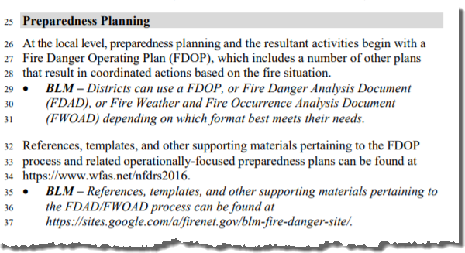
Interagency Standards for Fire and Fire Aviation Operations (Red Book, Chapter 10 – Preparedness)
“At the local level, preparedness planning and the resultant activities begin with a Fire Danger Operating Plan (FDOP), which includes a number of other plans that result in coordinated actions based on the fire situation.”
Notes:
Slide # 8
Animated Slide
Interagency Standards for Fire and Fire Aviation Operations (Chapter 10 – Preparedness)
This language refers to the FDOP as the focal point for preparedness planning. In addition, the FDOP will include several other plans that have been coordinated to result in actions based on fire danger levels.
Other background information:
For the USDI - Bureau of Land Management the Red Book is supplemental policy. . . Except for Fire Danger Preparedness Planning.
BLM IM FA-IM-2019-004 replaces Red Book language pertaining to the FDOP for the BLM.
For the USDA Forest Service the Red Book is referenced in Forest Service Manual 5108.
For the USDI - Fish and Wildlife Service the Red Book is supplemental policy.
For the USDI - National Park Service the Red Book is supplemental policy, in addition to Reference Manual 18.
For the USDI – Bureau of Indian Affairs the Red Book is supplemental policy.

Slide 9
Federal Land Use Planning
Fire Management Planning
Preparedness
Wildfire Response
Fuels Management
Aviation
Fire Danger Operating Plan
Wildfire Operations Plan
Fuels Program
of Work
Aviation Operations Plan
Preparedness Level Plan
Mobilization Guide
Prescribed Fire Plan
Aviation Mishap Response Plan
Staffing Plan
Initial Response Plan
Project Aviation Safety Plan
Prevention Plan
Restriction Plan
Notes:
Slide # 9
ANIMATED SLIDE
Key Points:
The guiding principles of a Fire Management Program begins with the Land Use Plan.
The Fire Management Plan outlines the implementation actions to attain the LUP objectives.
Many (federal) fire management programs are responsible for four components: Preparedness, Suppression, Fuels, and Aviation.
The Fire Danger Operating Plan provides the framework for decisions primarily affecting preparedness, wildfire response, and fuels management actions.
For example, the FDOP describes at escalating fire danger levels when
Preparedness decisions will affect the mobilization of fire resources, or
Staffing draw-down affects the ability to dispatch resources, or
Response to new incidents affects local staffing levels, or
Preparedness Levels constrain prescribed fire treatments.
The purpose of the FDOP (as illustrated by the red boxes) is to document an analysis of the fire environment and determine what decisions can be supported to effectively change the behavior of specific target groups. The premise that we can make strategic decisions at pre-determined fire danger thresholds, provides the basis for specific actions in subordinate preparedness plans (such as the Staffing, Preparedness, Prevention, Response and Restriction plans).

Slide 10
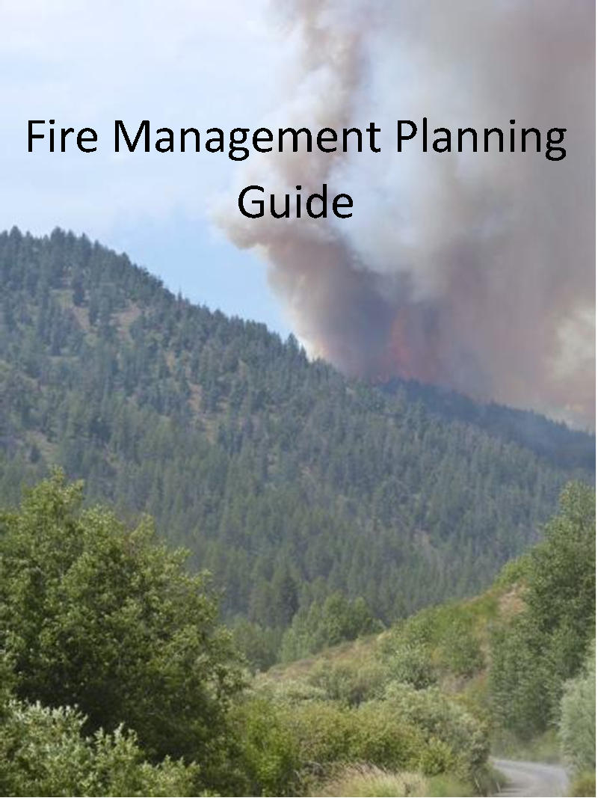
Fire Management Planning Guide
Fire Danger Operating Plan
FSM 5124.1, 1, & Red Book, Chp. 10
Pocket cards
FSM 5124.2 & Red Book, Chp. 10
Remote Automated Weather Station (RAWS) Maintenance
Fire Prevention Plan
FSM 5110.4, 2a.
Preparedness Plan
FSM 5121.11, 1 & Red Book, Chp. 10
Daily Staffing Plan
FSM 5121.11, 1 & Red Book, Chp. 10
Fire Restriction/Closure Plan
Notes:
Slide # 10
The FMRS is organized into four sections: Preparedness, Wildfire Response, Hazardous Fuels Management & Prescribed Fire, and Aviation. Under each section, fire management plans, guides, and other documents which are required or suggested for unit-level management of the fire, fuels, and aviation program are listed. Required documents are bolded with an accompanying reference.
Preparedness
Fire Danger Rating Operating Plan (FSM 5124.1, 1, & Red Book, Ch. 10)
Pocket cards (FSM 5124.2 & Red Book, Ch. 10)
Remote Automated Weather Station (RAWS) Maintenance
Fire Prevention Plan (FSM 5110.4, 2a.)
Preparedness Plan (FSM 5121.11, 1 & Red Book, Ch. 10)
Daily Staffing Plan (FSM 5121.11, 1 & Red Book, Ch. 10)
Fire Restriction/Closure Plan (FSM 5109.18.10)

Slide 11
The “Desired End-State”
Fire Danger Operating Plan
Appendices:
Preparedness Levels (5)
Staffing Levels (5)
Response Levels (3-5)
Adjective Fire Danger Rating Levels (5)
Preparedness Plan
Staffing Plan
Response Plan
Notes:
Slide # 11
Interagency Fire Danger Operating Plan (FDOP) Template
Desired End-State: The expectation at the end of the workshop is that each group has developed the following:
Fire Danger Operating Plan (FDOP) – an interagency FDOP which describes, for each Fire Danger Rating Area (FDRA), an analysis of historical fire occurrence and weather observations with rationale to support decision points determined from either climatological breakpoints or fire business thresholds. Minimally, each group will determine the following fire danger levels (reference Lesson 3 and FDOP Template):
Preparedness Levels (5)
Staffing Levels (5)
Response Levels (3-5)
Adjective Fire Danger Rating Levels (5)
Appendices – Minimally, the following plans will be incorporated as action plans tiered from the FDOP (Lesson 3 and FDOP Template):
Preparedness Plan
Staffing Plan
Response Plan
Prevention Plan (Optional) Using Adjective Fire Danger Rating Levels determined in the FDOP, include (at a minimum) those sections that pertain to fire danger-based decisions affecting the public, such as changing fire danger signs. Refer to each agency-specific guidance/policy regarding the incorporation of other fire danger-related decisions, such as restrictions and closures.

Slide 12
The “Desired End-State”
Ideally, Interagency / Partnership Approach and Collaboration Effort
Notes:
Slide # 12
Interagency Fire Danger Operating Plan (FDOP) Template
Desired End-State: The expectation at the end of the workshop is that each group has developed the following:
Fire Danger Operating Plan (FDOP) – an interagency FDOP which describes, for each Fire Danger Rating Area (FDRA), an analysis of historical fire occurrence and weather observations with rationale to support decision points determined from either climatological breakpoints or fire business thresholds. Minimally, each group will determine the following fire danger levels (reference Lesson 3 and FDOP Template):
Preparedness Levels (5)
Staffing Levels (5)
Response Levels (3-5)
Adjective Fire Danger Rating Levels (5)
Appendices – Minimally, the following plans will be incorporated as action plans tiered from the FDOP (Lesson 3 and FDOP Template):
Preparedness Plan
Staffing Plan
Response Plan
Prevention Plan (Optional) Using Adjective Fire Danger Rating Levels determined in the FDOP, include (at a minimum) those sections that pertain to fire danger-based decisions affecting the public, such as changing fire danger signs. Refer to each agency-specific guidance/policy regarding the incorporation of other fire danger-related decisions, such as restrictions and closures.

Slide 13
Questions?
Notes:
Slide # 13
Questions?

Slide 14
Notes:
So what are the major changes with NFDRS2016?
Replaces Live Fuel Moisture Model with GROWING SEASON INDEX (GSI)
Replaces Dead Fuel Moisture Model with NELSON DEAD FUEL MOISTURE CALCS
Consolidates the existing 20-35 fuel models to 5 fuel response types: grass; grass/brush; brush; timber; and slash.
Thus simplifing the system!

Slide 15
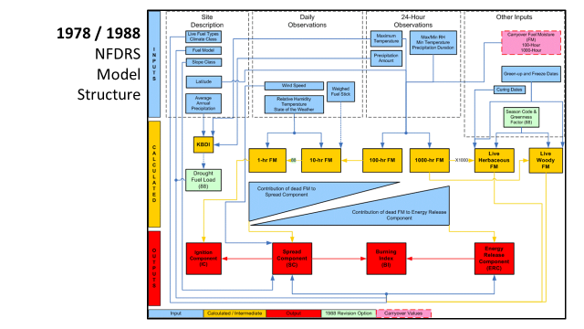

Slide 16
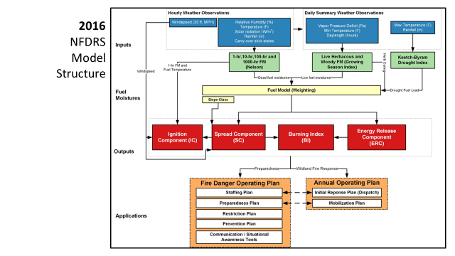

Slide 17
Notes:
What’s changed in NFDRS?
Using a familiar graphic of the 1978/1988 model (known as the spaghetti or lasagna chart), this slide depicts two of the major changes.
Both the live and dead fuel moisture algorithms were changed to include new science:
Replaced live fuel moisture model with (Growing Season Index) GSI-based live fuel moisture values.
Replaced state-of-the-weather driven fuel moisture calculations with Nelson dead fuel moisture calculations.
A third change was the consolidation of the existing fuel models to five fuel response types (based on existing fire behavior fuel models).
Together, these enhancements ultimately simplified the system.

Slide 18
Notes:
KEY POINTS:
This is a summary of the components of the 1978/1988 that are removed from NFDRS 2016. This results in a much more simplified and streamlines system.

Slide 19
Notes:
KEY POINTS:
There are many improvements to the new system, particularly the fact that it can be run in fully-automated mode and it requires much less human intervention and finally it can be more easily applied to gridded weather data, positioning us to leverage emerging data resources to calculate spatial fire danger.

Slide 20
Northern Rockies Roll-out Plan
Target Attendees: FMOs, AFMOs, Dispatch, Prevention; those with prior experience or have gone thru NFDRS or A-NFDRS training.
Plan A: NR NFDRS/FDOP Workshop – May 13-17, 2019 CANCELED!
Plan B: Working with Matt Jolly (Mr. FF+),
Setting up series of weekly Webinars starting June 2019.
TBD -- 2.5 day Fall Workshop – Q&A / working session
Traveling road show slated for 2020.
Notes:
Slide # 20
Questions?

Slide 21
Questions?
Notes:
Slide # 21
Questions?

Slide 22
OFF TOPIC!!!!!
Forest Service Dispatchers:
UPDATE YOUR EMAIL ADDRESSES in your WFDSS contact information
from fs.fed.us to usda.gov!!

