Slide 1
NATIONAL INTERAGENCY FIRE CENTER
Northern Rockies Dispatcher Workshop
March , 2012
Jose M. Lopez
NIICD 2012

Slide 2
DISCUSSION POINTS
Geographic Area Representatives
Type 3 Support
NIICD Frequency Fire Support
AM Frequency Management for Incidents
AM and FM Frequency Management for Initial Attack
A/G Naming Convention
Zone Boundaries
NIICD 2012

Slide 3
GEOGRAPHIC AREA REPRESENTATIVES
Establish a long term relationship between the GACC, the Zones, and the Communications Duty Office
Provide Communications Coordinator (COMC) Support
Provide National Interagency Communications Division (NIICD) updates for all dispatch workshops and/or meetings
Assist in updating the National Interagency Aviation Frequency Guide
Available to assist the GACC in updating the communications portion of the GACC mobilization Guide
Northern Rockies GACC Rep:
Jose Lopez
208-387-5858
208-850-8649 (Cell)
joselopez@fs.fed.us
NIICD 2012

Slide 4
TYPE 3 SUPPORT
Filling Frequency Requests
No communications personnel (COMT/COML) assigned
Incident orders all frequencies (including ground tactical) through dispatch process
Dispatch places orders up through ROSS
Aircraft Resource Order
Communications personnel are involved providing services for the incident
Aviation frequencies are the only requests placed on resource orders
Any additional (ground tactical) frequencies will be coordinated directly between the COML/COMT assigned and the CDO/COMC
NIICD 2012
Notes:
We have had problems in the past with the CDO not being notified by the incident of the release of ground tacticals, keeping them tied up when they could be re-used

Slide 5
TYPE 3 SUPPORT
Providing Equipment Resources
No communications personnel assigned
Equipment that doesn’t require setup (hand held radios) can be ordered and filled as long as there is a name to put on the order as the responsible party
Equipment that does require setup (repeaters, etc.) will need a qualified person to set up and take down
Communications personnel are involved providing services for the incident
Business as usual
All equipment requests will come from the COML/COMT assigned to the incident
NIICD 2012

Slide 6
TYPE 3 SUPPORT
Confused?
Questions?
Call the CDO at (208) 387-5644
Or
GACC Rep
NIICD 2012

Slide 7
NIICD Frequencies
NIICD loses multiple frequencies for fire support
Tactical:
164.1375 no longer available
National Air Frequencies
166.6875 and 171.1375 no longer available
Repeater Pairs
162.9625 and 171.7875 (C7 repeater) no longer available
AM Frequencies
122.2250, 122.4250, and 122.5750 no longer available
NIICD 2012

Slide 8
AM FREQUENCY MANAGEMENT FOR INCIDENTS
Each frequency request can take from 2 to 12 hours due to processes required to identify and engineer a frequency for given geographic area
NIICD NO Longer has temporary AM assignments that, if available, can be given to an incident until the FAA assignment is determined
The incident must wait until the FAA assignment can be made before replacing the AM IA frequency
NIICD 2012

Slide 9
AM FREQUENCY MANAGEMENT FOR INCIDENTS
Order early… If there is any indication that IA or extended IA will go long, call the CDO and request an assignment
If a COMC is in place, they will usually start a request early with the FAA through the CDO
Get FAA assigned frequencies in place before the team transition takes place
NIICD 2012

Slide 10
AM AND FM FREQUENCY MANAGEMENT FOR IA
Process Involves both Forest Service and DOI frequency managers as well as the FAA to determine assignments and what changes may be needed for the coming season
Frequency managers and FAA provide information to the CDO
CDO finalizes the maps and forwards them on to the frequency managers and GACCs for distribution
Contact your GACC Rep for map modifications
Draft IA maps to frequency managers for review – January 15
Draft IA maps back to CDO ready for publication – January 25
Final IA maps to GACCs and frequency managers – February 1
NIICD 2012

Slide 11
Air-to-Air AM IA Frequencies for Northern Rockies GACC 2012
Pending from FAA
NIICD 2012

Slide 12
Air-to-Air AM IA Frequencies for Northern Rockies GACC 2012

Slide 13
Air-to-Ground FM IA Frequencies for Northern Rockies GACC 2012 (Modified)
NIICD 2012

Slide 14
A/G Naming Convention
National Aviation pushing National Naming Convention for IA A/G
Currently 73 frequencies have been identified
Current GACCs converting to the Naming Convention for 2012
Pacific Northwest
Rocky Mountain
Eastern Great Basin
Western Great Basin
Southwest
NIICD will continue to issue maps with frequencies only.
Contact your local GACC Rep for maps with Naming Convention labels
NIICD 2012

Slide 15
Zone Boundaries
Please provide NIICD with correct zone boundaries prior to final map distribution date
Format for Topo USA:
Zone changes must be coordinated 1 year prior to implementation
Approval from FAA
Approval from Government and State agencies

Slide 16
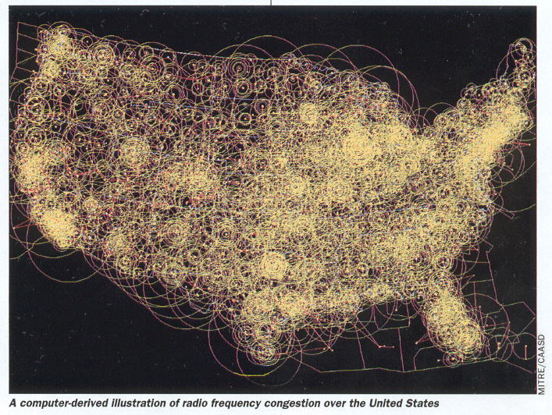
NIICD 2012
Notes:
This is a depiction of the Air Traffic Control density of frequency assignments in the US, the air space is getting crowded and we are losing ground.
We can expect the FAA to support our requests for initial attack only if we show them we are efficiently using the assignments they give up so that we can meet our mission.
The use and assignment of frequencies must be in direct support of the incident and not for our convenience or turf issues within our organizations. We must be professional in our utilization of a resource that is widely shared with commercial, private and the general aviation community.

Slide 17
Questions ?
Contact the CDO:
208-387-5644
Or
Northern Rockies GACC Rep:
Jose Lopez
208-387-5858
208-850-8649 (Cell)
joselopez@fs.fed.us
NIICD 2012

