Slide 1
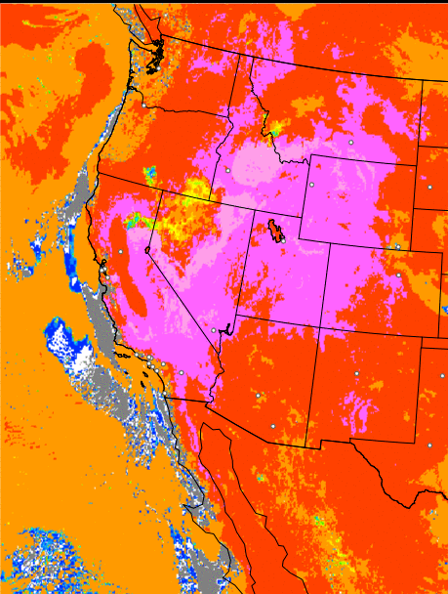
HRRR-SMOKE – EXPERIMENTAL
Surface Visibility (miles)

Slide 2
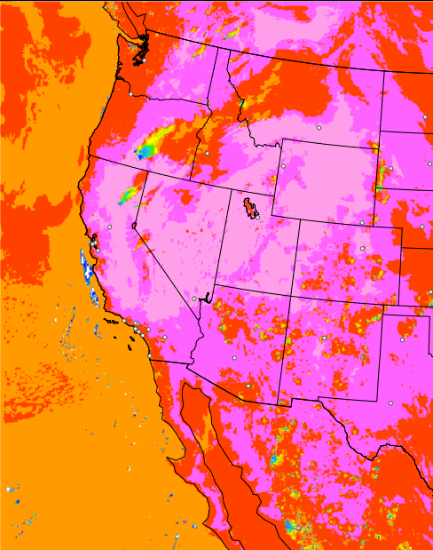
HRRR-SMOKE – EXPERIMENTAL
Surface Visibility (miles)

Slide 3
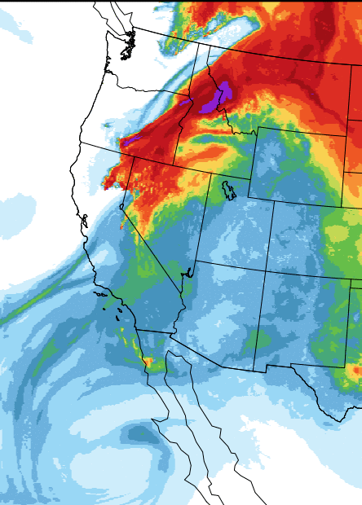
HRRR-SMOKE – EXPERIMENTAL
Vertically Integrated Smoke(mg/m² )

Slide 4
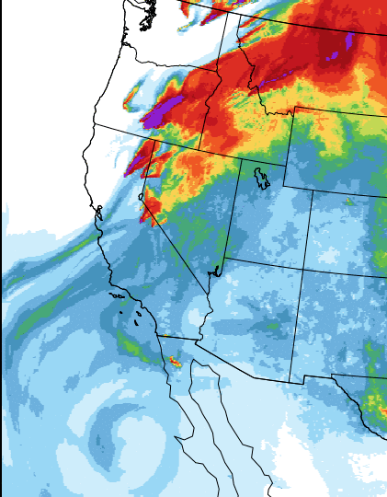
HRRR-SMOKE – EXPERIMENTAL
Vertically Integrated Smoke(mg/m² )

