Slide 1
2021 VIPR Heavy Equipment Task Force (HETF) Region 1 and 4
Jeff Gardner, USFS Fire Contracting Officer
Jeffrey.gardner@usda.gov
406-329-3779

Slide 2
HETF REQUIREMENTS
D.2.1.1 -- MINIMUM EQUIPMENT REQUIREMENTS.
The intent of this solicitation and any resultant Agreement is to obtain a Heavy Equipment Task Force (HETF) to be used in forested terrain. The HETF will consist of one Job Site Foreman (hereafter referred to as Foreman) with 4 wheel drive transportation, one leveling Feller Buncher, one rubber tired Skidder, one Type II or Type III Dozer equipped with a 6 way blade (PAT) or manual angle with hydraulic tilt, one drop tank Skidgine or Pumpercat that can also skid logs, and the transportation for the equipment to and from the incident. In addition a second Feller Buncher, an Excavator (Option 1), or a Boom Mounted Masticator (Option 2) may be ordered in compliance with requirements stated below. HETF must transport the leveling Feller Buncher, Drop tank Skidgine, and job site foreman to meet date time needed on the resource order; and will be given up to 24 hours to transport the Dozer and Skidder (or ordered configuration) to the site to complete the HETF (see PAYMENT EXCEPTION for extended mobilization). One transport capable of hauling all equipment and designed for use on arterial FS roads (i.e. approx. 65 radius curves, 10- 12% grades and 2-4 % vertical curves) shall remain onsite after initial haul-in of the equipment for the duration of the assignment.

Slide 3
HETF REQUIREMENTS (cont.)
D.2.1.1 -- MINIMUM EQUIPMENT REQUIREMENTS (Cont.)
Once an order is placed and accepted by the vendor, Incident Operations may negotiate the following re-configuration directly with the vendor; 1) replace the dozer with excavator, 2) add a feller buncher and/or excavator and/or boom mounted masticator. The HETF shall not at any time exceed 6 heavy equipment components. The Foreman position is mandatory and is not considered a component in the HETF. Following mobilization, the HETF may be reconfigured in the same fashion; any released equipment will be compensated for demobilization travel in accordance with the agreement.

Slide 4
Standard Configuration and Options
Standard Configuration:
Job Site Foreman with 4 wheel drive transportation
One leveling Feller Buncher
One rubber tired Skidder
One Type 2 or 3 Dozer equipped with 6 way blade (PAT0 or manual angle with hydraulic tilt
One drop tank Skidgine or Pumpercat capable of skidding logs
Options:
(If vendor has capability) second leveling Feller Buncher
Option 1 (if offered) Excavator, net 85 horsepower
Option 2 (if offered) Boom Mounted Masticator, minimum 111 horsepower

Slide 5
Transports
Transports:
(Mandatory) One fully operated transport, upon arrival at incident must remain
(Mandatory) second transport, may be unoperated
Additional transports optional

Slide 6
HETF Reconfiguration
Re-configuration, upon initial order or at any time while under hire:
Dozer may be exchanged for excavator
Second Feller Buncher, Excavator, and/or boom mounted Masticator may be added
Re-configuration limitations and requirements:
The Foreman, Feller Buncher, Skidder, and Skidgine/Pumpercat in the original configuration are all mandatory; ONLY the Dozer may be changed out
The award allows that, once an order is placed and accepted by the vendor, Incident Operations may negotiate re-configuration directly with the vendor. The intent is that if need be, Operations may communicate directly with a vendor on the configuration of HETF without having to rely on dispatch to communicate with the vendor, but operations needs to ensure that dispatch is informed of these changes. DOCUMENTATION MUST BE OPS GENERATED IN CAMP
At no time is the HETF to exceed 6 pieces of heavy equipment or fall below 3 pieces (The “pieces of heavy equipment” does not count transports or foreman).

Slide 7
General Reminders
HETF may not be double shifted
Operations may be required to inspect equipment; please be sure the equipment meets minimum specifications. Please report any spec violations.
The first factor for award consideration is “Operational acceptability defined as company experience in either commercial logging operations or heavy equipment tactical operations on a wildland fire.” Please report any companies who you do not feel meet this factor for award.
All operators must by 18 years old, have RT-130, and be able to operate their equipment safely up to the manufacturer’s limitations under logging type operations (including working in steep terrain, timber, etc.)
**Please Note: Region 1 requires operators to have passed an annual light duty work capacity fitness test. Region 4 does not require the annual light duty work capacity test for heavy equipment operators.

Slide 8
Finance and Invoicing
Pay Items:
Task force is subject to first and last day time under hire constraints; if this resource mobilizes after 1600 on the first day, what arrives should be paid 50% of rate, including transport.
HETF main component daily rate breakdown
Feller Buncher – 32%
Skidder - 18%
Dozer – 23%
Skidgine/Pumpercat – 21%
Foreman – 6%

Slide 9
Finance and Invoicing (Cont.)
Pay Items (Cont):
Option Items
Second Feller Buncher – pay 32% of the daily rate
Option 1, Excavator – priced on the schedule of items
Option 2, Masticator – priced on the schedule of items.
If incident replaces Dozer with Excavator reduce HETF Daily rate by 23% and add the awarded Excavator rate from the schedule of items, this will be the new daily rate for the HETF with Excavator instead of Dozer.
Make note of all of these changes in remarks for payment center.

Slide 10
Breaking Up of the Task Force
Contractor must agree
HETF E number must be closed out, new E numbers must be processed for resources remaining
May use VIPR awards for individual pieces if available, or do EERAs
This is a reassignment on incident; the new resource orders are not subject to DPL requirements as the incident already has them under hire.
**If the task force is “broken up” and the individual resources are not assigned individual E numbers, the equipment will be considered working out of scope and outside of the HETF agreement coverage for both the vendor and the Government.

Slide 11
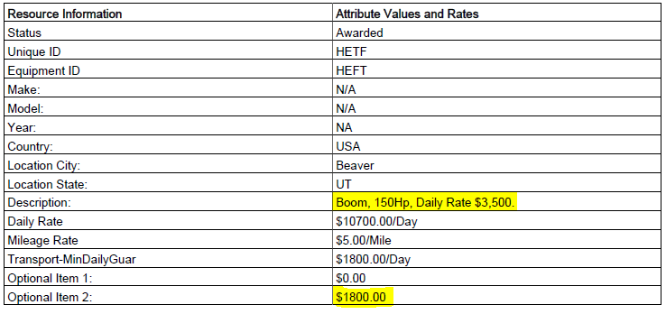
Invoicing Watch Out
**There was some confusion on how to price the options and some vendors placed pricing in comments section. We cannot use what was placed in the comments as the comment sections of the quotes were not evaluated. Unfortunately, this vendor’s rate for their “Option 2” masticator is $1,800. I am going to work to get this fixed, but in the meantime be on the lookout for this.

Slide 12
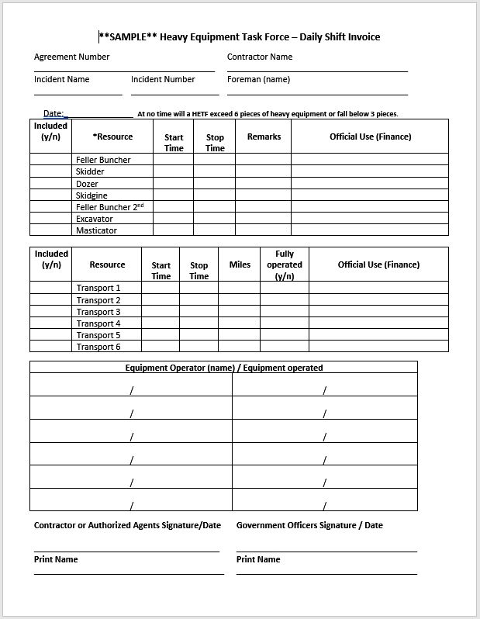
Sample Contractor Provided Shift Invoice (In leu of Daily Shift Ticket) - Optional
Only one daily shift ticket is needed per day for the HETF as it is ordered and invoiced under one E#.
After the 2015 HETF trail year in Region 1, vendors and Government representatives found it difficult to place all the relevant information on one shift ticket and developed alternatives for daily tracking of the HETF.
This daily invoice in leu of a shift ticket is optional but is recommended as it has helped finance in R1 tremendously with entering and tracking HETF costs.

Slide 13
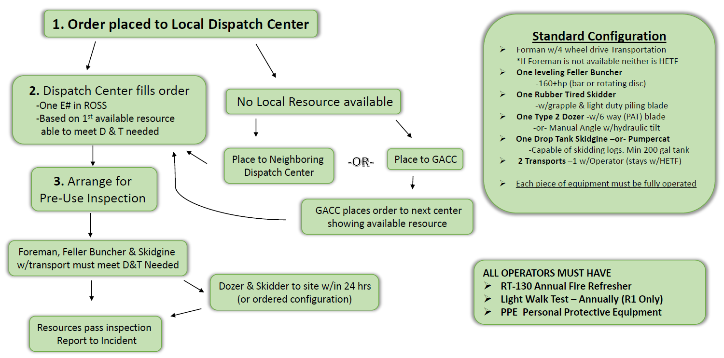
Ordering Heavy Equipment Task Force -Standard Configuration

Slide 14
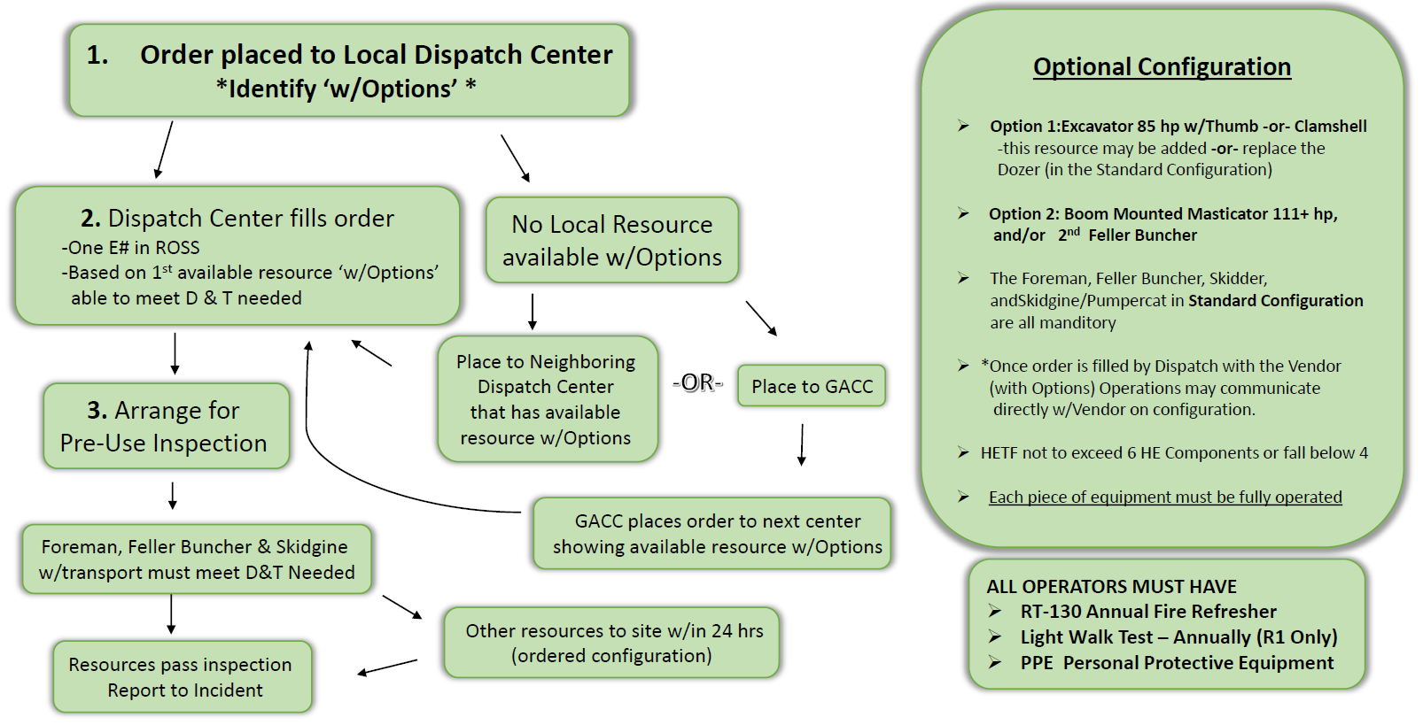
Ordering Heavy Equipment Task Force – “Options” Configuration

Slide 15
Questions?

