Slide 1
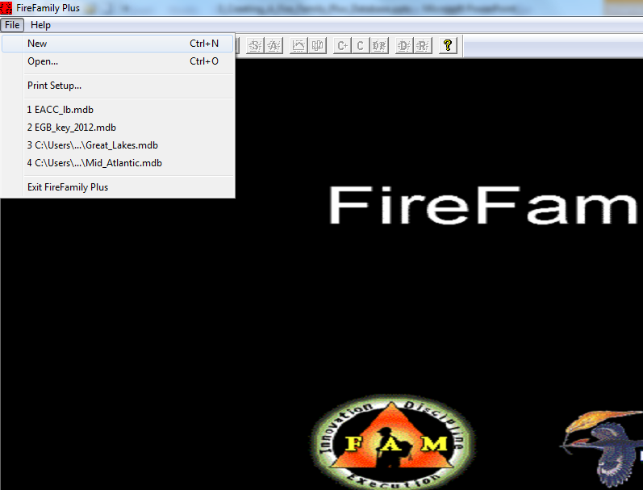
Producing Pocket Cards
Click on File - > Open

Slide 2
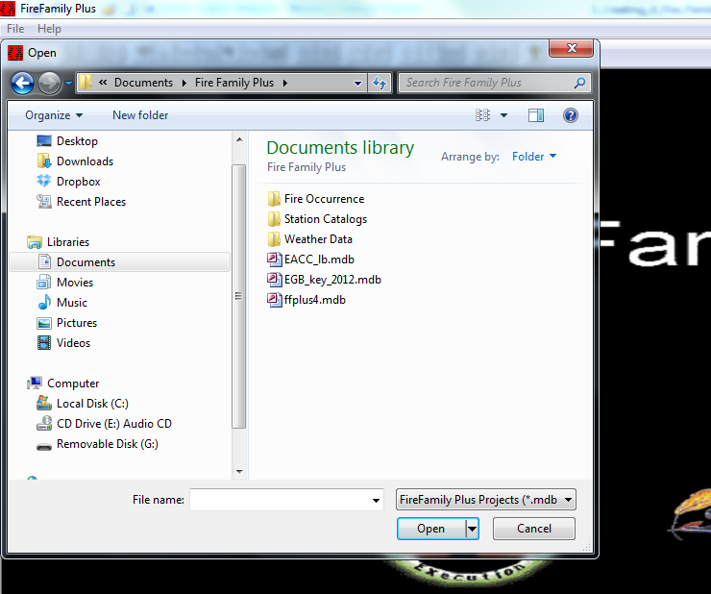
Open fire family plus database
Click on Database
Click on “Open”

Slide 3
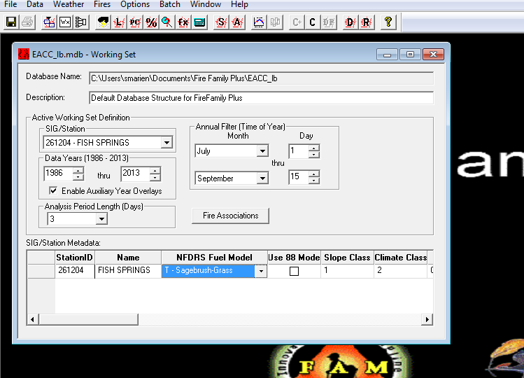
Select parameters to be displayed in the pocket card
Select Station or SIG
Select Year and Month Range
Select Analysis Period Length in Days
Select Fuel Model

Slide 4
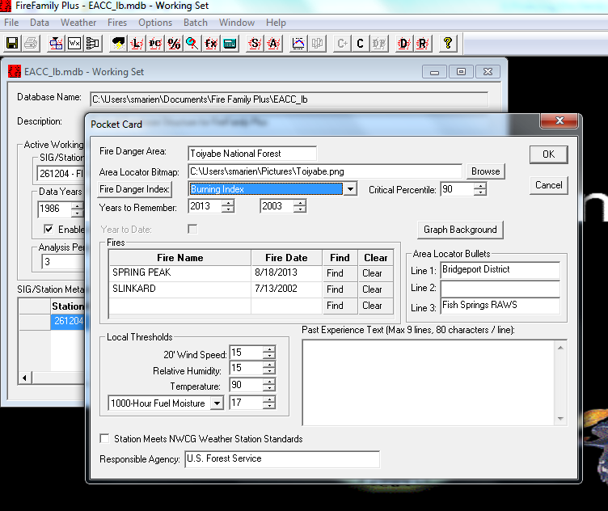
Select years to Remember and Fire Danger Index to be displayed
Select Fire Danger Index and Percentile Line to be Displayed on Pocket Card
Select “Years to Remember” to be displayed

Slide 5
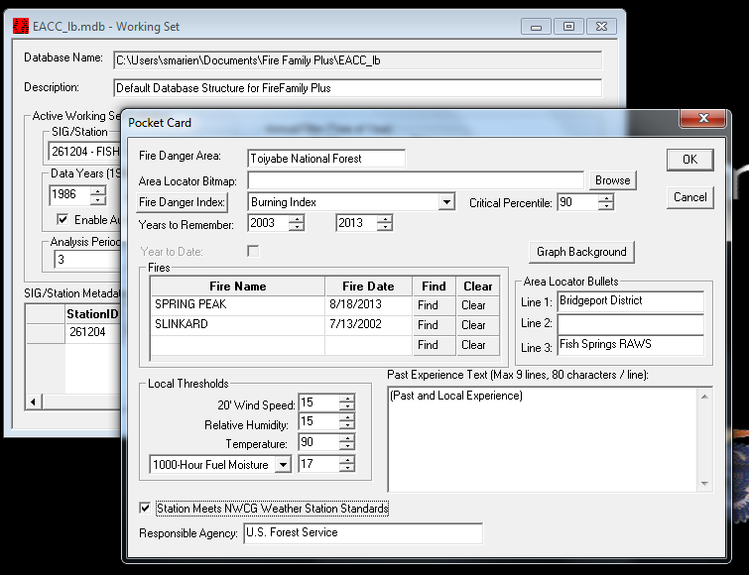
Enter Additional Information to be displayed
Type in Forest, Refuge, District , Park, RAWS , etc. bullets to be displayed on the Pocket Card
Select Local Thresholds to be Displayed
Check “Meets NWCG Standards” if RAWS
qualifies
Type in any Past
Experience
to be Displayed
Responsible Agency can be Displayed

Slide 6
Select Significant historical fires to be displayed
Click on “Find” to select a significant fire to be displayed on the pocket card

Slide 7
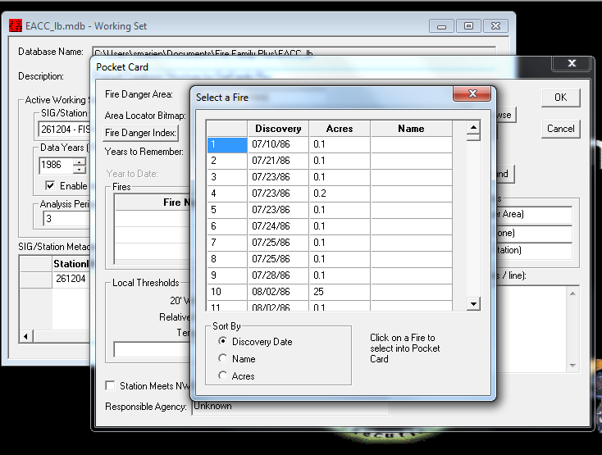
Select Significant historical fires to be displayed
Select Year Range to be Displayed
Sort Fires by Discovery Date,
Name or Acres

Slide 8
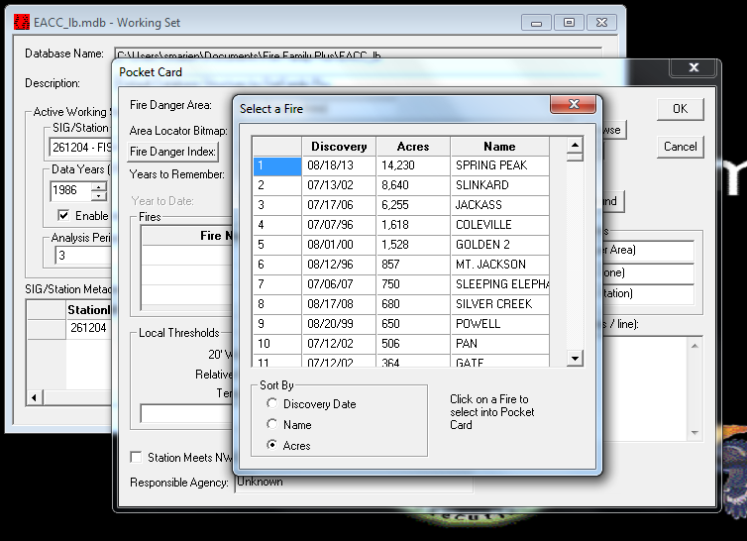
Select Significant historical fires to be displayed
Click on fire to select it into Pocket Card
Acres descending selected

Slide 9
Select Significant historical fires to be displayed
Up to three significant fires can be displayed on the Pocket Card

Slide 10
Produce Pocket Card
Click on “OK” to produce Pocket Card

Slide 11
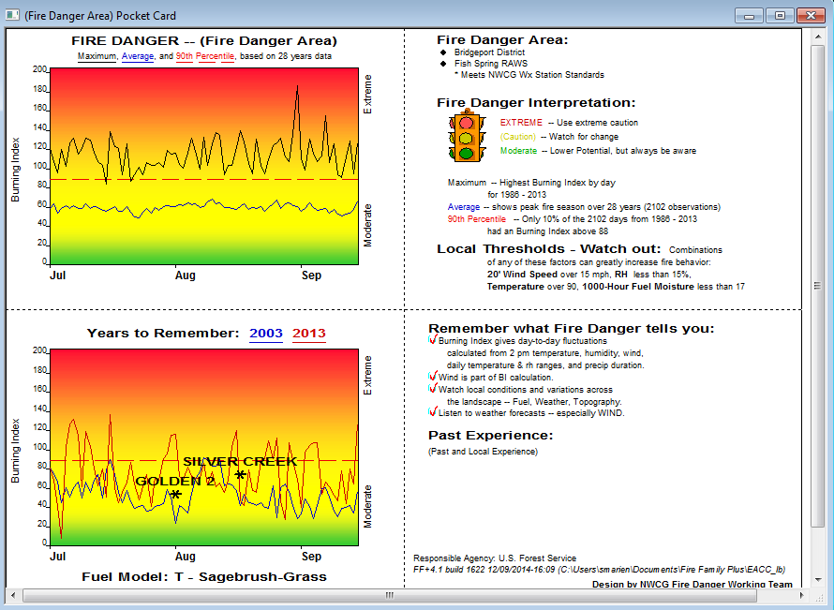
Pocket Card displayed
Up to three significant fires can be displayed on the Pocket Card

Slide 12
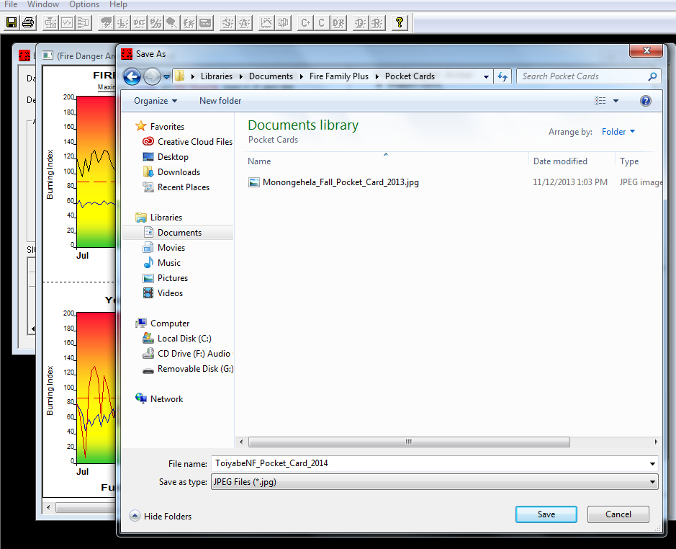
Save Pocket Card to desired location
1. Click on “File-->Save As” in the upper left
2. Select folder to save Pocket Card
3. Type in File Name of Pocket Card
4. Click on “Save”

