Slide 1
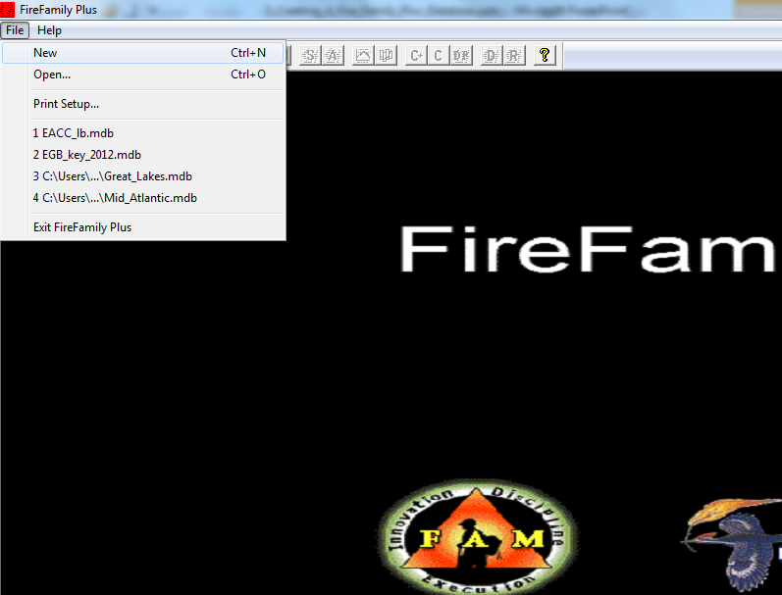
Create a New fire family plus database
Click on File - > New

Slide 2
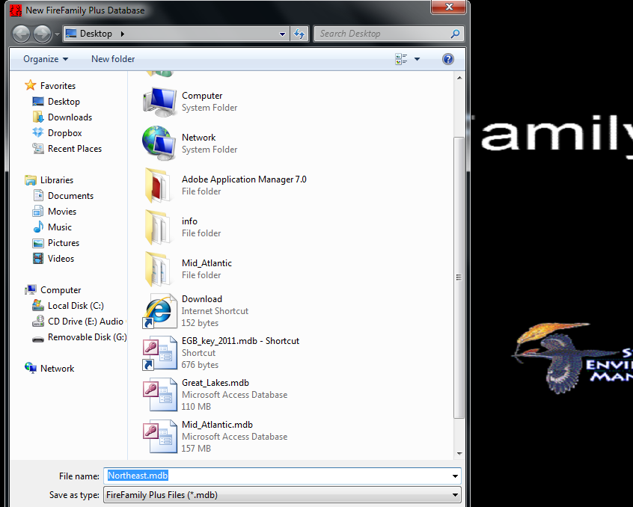
Name and save the fire family Plus database to the fire family plus folder
Name Database then click on “Save”

Slide 3
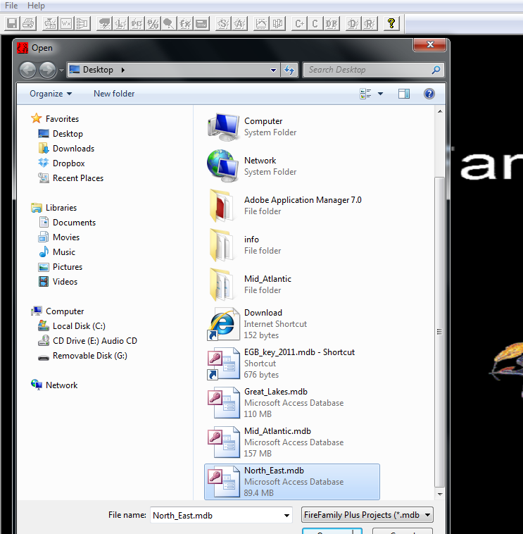
Open the created database by selecting “file” -> “open”. Then double click on file in the saved location
Click “File” - > “Open”
Double Click on database file

Slide 4
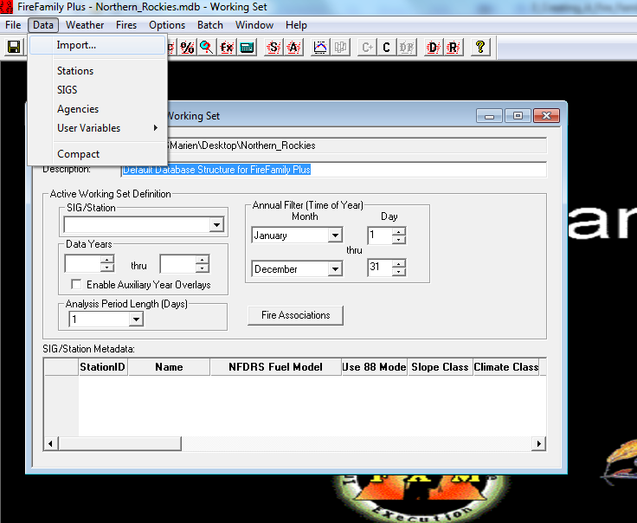
Import station catalog(s)
Click “Data” -> “Import”

Slide 5
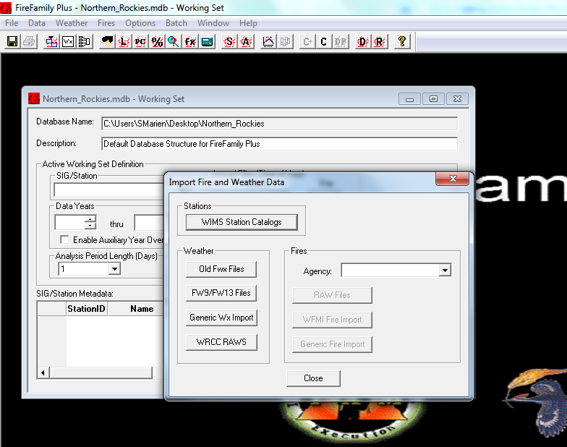
Import station catalog(s)
Click “WIMS Station Catalog”

Slide 6
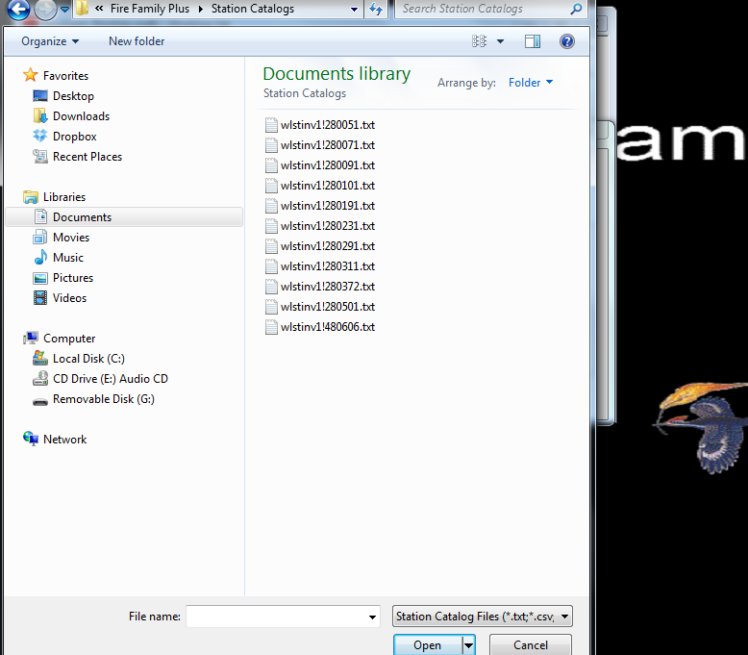
Import station catalog(s)
Navigate to the Fire Famliy Plus/Station Catalogs Folder
Highlight the Station Catalog(s) you wish to import
Click “Open”

Slide 7
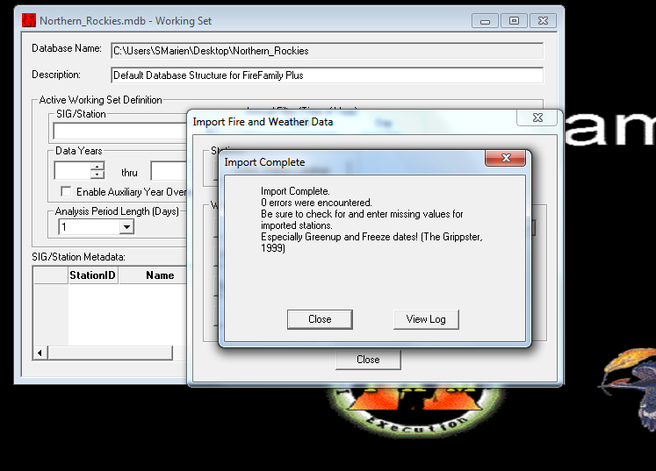
Import station catalog(s)
Import of Station Catalog Complete

Slide 8
Import Weather Data
Click “Data” -> “Import”

Slide 9
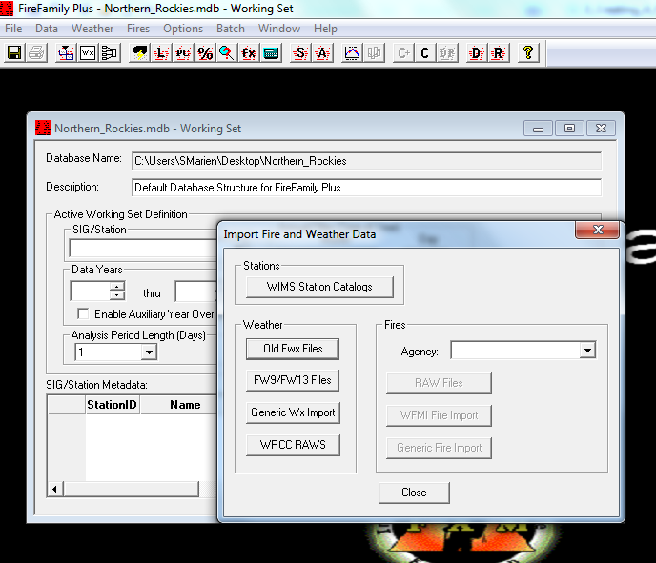
Import Weather Data
Click “FW9/FW13 Files

Slide 10
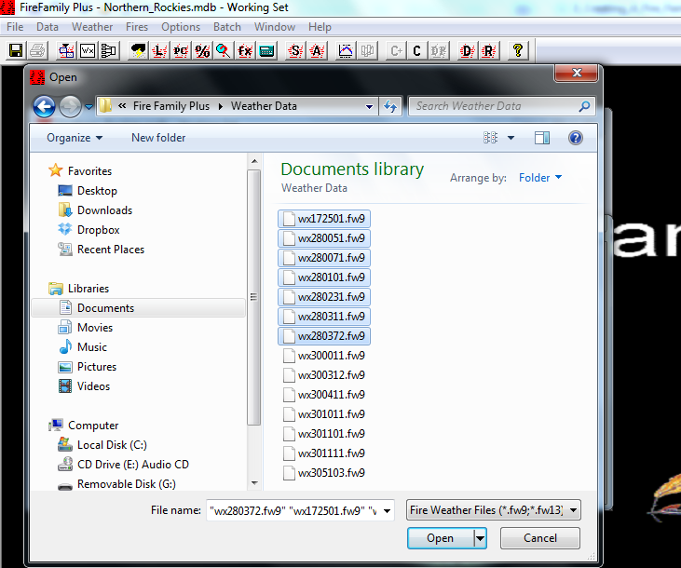
Import Weather Data
Navigate to the Fire Famliy Plus/Station Catalogs Folder
Highlight “FW9/FW13 Weather files you wish to import
Click “Open”

Slide 11
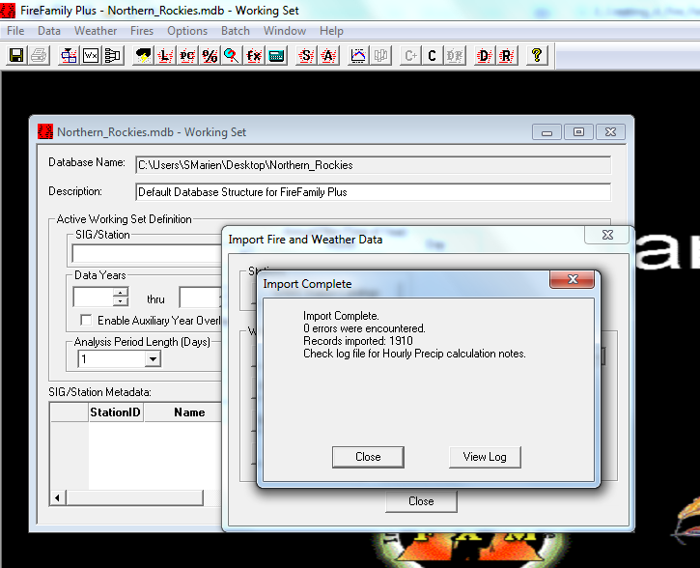
Import Weather Data
Import of Weather Data Complete

Slide 12
Import Fire Occurrence Files
Click “Data” -> “Import”

Slide 13
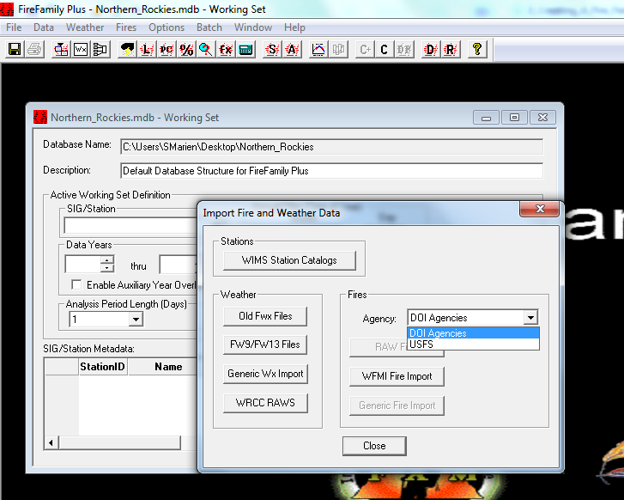
Import Fire occurrence file(s)
Choose Fire Occurrence Agency

Slide 14
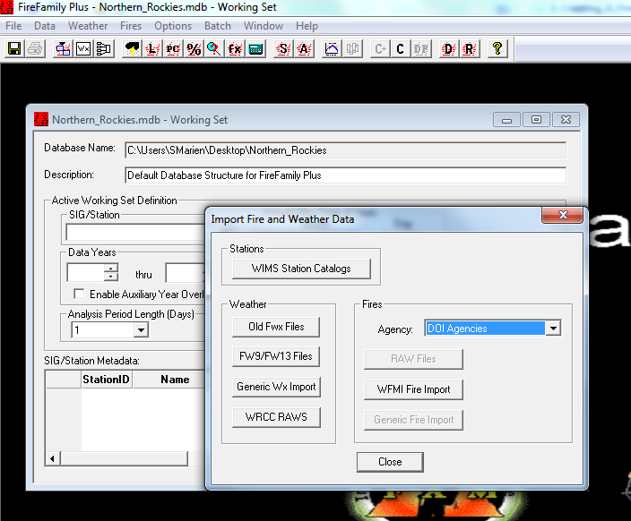
Import Fire occurrence file(s)
Choose Fire Occurrence File Type

Slide 15
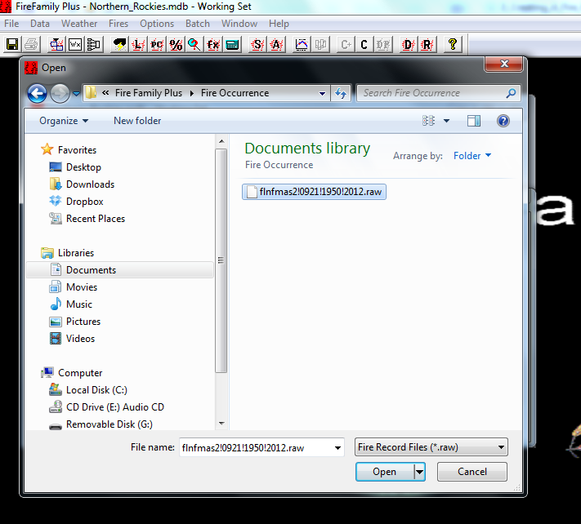
Import Fire occurrence file(s)
Navigate to the Fire Famliy Plus/Station Catalogs Folder
Highlight the Station Catalog(s) you wish to import
Click “Open”

Slide 16
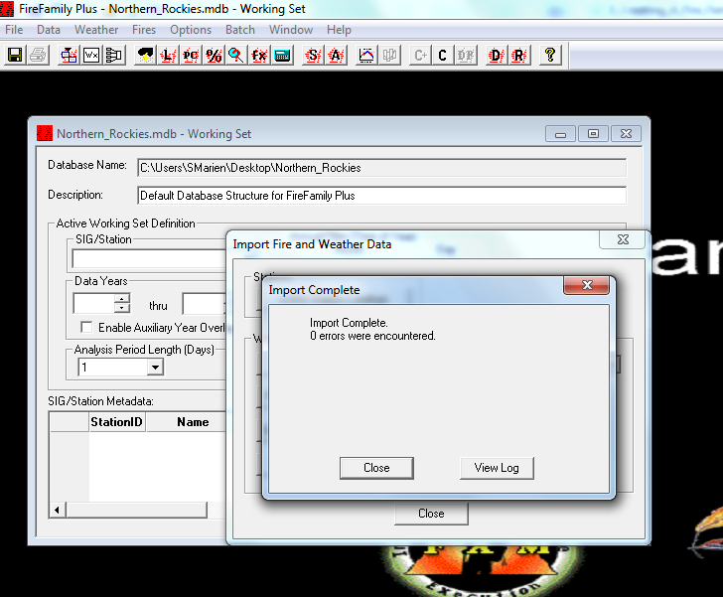
Import Fire occurrence file(s)
Import of Fire Occurrence File(s) Complete

Slide 17
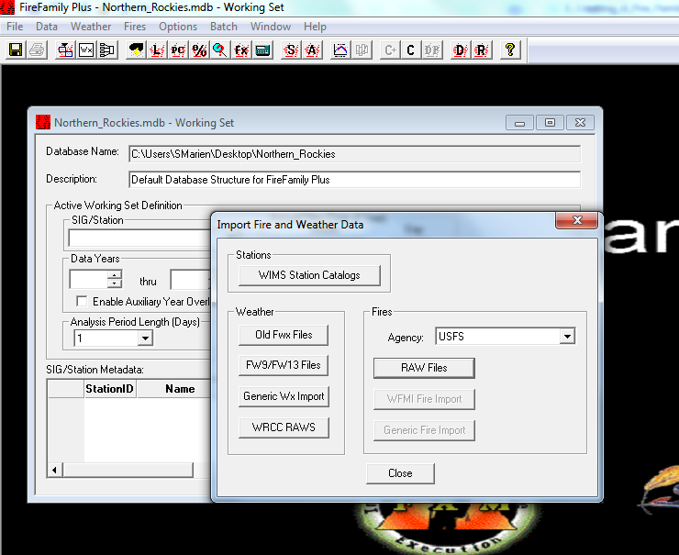
Close data import window
Click on “Close” to close Data Import window

Slide 18
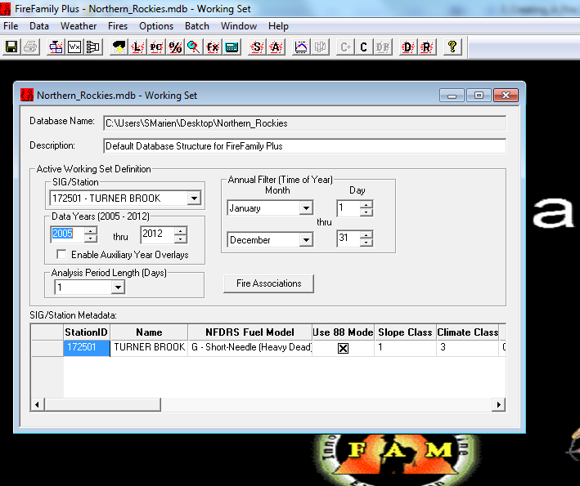
Save database
Click on “Save” diskette icon

