Slide 1
End of Year Report
Did you know for ROSS to run effectively there are recommended hardware requirements? Find them on the ROSS website under the documents library or click here.
Resource Ordering and Status System
2013
What you may not have known… Special points of interest

Slide 2
OVERVIEW
ROSS and Supporting Components
ROSS Supports
NESS Application Portal / NAP
ROSS Environment
Data Exchange with External Systems
ROSS Thick Client (USDA/UTN and Internet) Flow
ROSS External Interface (Inside NITC)
ROSS Error Messages
ROSS Statistics
Request Transactions
ROSS Ticket Counts
Help Desk Ticket Totals
ROSS Reports
Report Execution
Report Types
Execution Totals
Report Usage and Ranking
ROSS Training and Practice Environments
Training update
CY 2013 Accomplishments
New O&M Contract

Slide 3
ROSS ENVIRONMENT – A Closer Look
Fire and Aviation (FAM) application systems are hosted on US Forest Service (USFS) owned equipment located at the National Information Technology Center (NITC) in Kansas City, MO, the Earth Resources Observation and Science Center (EROS) in Sioux Falls, SD and the FAM Application Development Environment which is located at the Denver Federal Center (DFC) in Lakewood, CO.
All three of these sites are collectively referred to as National Enterprise Support Services (NESS).
NESS-NITC and NESS-EROS are identified as alternate production sites and may house test, practice pre-production and production environments, whereas NESS-DFC is designated for development and quality assurance.
ROSS is hosted on the NESS computer server hardware on six physical servers housing virtual machines (VMs) and logical partitions (LPARS) that run Production, Practice, and Training application configurations.
Using Cognos , a reports application, ROSS exchanges data with several external systems. Cognos is available for other applications including: InciWeb, WFDSS, Enterprise Geo Spatial Data and e-ISuite. As in ROSS Reports, Cognos allows users of these other applications to extract and convert data into a compatible format to be used in spreadsheet applications such as Microsoft Excel.

Slide 4
What you may not know…
Today, ROSS supports the incident response and protection mission of more than 600 federal, state, and local agencies
ROSS supports more than 10,000 user accounts, including:
Federal Government employees
Cooperators
Non-federal agency cooperators that include users from the local government, state government, counties and vendors
Multi-agency dispatch centers, which may operate with a mix of federal and non-federal users
Contractors.
Concurrent use of ROSS ranges from 50 users (during non-peak times) to 2000 users (during peak times).

Slide 5
Supporting Components
The ROSS Program provides support:
24 hours per day
7 days per week
365 days per year
The United States Department of Agriculture (USDA) Forest Service (USFS) is the managing agency for ROSS and its two supporting components:
Organization Information System (OIS)
National Enterprise Support Services (NESS) Application Portal (NAP)

Slide 6
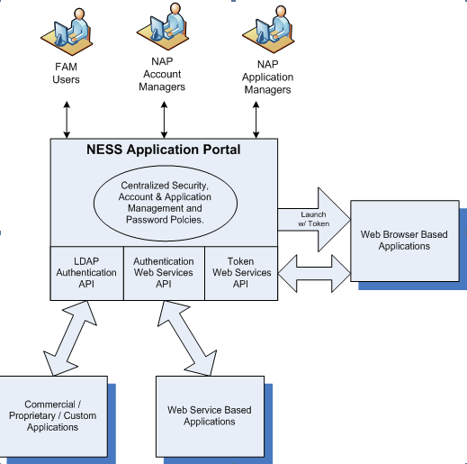
National Application Portal (NAP)
NAP manages user application log on account information. Once an account exists in NAP, it can be added to one or more Dispatch Centers by a local ROSS Account Manager. Note: Unless you are a vendor/contractor with contract resources you can only be added to the Dispatch Office that manages your organization.
This summarized conceptual overview shows how users, managers and applications interface with the NESS Application Portal which is a component of ROSS but supports other applications.

Slide 7
DATA EXCHANGE
ROSS exchanges data with external systems through a Web Services Enterprise Service (ESB).
Current System Interfaces
Interagency Cache Business System (ICBS)
California Altaris Computer Aided Dispatch (CAD)
Interagency Qualifications and Certification System (IQCS)
Incident Qualifications System (IQS)
While ROSS shares interface data with several external systems it is also available for
other applications to extract data. These applications use Cognos to extract
the data to external applications.
Consumer Data External Applications
InciWeb
WFDSS
Enterprise Geo Spatial Data
eI-Suite
.

Slide 8
ROSS USDA/UTN to NITC
ROSS Thick Client at a Dispatch Center on (USDA UTN) network
Outbound Firewall
WebSphere Applications Server
ROSS Application Servers
NITC Firewall
The total number of servers include
ROSS Production (19)
NAP/OIS Production (17)
NAP/OIS Production(17)
Practice (10)
Training (6).
Outbound Firewall
ROSS Thick Client (Internet)
Dispatch Office

Slide 9
ERROR Messages – Have you seen some of these?
VLS Error: Cannot reach server due to firewall/security blocking access, Edge loading balancing not functioning, application or server down
CORBA / String Bean Errors: Intermittent connectivity issues can result in Corba
error, slow network response, retransmit and timeout issues
Optimistic Failure: Means that the update the system tried to make to the database failed due to data being locked by another user
Error Roli Assignment: This occurs when trying to delete a resource. It means the resource is part of incident documentation and therefore can not be deleted
RESCR 3031: Error received when you save updates to a IQCS/IQS resource that is currently in transfer status
Error: Java.lang.arrayindex out of bound exception: Occurs when user is trying to print a report and the user may not have basic user role
DPR-ERR-2082 Error: This occurs when running a report containing blank objects

Slide 10
Request Transactions for CY 2013
Do you realize that there were over 2,412,600 request transactions in ROSS in 2013. These are requests that were filled, deleted, canceled, canceled UTF, or pending.

Slide 11
Help Desk Ticket Count by Application CY 2013
NAP | 11380
ROSS - Production | 2807
ROSS - Practice | 60
ROSS - Training | 6
Grand Total | 14253

Slide 12
Special Point of Interest
The Help Desk generated 29,015 tickets for all applications in 2013.
ROSS and NAP contributed 14,253 of the ticket total (with June being the busiest month).
Average handle time for ROSS/NAP tickets was 7.5 minutes per caller.
Month | Total
1/2013 | 780
2/2013 | 823
3/2013 | 1264
4/2013 | 1623
5/2013 | 2194
6/2013 | 2479
7/2013 | 1909
8/2013 | 1651
9/2013 | 612
10/2013 | 315
11/2013 | 293
12/2013 | 310
Application | Total
NAP | 11380
ROSS | 2807
ROSS - Practice | 60
ROSS - Training | 6
Grand Total | 14253
NAP/ROSS Ticket Breakdown
NAP/ROSS Tickets per Month

Slide 13
ROSS Reports
Of all reports available, did you know that the Resource Order Form was the most popular. It was executed over 80,000 times!
There were over 1800 execution type reports generated in 2013.
Reports types included Scheduled Reports, Saved Reports, Ad Hoc Reports, and Interactive Reports.
The execution count for running these reports was over 510,000 times during the CY 2013 season.

Slide 14
Reports Usage and Ranking by Report Name CY 2013
ROSS
Resource Order Form | Run Count | 78,612
Incident Resource List O | Run Count | 8,722
Incident Resource List C | Run Count | 8,722
Incident Resource List E | Run Count | 8,722
Equipment, Overhead & Crew Requests | Run Count | 26,166
Ross Historical
Resource Order Form |  | 4,807
Resource Order Form by Dispatch Provider |  | 185
NEFS Resouce Order Form |  | 36
Report View Resouce Order Form | Run Count | 21
Report View Resouce Order Form Equipment | Run Count | 11
ROSS AR
Current ROSS Incidents | Run Count | 17,344
Current ROSS Comments | Run Count | 17,433
Adhoc Reports | Run Count | 11,117
CA Ross Incidents for Current Year | Run Count | 8,745
ROSS-AR Historical
Adhoc Report | Run Count | 4,207
Unsaved Report | Run Count | 1,468
Resource Currently on Assignment by Res GACC | Run Count | 924
Resource Currently on Assignment by Incident GACC | Run Count | 833

Slide 15
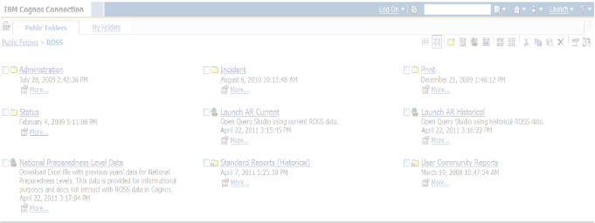
ROSS Reports Management Board (RRMB)
RRMB’s Purpose is to provide governance to ROSS Reports and Reports Training and includes
Organizing ROSS Report Users
Managing processes, products and training to effectively meet user needs
RRMB Mission
Organize a hierarchy system of reports
Develop report standards
Advise and guide users and user community
RRMB Goal
To create a network of expertise across Geographic Areas and user communities in support of the information demanded by users and decision-makers

Slide 16
ROSS TRAINING
Over 40 Training Sessions last year included:
National ROSS training (Basic, Intermediate, Advanced and Tactical Aviation)
Report training (Basic, Analytical Reporting Query Studio and Analytical Reporting Historical)
CA Dispatch, D310 and D110 training
Plus numerous refresher sessions and drills

Slide 17
2013 System Accomplishments
NAP 1.2 Release – 6/30/13
ICBS Integration with NAP – 7/1/13
Migrated all development and test environments to DFC – 7/5/13
VIPR Requirements complete – 8/15/13
O&M NAP 1.2 Emergency Bug Fix – 9/17/13
ROSS Field Reviews - Fall of 2013
O&M ROSS 2.15c.1 – Trouble Ticket Analysis – 10/7/13
O&M ROSS 2.15.1 – 11/14/13
DFC Development Environment Startup / Shutdown for Cooling Tower
Maintenance – 11/21/13
O&M Annual Archive Testing – 11/25/13
NAP 1.3 Release 12/10/13

Slide 18
ROSS 2013 Field Review
ROSS SMEs conducted face-face interviews and collected electronic questionnaires from 51 dispatching offices during scheduled site visits
The objectives of the interviews and electronic questionnaire was to acknowledge and engage the ROSS user community in achieving the following:
Obtain user community feedback of the current ROSS application, version 2.15, as outlined in item 4, “User/Customer Assessment,” in the “Operational Analysis Review, July 19, 2013”
Determine the level of end user satisfaction of the current ROSS application, version 2.15
Identify new areas of functionality and interoperability within the ROSS application
Obtain feedback from end users for improving ROSS Program support, including
training, the ROSS Website, and assigned SME support
Interviews and electronic questionnaire were categorized into six areas of concern:
Usability and Functionality
Accessibility
Dispatch and Reports Training
ROSS Reports
End User Information, Support, Availability, and Effectiveness
Potential Enhancements to Usability and Functionality.

Slide 19
GACC Contact List for ROSS SMEs

Slide 20
PHACIL
Did you know Phacil was selected as new O&M Contract replacing Lockheed Martin?

Slide 21
Next Generation of ROSS
Conduct Technical Assessment Spring-Summer 2014 for next Gen ROSS

