Slide 1

Forest Service Aviation Program Overview
Last (5^{th)} Year of commercial Airtanker Contract in 2012
EIS study and use of fire chemicals – guidance in place
AFUE – Study to determine how effective we are at dispensing on fires; water, gel, retardant
Larger AT strategy sent to OMB -> Congress
GAO Audit in progress (2013) on aviation resources
Evaluation of small numbers of Waterscoopers ongoing
Two airtanker accidents:
  T-11 and MAFFS 7

Slide 2
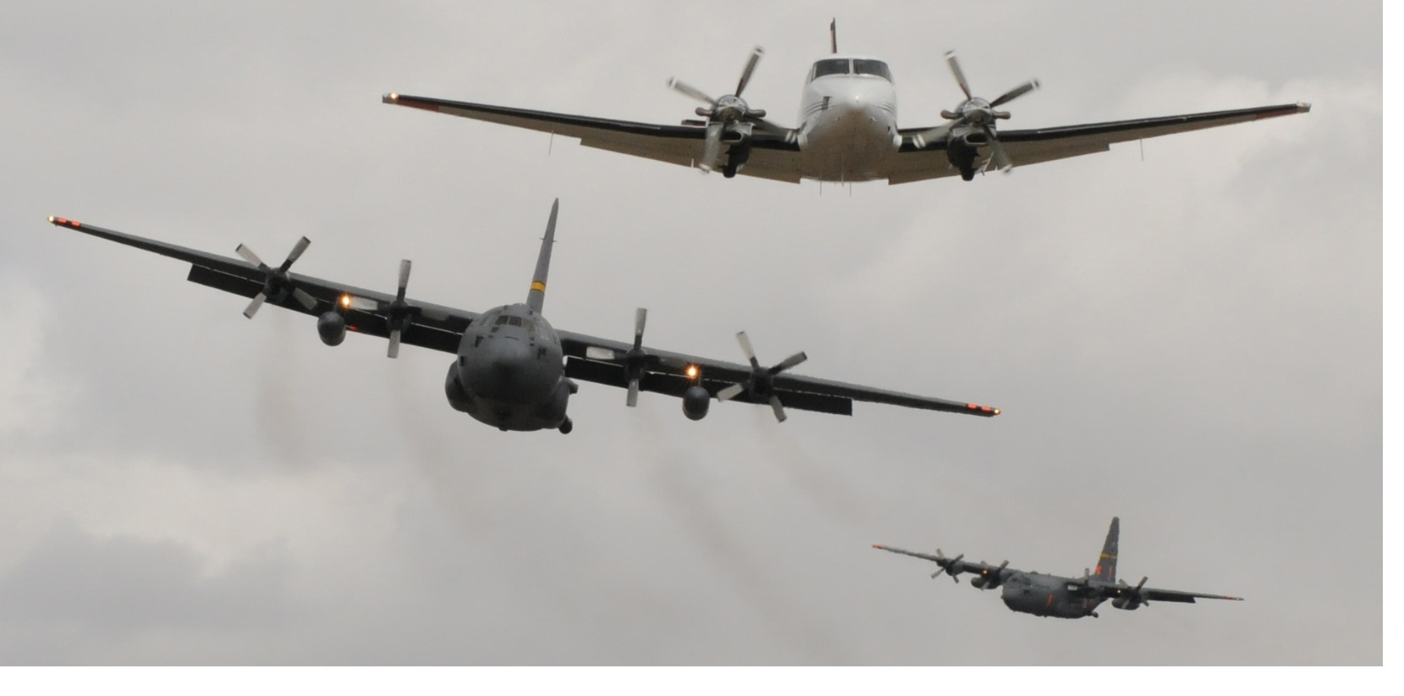
Aerial Supervision ATGS, HLCO, LP, ASM
2000 Agency Letter directing ASM and again in 2002
Unfunded, Not well Defined, Different Approaches
Fewer LP Pilot Positions (declining)
High number of near miss incidents on fires in 2011
Over 50% of ATGSs are ADs – militia more difficult

Slide 3
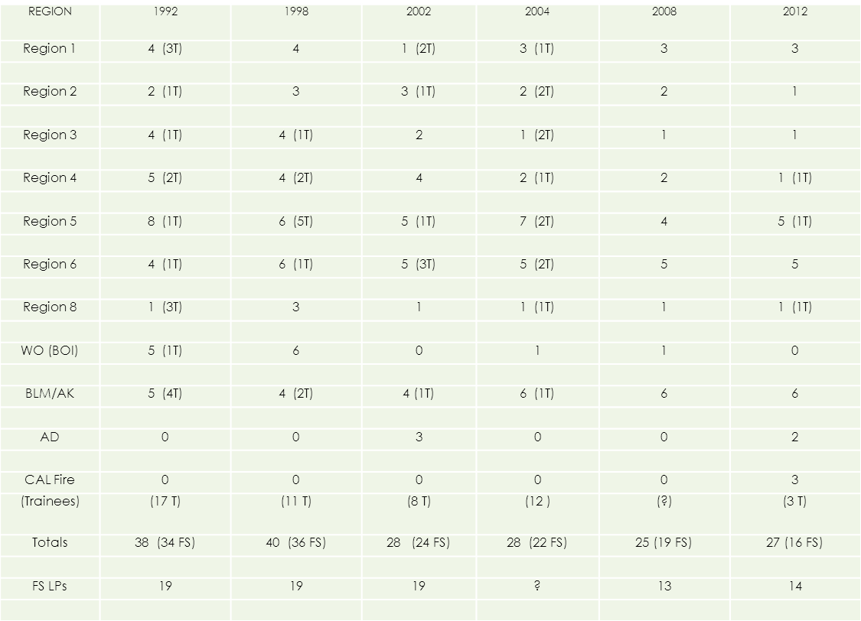
General Decline in LP Pilots

Slide 4
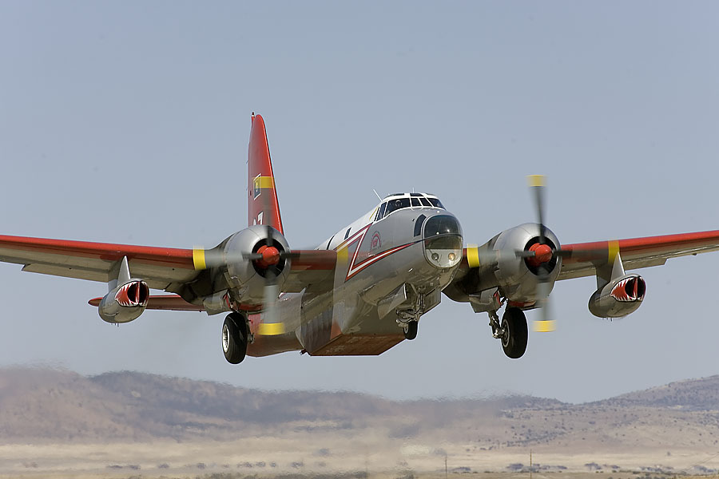
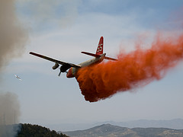
Airtankers
Legacy Contract
8 in 2013 (Type 2)
Next Gen Contract
7 in 2013 (Type 1)
Cooperator Aircraft
2-4 Convair 580s
CIFFC/NIFC Agreement
MAFFS - 8 Systems
(Type 1 “BOA”)

Slide 7
Tanker | 2013 Notional Airtanker Schedule of Items
 | January | February | March | April | May | June | July | August | September | October | November | December
LEG - 1 |  | 2/20 | ** | ** | ** | ** | ** | ** | 9/15
LEG - 2 |  |  | 3/5 | ** | ** | ** | ** | ** | 9/30
LEG - 3 |  |  | 3/20 | ** | ** | ** | ** | ** | ** | 10/15
LEG - 4 |  |  | 3/30 | ** | ** | ** | ** | ** | ** | 10/5
LEG - 5 |  |  |  | 4/15 | ** | ** | ** | ** | ** | 10/20
LEG - 6 |  |  |  | 4/25 | ** | ** | ** | ** | ** | 10/30
NEX - 1 |  |  | *2014 | 4/25 | ** | ** | ** | ** | << | 10/30
NEX - 2 |  |  |  | *2014 | 5/5 | ** | ** | ** | ** | << | 11/10
LEG - 7 |  |  |  |  | 5/10 | ** | ** | ** | ** | ** | 11/15
NEX - 3 |  |  |  | *2014 | 5/20 | ** | ** | ** | ** | << | 11/25
LEG - 8 |  |  |  |  | 5/30 | ** | ** | ** | ** | ** | 11/10
NEX - 4 |  |  |  |  | *2014 | 6/5 | ** | ** | ** | ** | << | 12/10
NEX - 5 |  |  |  |  | *2014 | 6/10 | ** | ** | ** | ** | << | 12/15
NEX - 6 |  |  |  |  | *2014 | 6/20 | ** | ** | ** | ** | << | 12/25
NEX - 7 |  |  |  |  | *2014 | 6/30 | ** | ** | ** | ** | << | 12/30
MAFFS |  |  |  | XX | XX | XX | XX | XX | XX | XX
Coop 1 |  |  |  |  |  |  | 7/1 | ** | 9/1
Coop 2 |  |  |  |  |  |  | 7/25 | ** | 9/10
Coop 3 |  |  |  |  |  |  |  | 8/10 | 9/25
Total Number of A/C per Month | 0 | 1 | 4 | 7 | 11 | 15 | 17 | 18 | 18 | 13 | 8 | 4

Slide 8
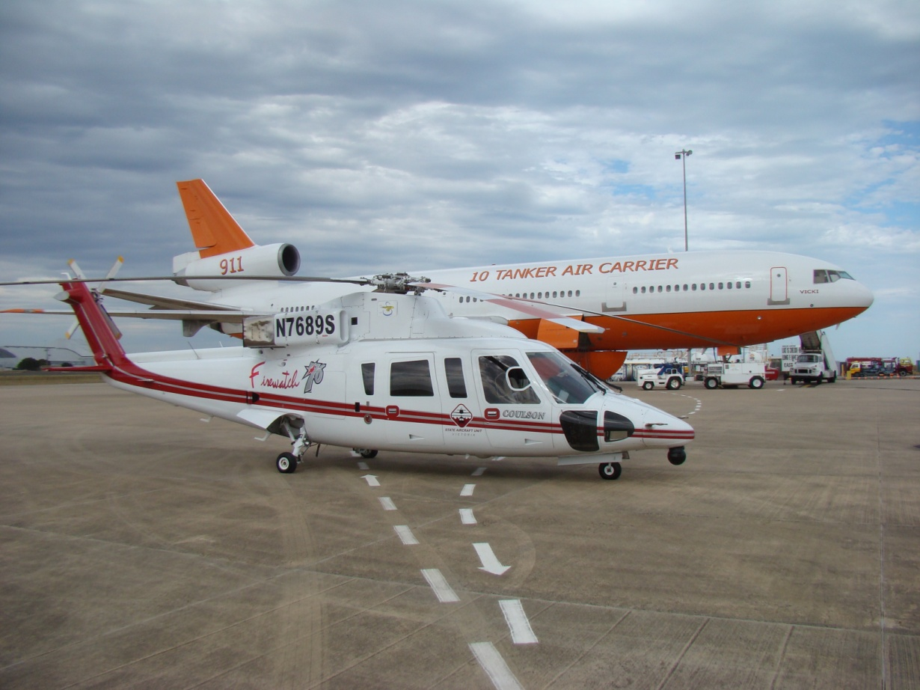
VLAT
VLAT Contract
Extended
8,000 + gallons
Renewal for 1 +2 option years
3 CWN items
Turnkey Ops

Slide 9
Turnkey Operations Required:
Albuquerque, New Mexico ABQ
Boise, Idaho** BOI
Casper, Wyoming** CPR
Colorado Springs, CO COS
Fort Huachuca, Arizona (Libby AAF) FHU
Grand Junction, Colorado COS
Helena, Montana** HLN
Hill AFB, Utah** HIF
Kenai, Alaska ENA
Klamath Falls, Oregon (Kingsley Field) LMT
Medford, OR MFR
Pocatello, Idaho PIH
Portland, OR PDX
Rapid City, South Dakota RAP
Sacramento, California** MCC
Stockton, California SCK
Twin Falls, Idaho TWF
Victorville, California VCV
** Use of existing large airtanker base may be possible

Slide 10
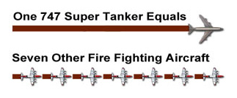
VLAT to Large AT (P2V) Comparison
100 Nautical Mile Dispatch
1 Load from DC-10
11,600 Gallons of retardant: $34,800
1 hour of flight time (round trip): $7,445
1 hour of fuel (dry flight rate): $14,139
2 Hour of daily availability : $11,117
Total : $32,711
Retardant Delivery Costs / Gal = $2.82
4 P2V Loads to Equal 1 DC-10 Load
8,320 Gallons of retardant: $24,960
Agency pays daily availability up front
8 hours of flight time: $46,928
Total: $46,928
Retardant Delivery Costs / Gal = $5.64
1 VLAT (DC-10) Drop on Large Fire at CL 4 = 1650 feet
4 Drops from P-2V = 1650 feet
3 Drops from MAFFS= 1700 feet
VLAT normally responds to one fire
4 P-2Vs can respond to different fires

Slide 12
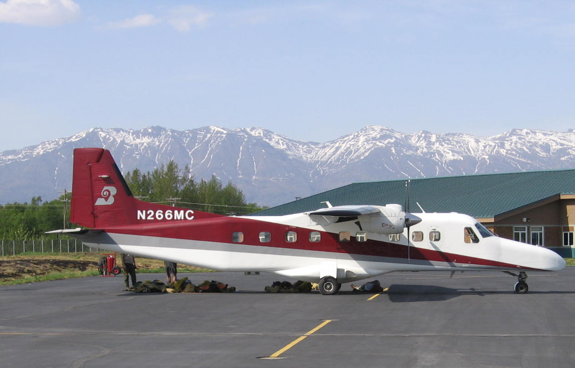
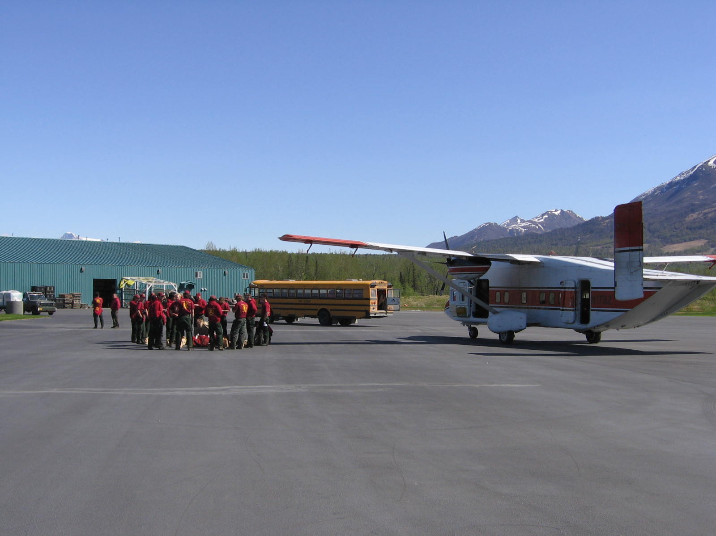
Smokejumper
4 Contract - West Yellowstone, NCSB, Grangeville, and Redding * Region 4?
Agency Aircraft –
4 C-23 Sherpa
2 DHC-6 Twin Otter
1 TDC-3

Slide 13
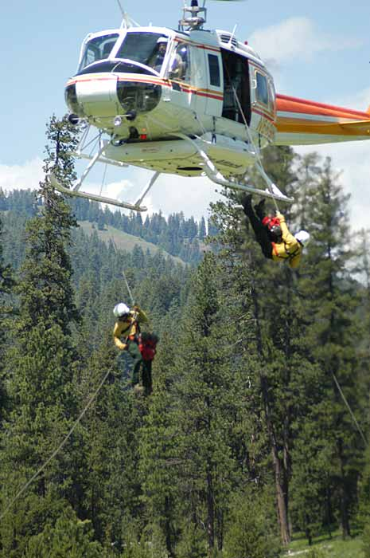
Helicopters
Large Fire Support
award for 2012 (T1)
30 plus 4 added
IA 33 (T2)*
Multiple regional
and call-when-
needed contracts
Exploring Possibility of Night Operations

Slide 14
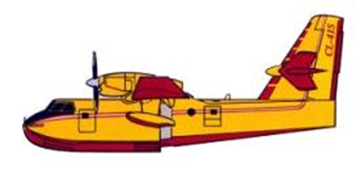
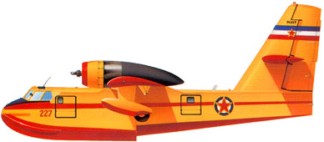
Waterscoopers
FS conducted minimal evaluation in 2012 – ongoing for 2013
2 CL-215s by adding 100 days on to end of DOI (OAS) Contract
Currently start in MN, then AK, then to NW or SoCal on evaluation

Slide 15
