Slide 1
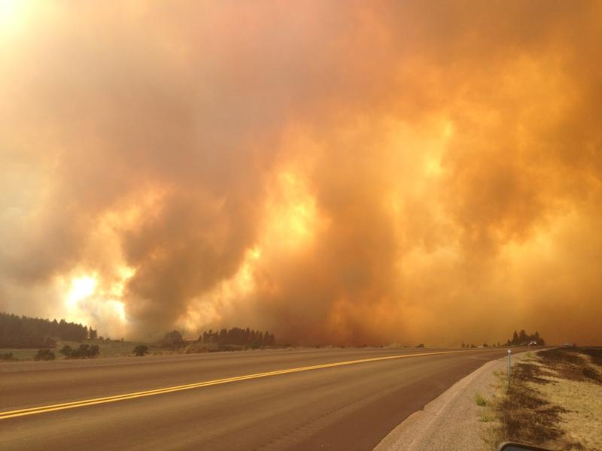
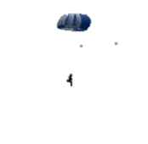
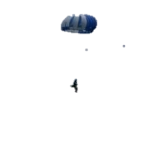
Fire Season 2013
Preliminary Outlook
March 5, 2013
Bryan Henry
Meteorologist
NRCC
Ash Creek 2012

Slide 2
10-Year Averages
 |  | WILDLAND FIRE |  | WILDLAND FIRE
 |  | 10-YEAR TOTALS |  | 10-YEAR AVERAGE
 |  | FIRES | ACRES | FIRES | ACRES
COMBINED
Bureau of Indian Affairs | BIA | 9,471 | 744,734 | 947 | 74,473
Bureau of Land Management | BLM | 981 | 632,567 | 98 | 63,257
Department of Defense | DOD | 4 | 0 | 0 | 0
Fish & Wildlife Service | FWS | 303 | 155,917 | 30 | 15,592
National Park Service | NPS | 327 | 243,323 | 33 | 24,332
Other | TRIBE | 188 | 9,812 | 19 | 981
Private Land | PRI | 3,787 | 882,726 | 379 | 88,273
State Agencies | ST | 4,777 | 654,804 | 478 | 65,480
USDA Forest Service | USFS | 9,539 | 2,308,692 | 954 | 230,869
10-YEAR TOTAL - ALL NRGA AGENCIES |  | 29,377 | 5,632,575 | 2,938 | 563,258

Slide 3
Last Year’s Forecast Under High Uncertainty…
2006 | 1,201,117
2007 | 1,185,199
2000 | 1,087,920
2003 | 942,022
2008 | 241,854
2001 | 223,310
1999 | 218,106
2011 | 198,624
2005 | 185,457
2002 | 172,197
2010 | 70,474
2009 | 69,016
2004 | 40,840
Median | 218,106
Questions?
What about the developing long-term drought conditions across SC and SE MT?
How’s all that standing, dead grass treating you on the East side?
Will there be impacts from the dry fall in the mountains?
How will a normal snowpack impact the fire season?
Analog years suggest a normal season. Are they wrong?
What will the monsoon be like this year?
2012?

Slide 4
Thoughts from February 2012 on Fire Season 2012
ENSO neutral conditions likely for summer though they could flirt with a weak El Nino by late summer.
Fuels should dry more quickly than in the past 3-4 years…more reminiscent of “early” curing observed during the 2000-2007 period.
We may get periodic wetting systems through August which may keep the season from becoming a “barn burner”.
In March the focus should begin to shift from observing snowpack accumulation to the observing the rate of snowpack loss.
La Nina springs are usually cool and wet. However, this past winter was not your typical La Nina. Why then should spring be typical?
-As a result of recent trends, we’re bucking the system and going for a normal spring that has a good warm up in mid-late May with high elevation snowpack gone by mid June.
A typical, average-above average fire season is expected with the season starting a few weeks sooner than in recent years (mid July).

Slide 5
2012-By the Numbers
3,433 Fires for 1,497,972 acres…making it the “torchbearer” of the modern era-from an acreage standpoint.
This was the largest fire season since 1919 when 1,514,554 acres burned.
1910 is the largest on record at 2,725,796 acres.
A little over 1.8 million acres burned in 1988, but recent research indicates that several very large fires my have been double counted that year.

Slide 6
2012 Acres Burned-The Rankings
2012 1,497,972
2006 1,201,117
2007 1,185,199
2000 1,087,920
2003 942,022

Slide 7
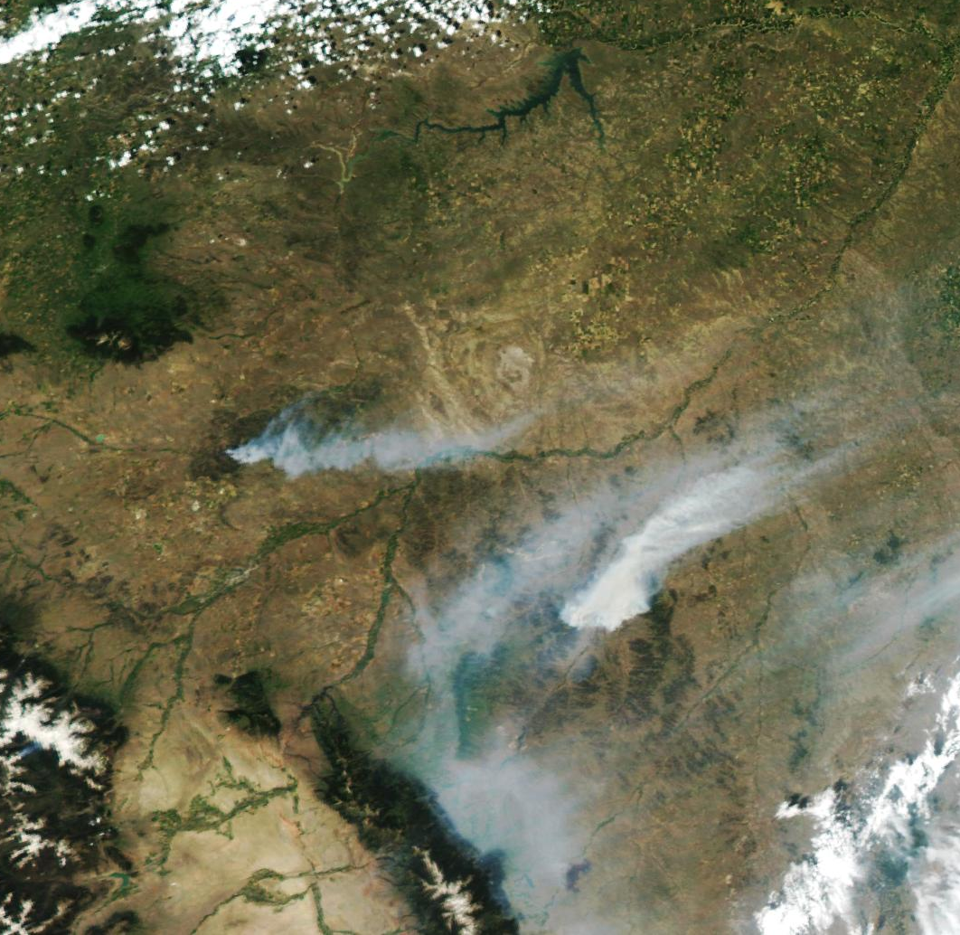
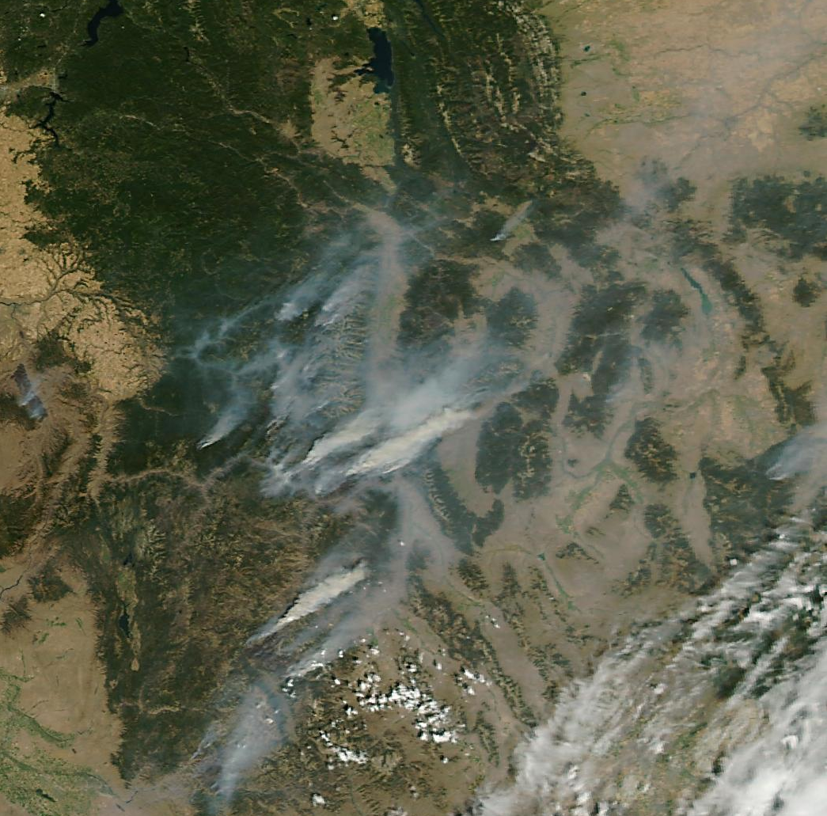
Fire Season 2012
* Missoula
* DahlFire
* Mustang Complex
* Billings
* Ash Creek Fire
June 27, 2012
August 30, 2012

Slide 8
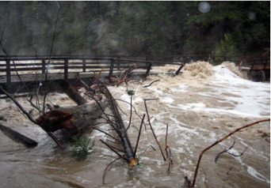
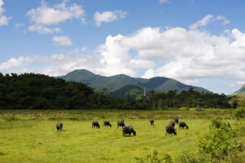
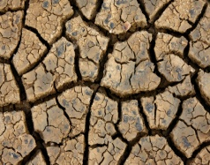
Factors that Influence Fire Season Severity
ENSO Neutral Springs Typically Lead to avg Conditions
July Temperatures and Precipitation
Summer Convection
Spring Factor
Snowpack is generally 80%-95% of normal
Ocean/Atmospheric Circulations (ENSO/PDO/etc.)
Winter Snowpack
Melt
Live/Dead Fuel Moisture
Fall was “near average” across the NR region
Fall Moisture and Preexisting Drought Conditions

Slide 9
Image 2 A: Fire sizes in relation to snow melt off date (basically, the earlier the melt off date, the larger the fires tend to be).
Image 2B: Number of large fires at mid elevations in relation to snow melt off dates. (Basically, the earlier the melt off date, the more large fires that develop).
*Note that the data only goes through 2002!

Slide 10
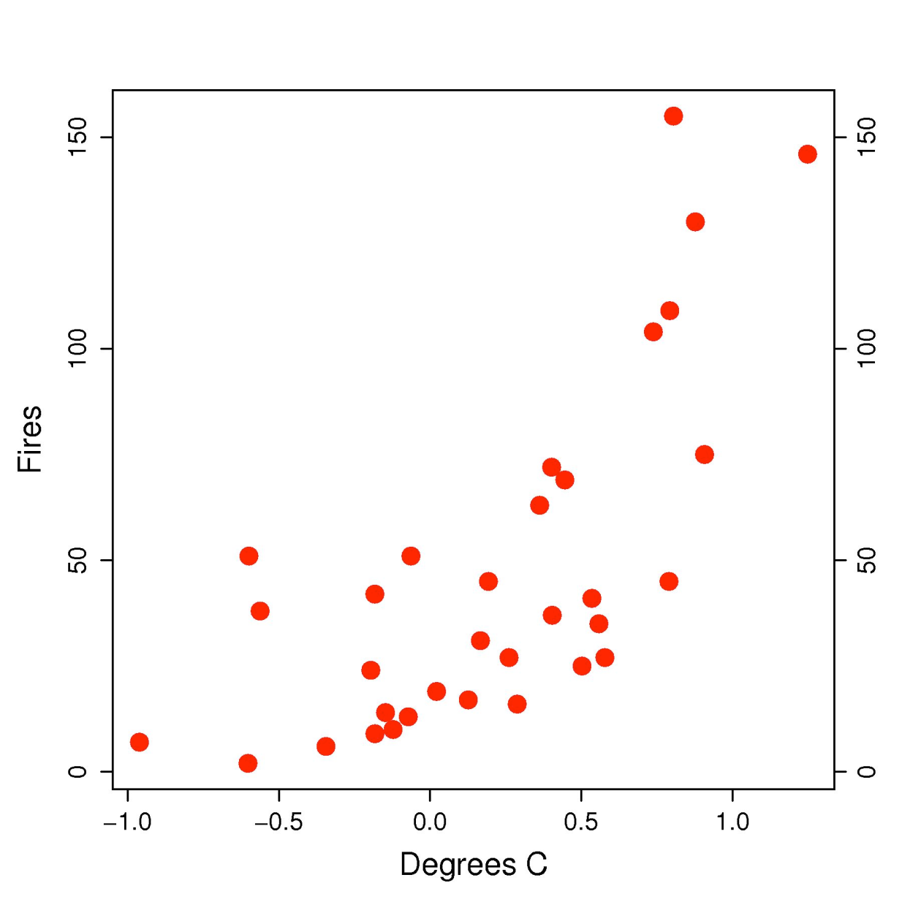
Effects of Climate Change on Numbers of Large Fires
Figure 4a scatter plot of annual number of
large (> 200 ha) forest wildfires versus avg spring and summer temperature for the Western USA USFS,
Park Service, and BIA
management units reporting 1972 - 2004. Fires reported as igniting in forested areas
only.
Big Jump in # of large fires in years that are .3 degrees warmer than normal.

Slide 12
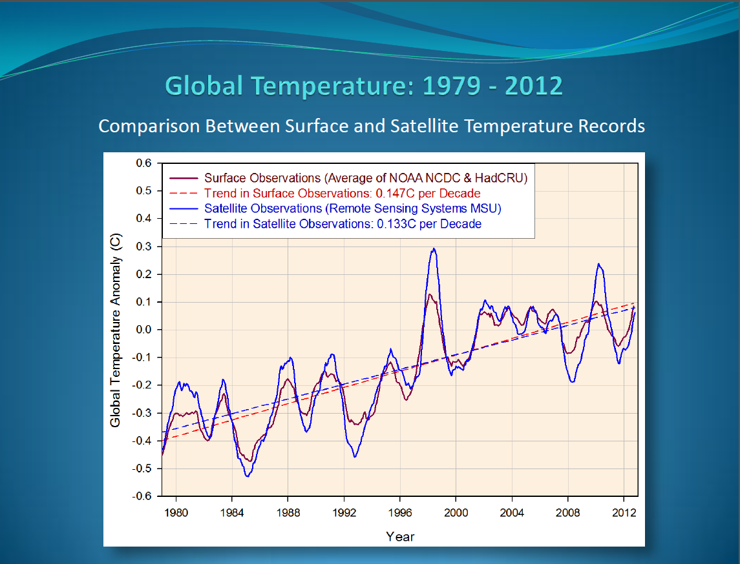
Flattening?

Slide 13
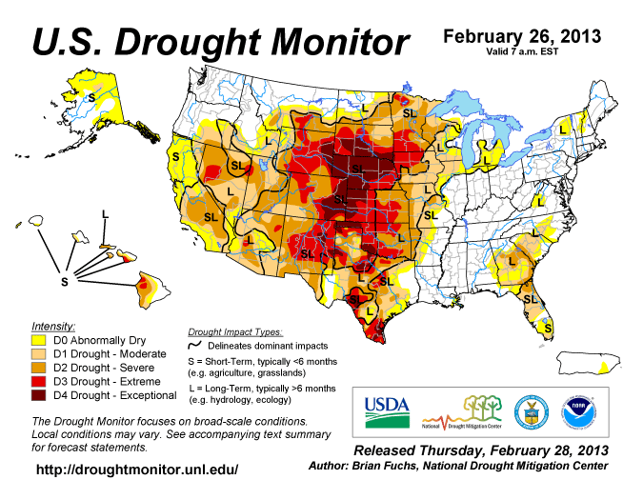

Slide 15
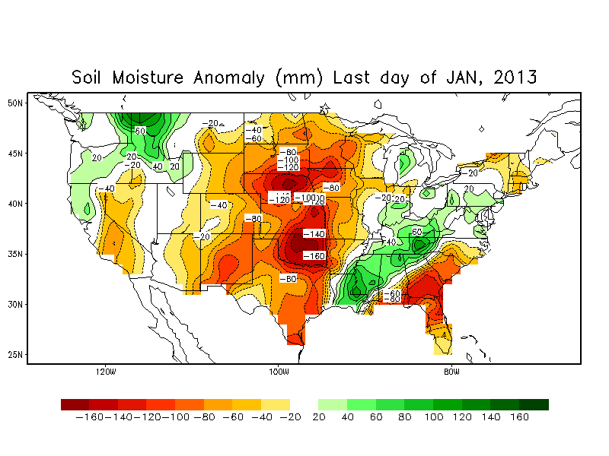
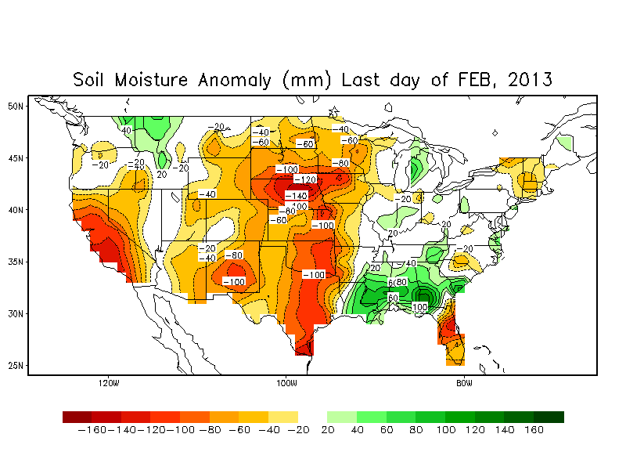
Soil Moisture Anomalies show the effects the long term drought conditions across SC-SE MT and the Dakotas. Notice the dry spot that has developed over SW MT.

Slide 16
Some of this area is already under Severe drought and will need to be monitored for the potential for “Above Normal” fire potential should drought relief not come.
Some relief
June
MAR-JUN
Percent of Normal Precipitation (Last 60 days)

Slide 17
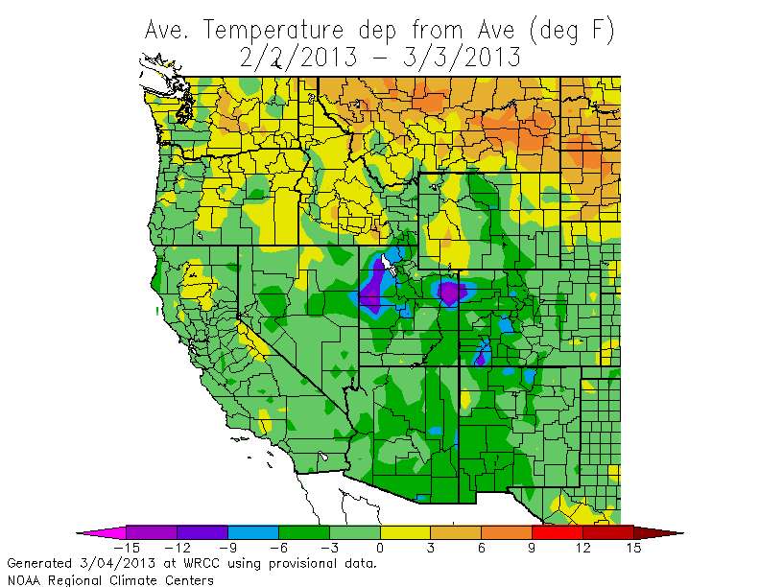
30 Day Temps Generally Above Normal

Slide 18
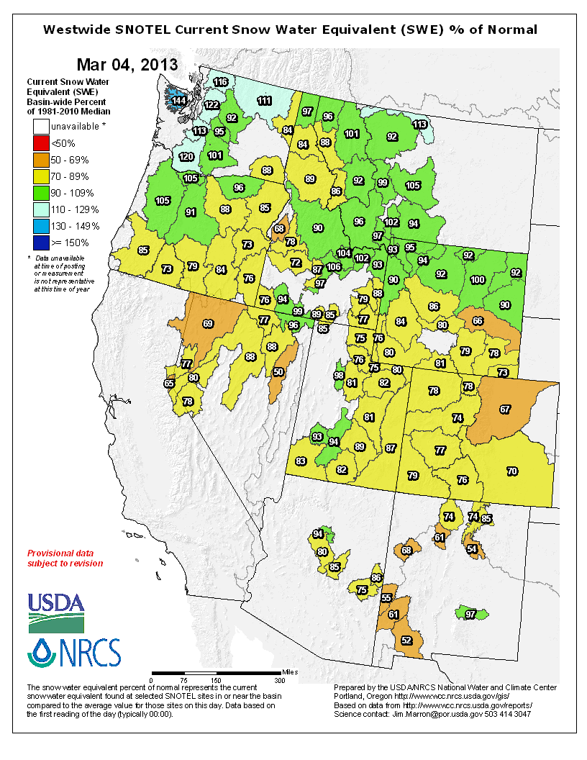
Snowpack is below-near normal
-Areas of most concern are Colorado and SE Wyoming though these areas have shown improvement over the past 2 weeks.

Slide 19
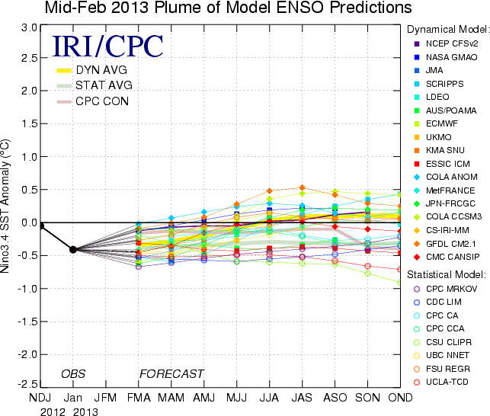

Slide 20
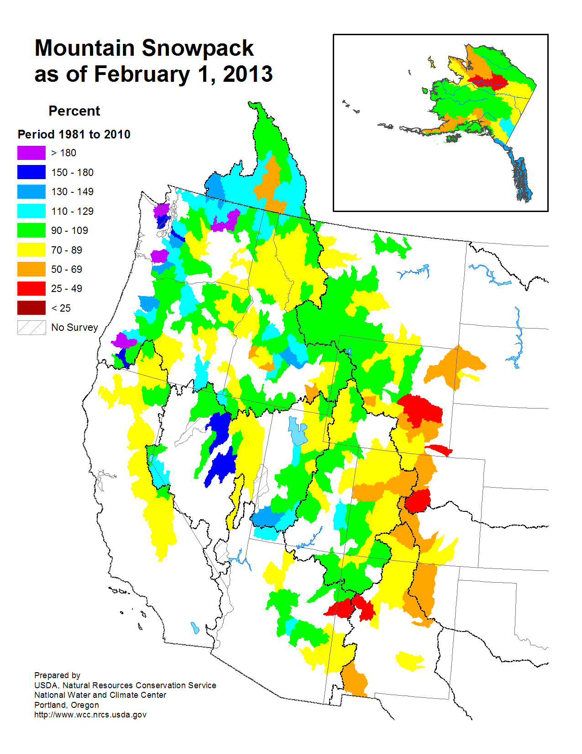
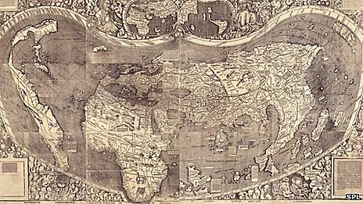
Best Analog Years (from an ENSO Perspective): 1487
Montana
…Actually, there are none this time around.

Slide 21
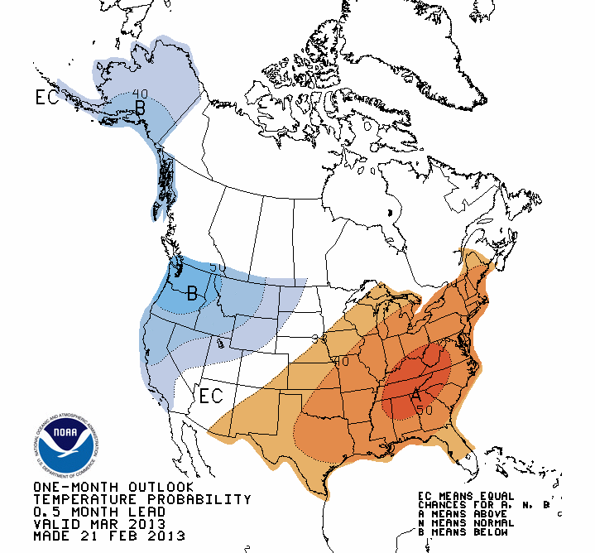
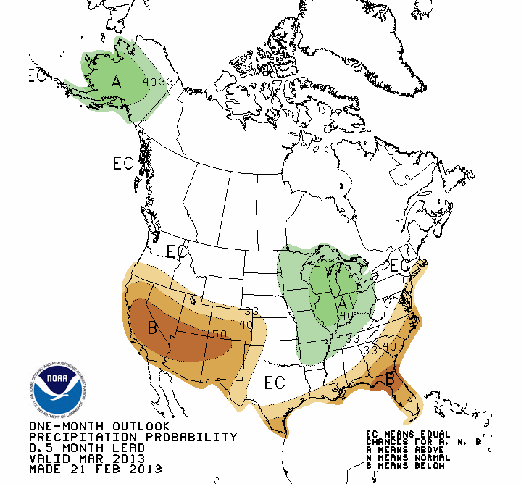
CPC Outlooks (March 2013)

Slide 22
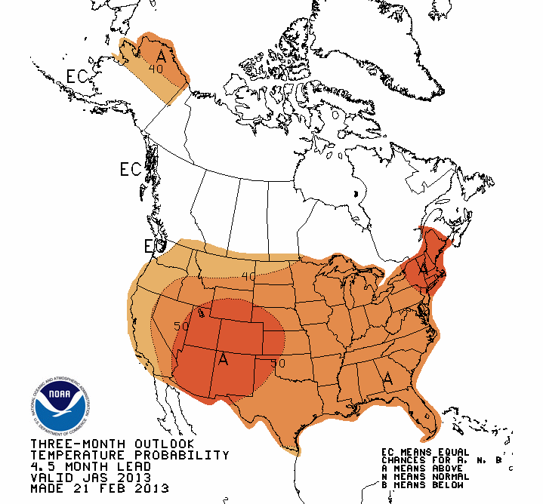
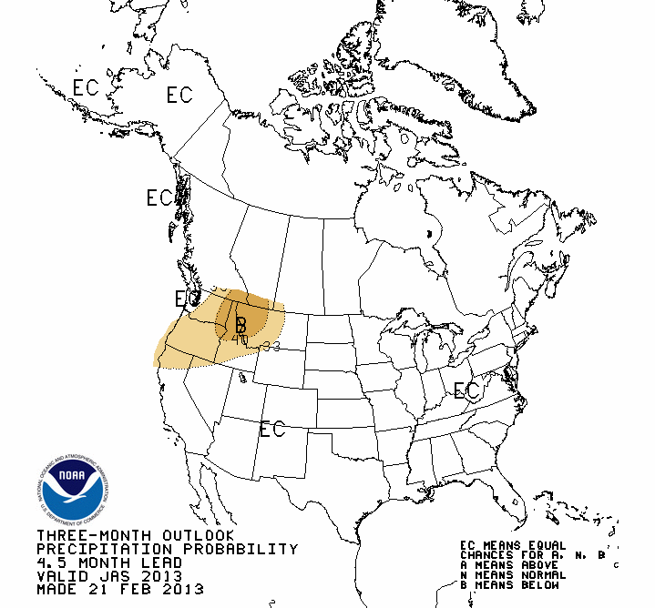
Early Outlooks for Fire Season (July-September)

Slide 23
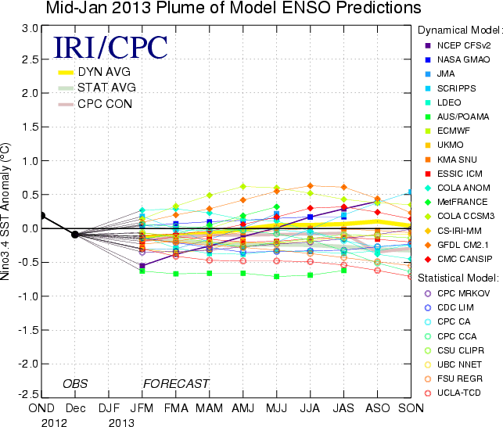
Thoughts on ENSO & PDO trends
ENSO data from 2012 paralleled 2006, another big season, but it also paralleled several other seasons that were not severe like 1996 and 2001.
Prolonged +ENSO Neutral conditions coupled with –PDO led to a longer than normal season last year with a near record number of acres burned.
Latest sea surface temperature trends suggest that we will be ENSO Neutral through the first half of the summer. This will likely promote above normal temperatures and below normal precipitation.
.3 degrees C means everything to us!
http://cses.washington.edu/cig/maps/index.shtml

Slide 24
Comparing Late Winter/Spring 2012 to this Year
Central MT – ND at least got some snow this winter…not a lot, but still “some”.
Drought signal showing improvement (E MT and ND) this year compared to last year when it was developing.
Anticipated springtime pattern more progressive and wet than last year.
Mountain snowpack is about 10-20% less this year than last year.
This winter has been less windy and warm than 2012.

Slide 25
Thoughts on Fire Season 2013
Pregreenup grassfire activity possible again across SC and SE MT in drought stricken areas. It probably won’t be as significant as last year’s activity.
Following greenup, same areas across SC and SE MT may experience normal-above normal fire activity again this year in July before the season shifts west.
Normal “core” fire season start is expected in all areas.
Convective activity remains a wildcard.

Slide 26
Northern Rockies Fire Season Outlook for 2013
(July through September)-Preliminary
NOT OFFICIAL
See Text
Normal
Normal
Text:
*Long range climate models point suggest drier than normal conditions across N ID and NW MT and above normal temperatures (region-wide). If another significant monsoon ensues, then the mountains could experience another above normal season.

Slide 27
http://gacc.nifc.gov/nrcc/
2013 Products and Services

