Slide 1
THE NORTHWEST WILDLAND FIRE PROTECTION AGREEMENT

Slide 2
WILDLAND FIRE COMPACTS
Notes:
Recognition that states may enter into compacts for the protection of forest and watersheds is noted in the 1911 Weeks Law.
The first Interstate Forest Fire Compact was established by Congress in 1949 to promote effective prevention and control of forest fires in the Northeastern Region of the United States. In 1952, Congress approved the addition of Canadian provinces that were interested in international mutual aid. There are currently 8 Forest Fire Compacts in the United States and Canada representing 42 US states and 11 Canadian provinces/territories.
The Northeastern Forest Fire Protection Compact
The Mid-Atlantic Forest Fire Protection Compact
The Great Lakes Forest Fire Protection Compact
The Big Rivers Forest Fire Protection Compact
The Southeastern Forest Fire Protection Compact
The South Central Forest Fire Protection Compact
The Great Plains Forest Fire Protection Compact
The Northwest Forest Fire Protection Compact

Slide 3
CURRENT COMPACT MEMBERS
ALBERTA
BRITISH COLUMBIA
NORTHWEST TERRITORIES
SASKATCHEWAN
YUKON
ALASKA
IDAHO
MONTANA
OREGON
WASHINGTON

Slide 4
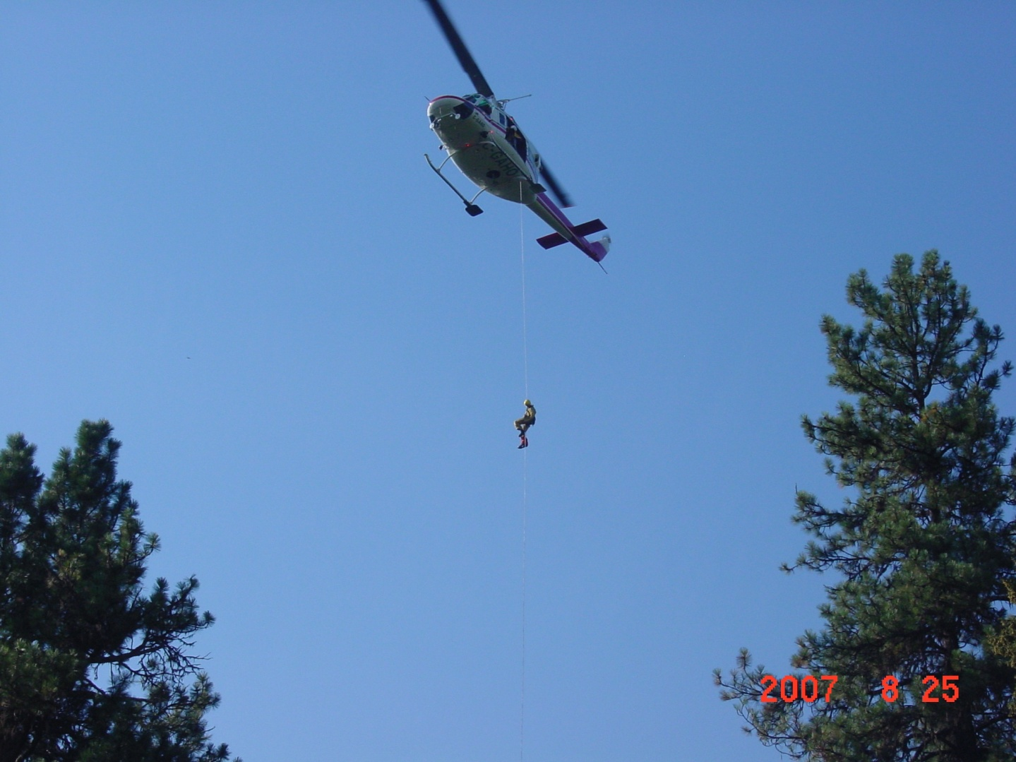
TYPES OF FIREFIGHTING RESOURCES SHARED
• AIRCRAFT
• OVERHEAD
• ENGINES
• CREWS
• EQUIPMENT

Slide 5
UNDER CANADIAN LAW, THE MEMBER PROVINCES WERE FREE TO JOIN THE COMPACT. IN THE UNITED STATES A CHANGE IN FEDERAL LAW WAS REQUIRED. PASSED BY THE 105TH CONGRESS, PUBLIC LAW 105-377 GRANTED APPROVAL TO THE STATES TO ENTER INTO THE INTERSTATE AND INTERNATIONAL AGREEMENT. “The Northwest Wildland Fire Protection Agreement” was established in 1998 “

Slide 6
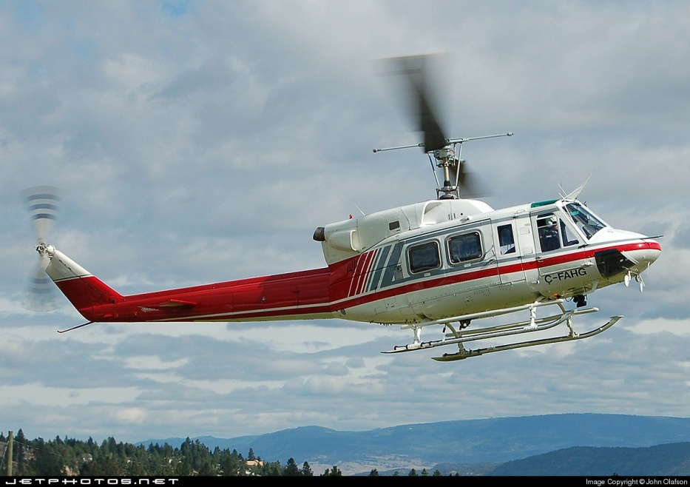
KEY POINTS
THIS COMPACT PROVIDES
FLEXIBILITY IN EXCHANGING FIREFIGHTING RESOURCES EXCLUSIVE OF CANADIAN AND U.S FEDERAL MOBILIZATION SYSTEMS.
• CROSS-BORDER INITIAL ATTACK BETWEEN MEMBER AGENCIES IS FACILITATED THROUGH THE COMPACT.
• MEMBERS ONLY PROVIDE RESOURCES TO THE EXTENT THAT IT DOES NOT JEOPARDIZE FIREFIGHTING READINESS AT HOME
Notes:
Forty-eight hours recall notice for personnel will be given from the Sending Agency wherever possible, and the Ordering Agency will make every effort to meet the 48 hour notice.
Equipment, aircraft and supplies will be returned to the Sending Agency as expeditiously as possible or as negotiated.

Slide 7
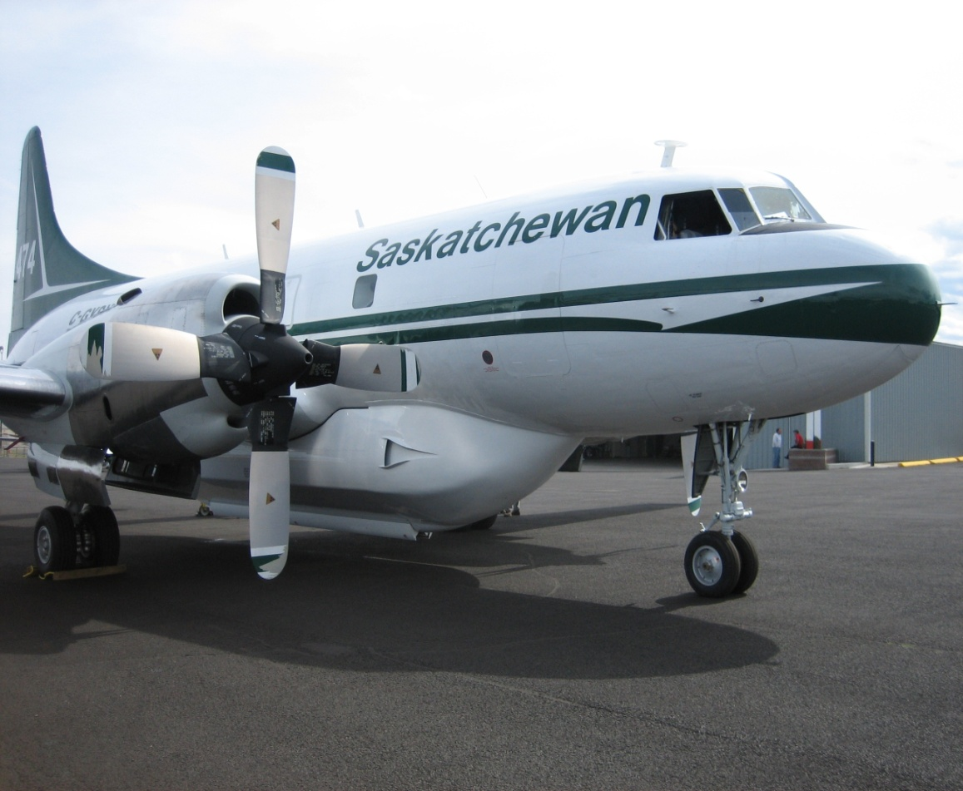
KEY POINTS
• MEMBER AGENCIES WILL ACCEPT THE STANDARDS ESTABLISHED BY THE SENDING ORGANIZATION.

Slide 8
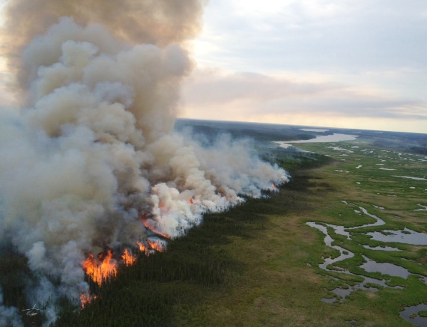
2012 NWFC resource exchanges
Notes:
SK, AB and BC also provided air resources to the USFS.

Slide 9
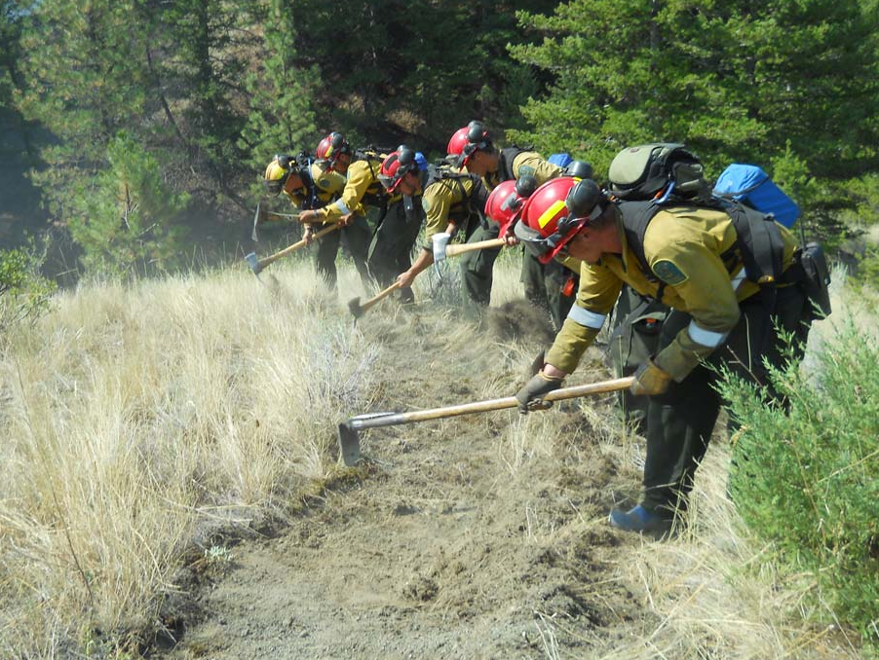
2012 Resource exchanges
Saskatchewan to Montana
CV580A double air tanker group
British Columbia to Yukon
41 personnel and L-188 air group
Oregon to Idaho
2 Fire investigators
Alaska to Alberta
2 helicopters groups
British Columbia to Alaska
3 personnel (instructors)
Washington to Idaho
Strike Team and Engine
British Columbia to Idaho
CV580 single air tanker group
Alberta to Montana
CV580 single air tanker group and 3 helicopter groups, Type 1 crews
Notes:
SK/AB tanker groups to MT (233 days, 147 dispatches, 122 incidents)
Numerous Alaska resource movements into lower 48 via NICC and ROSS.
AB – 2 heli-attack and 1 rappel unit to MT (103 days, 34 dispatches, 25 incidents)

Slide 10
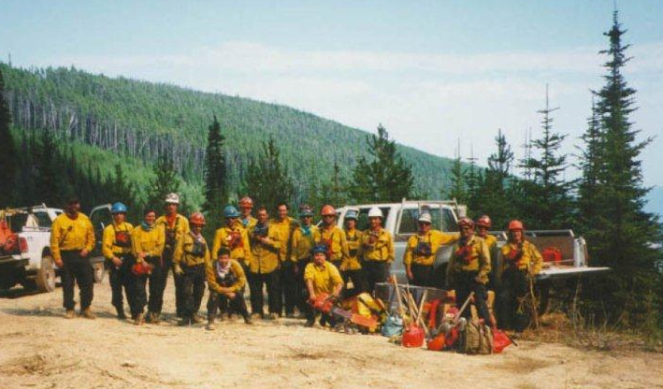
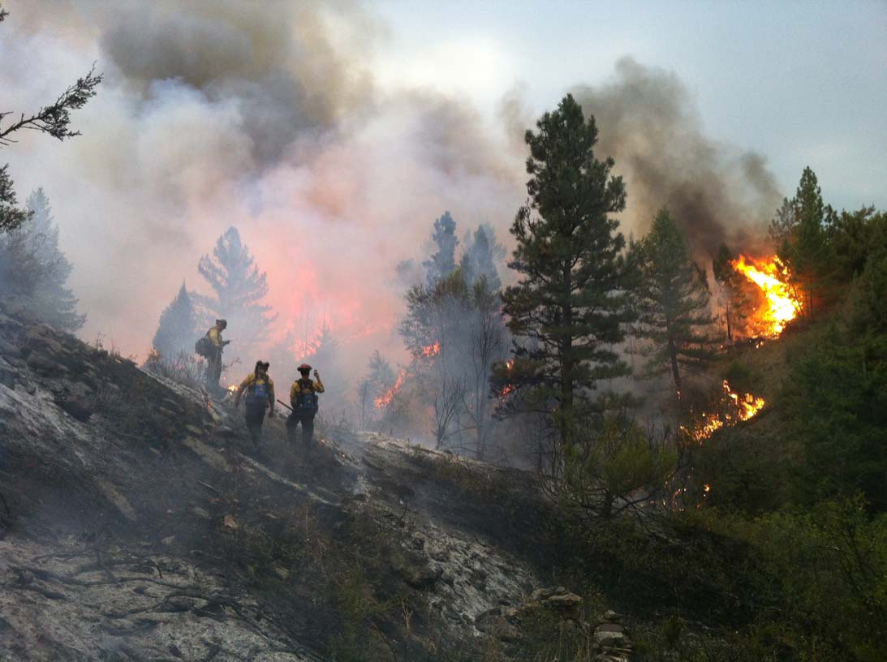
2012 Resource exchanges
Idaho to Montana
1 Helicopter group, Aviation Coordinator
British Columbia to Washington
103 personnel and 8 “Splash and Dash”
Alaska to Northwest Territories
30 personnel
Yukon to British Columbia
10 personnel and 4 “Splash and Dash”
Montana to Idaho
2 Wildfire trainers
Saskatchewan to Idaho
– 21 personnel
Alaska to Yukon Territory
2 “Splash and Dash”
Yukon to Washington
4 personnel
Alberta to Alaska
2 helicopter groups
Notes:
BC - 4 unit crews and overhead personnel to Washington
“Splash and Dash” pre-approval arrangements
ID Aviation Coordinator to MO to manage AB and SK aircraft

Slide 11
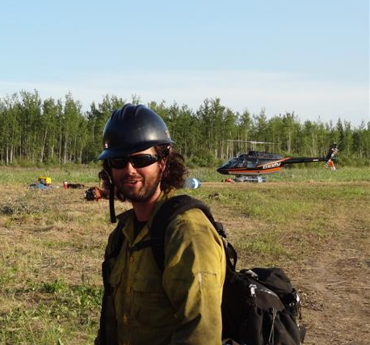
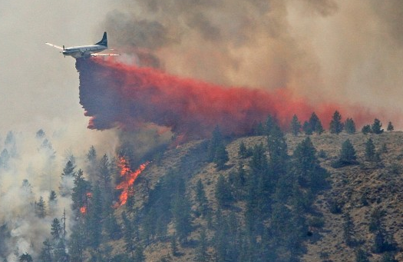
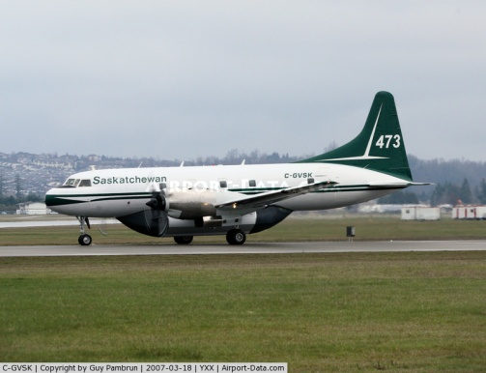
2012 Resource exchanges
Alberta to British Columbia
Personal (non-suppression exchange)
Oregon to Washington
Strike team engine and DC7 air tanker
Alberta to Yukon
35 personnel
Notes:
BC - 4 unit crews and overhead personnel to Washington
“Splash and Dash” pre-approval arrangements
ID Aviation Coordinator to MO to manage AB and SK aircraft

Slide 12
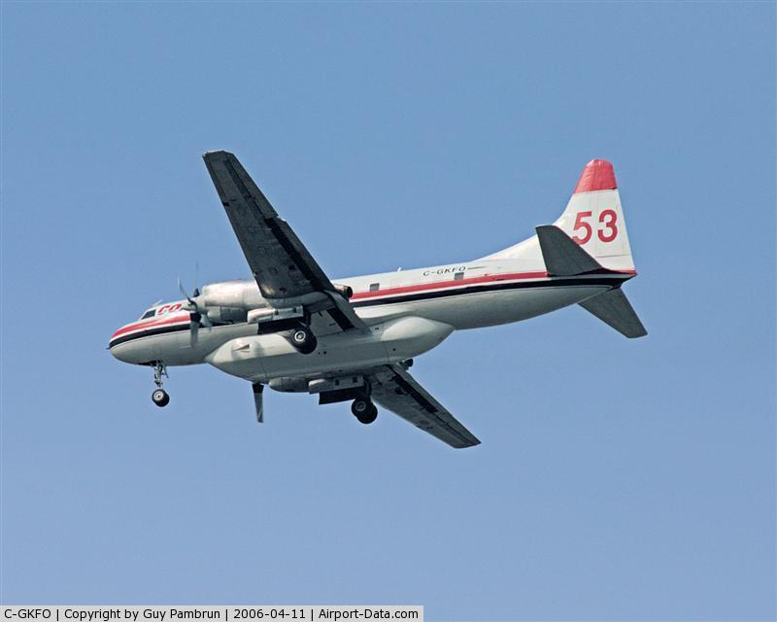
Successes & Best Practices
Use of assigned agency representatives (from both agencies)
Flexibility at all phases of agency interactions
Pre-planning (Border crossing, standard resource request forms, etc.)
Multi-agency resource coordination to address demands
Geographic variability of wildfire season hazards allows for greater resource exchange opportunities

Slide 13
QUESTIONS

Slide 14
THANKS !!

