Slide 1
National Weather Service Products and Services
Jenn Kitsmiller

Slide 2
Decision Support What is it?
Focusing on the impacts
Instead of just telling people the weather, focus on what that weather will mean
Take time to understand the impacts different groups have in regards to the weather
Very applicable to the fire weather community
Have been doing this for a while for fire weather

Slide 3
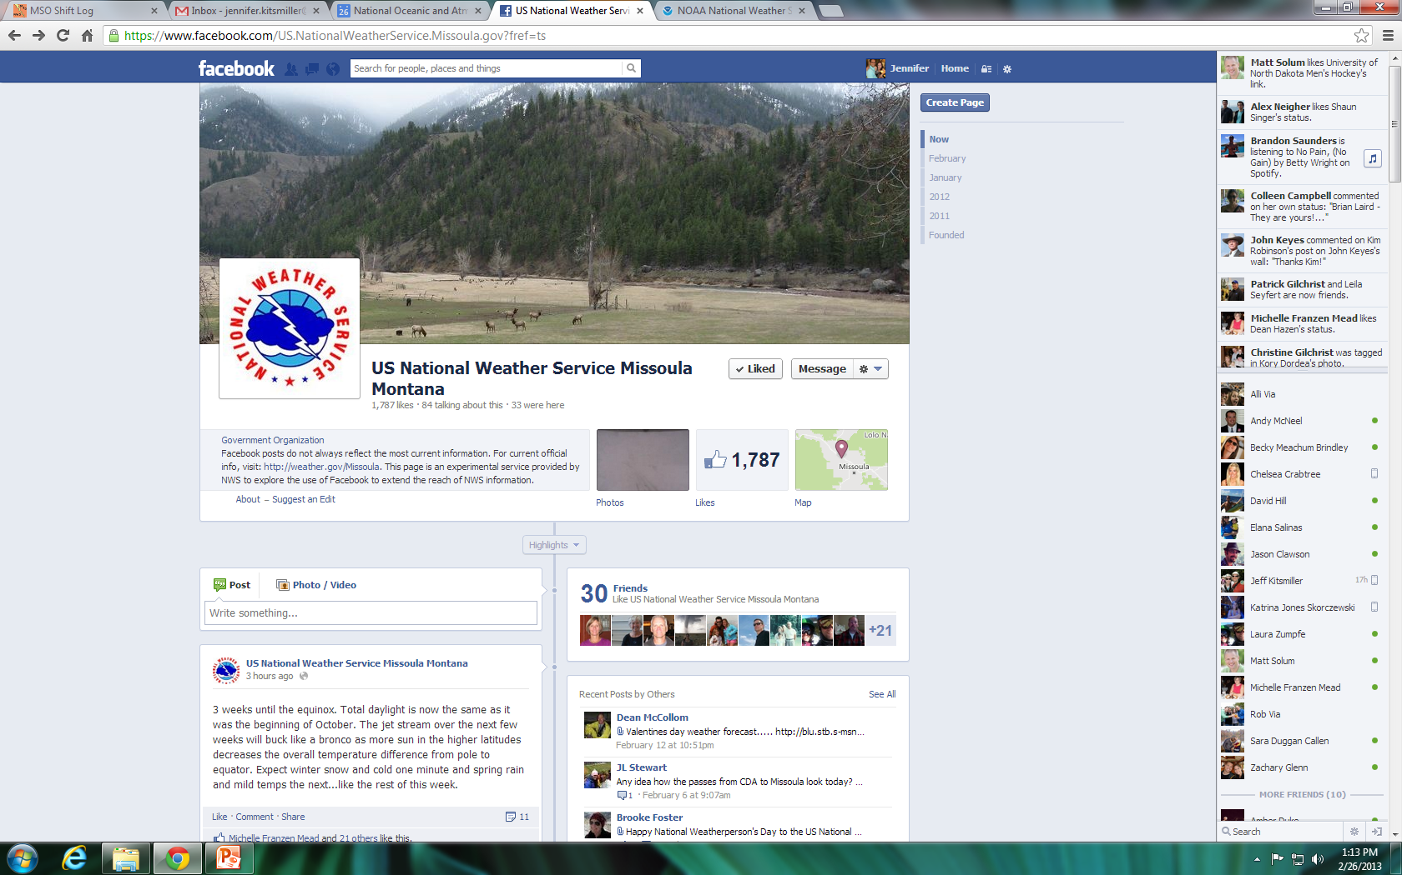
Use of Social Media Facebook
Facebook
US National Weather Service Missoula Montana (Like our page!!!)
Longer Term Weather Info
May discuss our confidence in long term changes
Geared to the public
Open line of communication (as long as the question isn’t urgent!)

Slide 4
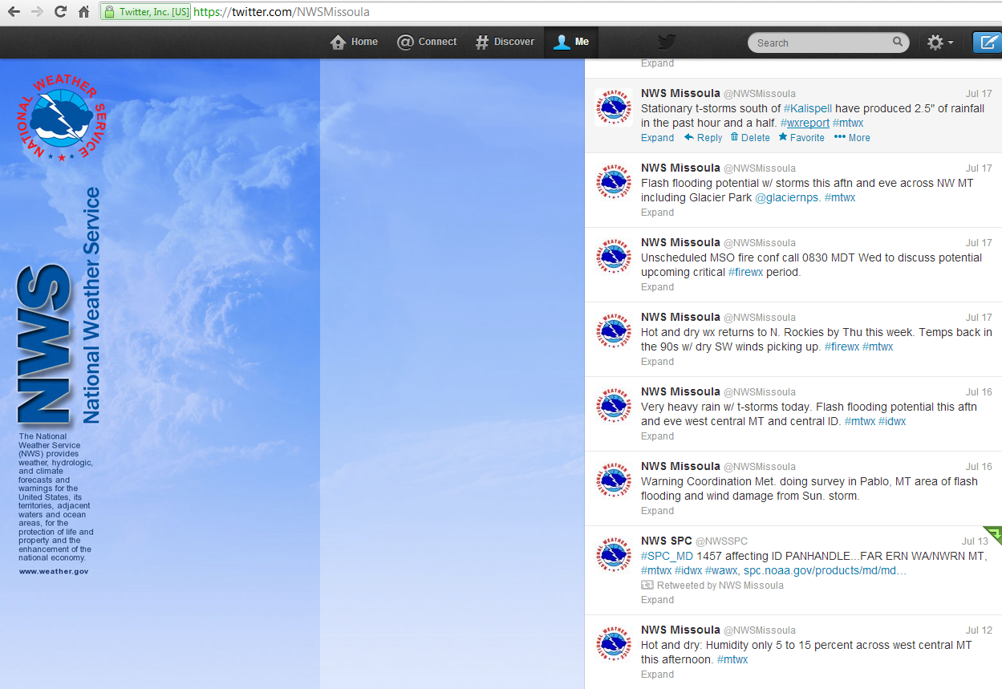
Use of Social Media Twitter
Twitter
@NWSMissoula
Used for short term weather information (next 24 hours)
Developing thunderstorms, winds, low RHs, may include red flag warning info
Quick bits of information

Slide 5
Weather Stories
Meant to be a one stop shop for weather info
Often use maps to highlight particular areas of concern
Graphics depict the main upcoming impacts
Not issued every day/ only as necessary

Slide 6
Recorded Briefings
Upcoming fire weather concerns
Address level of confidence in weather systems and potential results (impacts)
Provide simple graphics to help highlight any potential areas of concern
Done by Missoula every Monday/Thursday, daily once conditions become critical for fire weather
Most all offices in the Northern Rockies provide a briefing
Fire Wx Briefing Link Appears Here

Slide 7
What Makes a Good Spot Forecast?
Observations (good obs!)
Give detail (to avoid confusion, let us know in the remarks the times you need)
Communication (give us a call if you have any questions and we will do the same!)

Slide 8
What Can We Do for You?
Don’t be shy, give us a call anytime!
Any questions?

