Slide 1
Northern Rockies Dispatcher Workshop ****************************************** “The ftp.nifc.gov site”
Anne Rys-Sikora
aryssikora@fs.fed.us
406-329-1005
March 2012

Slide 2
Northern Rockies GACC Instructions for posting documents to the ftp.nifc.gov ftp site
All Northern Rockies data for the 2012 fire season will be filed underneath: ftp://ftp.nifc.gov/Incident_Specific_Data/N_ROCKIES
ftp = File Transfer Protocol
the protocol for exchanging files over the Internet. FTP works in the same way as HTTP for transferring Web pages from a server to a user's browser and SMTP for transferring electronic mail across the Internet in that, like these technologies, FTP uses the Internet's TCP/IP protocols to enable data transfer.

Slide 3
Two levels of Security
Incident_Specific_Data
GACC_Support
ftp is an older technology circa 1990
Still used today to meet the interagency needs of transferring larger files efficiently.

Slide 4
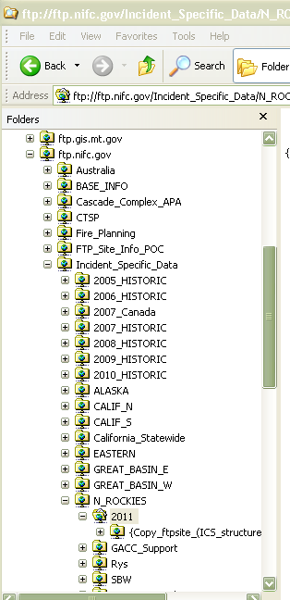
Incident Specific Data & GACC Support
Data on the ftp site is accessible for everyone to view, read or download without a password for all folders below Incident Specific Data.
Except for the GACC_Support folder
which is intended specifically for secure information such as IAPs or Contracts.
Except for the GACC_Support folder
To view, download or copy data from the GACC_Support a password is needed.
It’s a ‘blind folder’.

Slide 5
Put vs. Get
A Password is needed to put data on the ftp site.
A Password is not needed to get data from the ftp site.
Except for the GACC_Support folder
It will be blind without a password
Once data is put on the site it cannot be deleted except by the system manager (WO Personnel).

Slide 6
To put non-secure data
On any folder except GACC_Support
Use the Username: nrgaccadm!n and its password
It is case sensitive
Non-Secure data includes
Whole ICS structure included.
GIS data or Maps.
Any Non-Personal information.

Slide 7
To put secure data
All secure data goes in the GACC_Support folder
Use the Username: secsupport and its password
It is case sensitive
Secure data includes
IAPs or Contracts

Slide 8
Help is available
The ftp.nifc.gov site is supported by:
NIFC HelpDesk
1-800-253-5559 or 208-387-5290
Local NR Help
Anne Rys-Sikora 329-1005 or 370-3378
Tyler Hackney 329-4935 or 544-0371
The Site Does Work given proper baud width

Slide 9
How ftp works
Who ever is first to work on an incident must take the initiative to create a folder in the ../N_ROCKIES/2012 folder
Copy the templet folder to your C:/drive, rename it the new fire name, then copy it back.
Templet folder: Copy_ftpsite_(ICS_structure)_put_your_fire_name_here}
The rules of ‘ftp land’ are that you cannot copy and paste within an ftp site.
Whoever creates the new folders must copy the templet from the ftp site to their local C:/drive re-name it and then copy it back to ftp site.
Finally, delete the folder from your C:/drive.

Slide 10
How ftp works
The Same -copy back and forth- of the templet folder logic holds true for the GACC_Support folder
Name the new folder the fire name.
You are free to make many folders within your new folder.
When posting anything to the ftp site, be sure to include the fire name the subject and the date. i.e. AlderFire_IAPMAP_072212.doc
Include Metdata in the name.

Slide 11
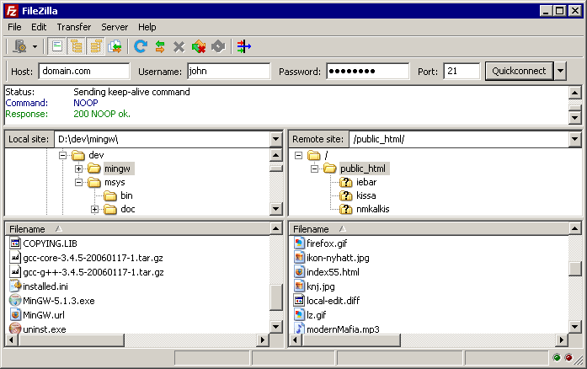
Why FileZilla
FileZilla is free, open source, cross-platform FTP software, consisting of FileZilla Client and FileZilla Server.

Slide 12
How FileZilla works
For Northern Rockies IMTs FileZilla will be loaded on Team Laptops.
FileZilla is an easy to use (freeware) utility to transfer data to an FTP site.
You may use FileZilla to post the Daily Fire Perimeters, Incident Action Plans and other documents to the ftp.nifc.gov site.
Filezilla can be downloaded at: http://file-zilla.com/category/filezilla-ftp-software/
Google filezilla

Slide 13
How FileZilla works
It may be useful to watch a 10 min video on Youtube: http://www.youtube.com/watch?v=yr_u2iKfAt0
You must type (not copy/paste) the username and password.
You can log on using either the Quickconnect tool bar or set a logon in the Site Manger.

Slide 14
Live Demostration

