Slide 1
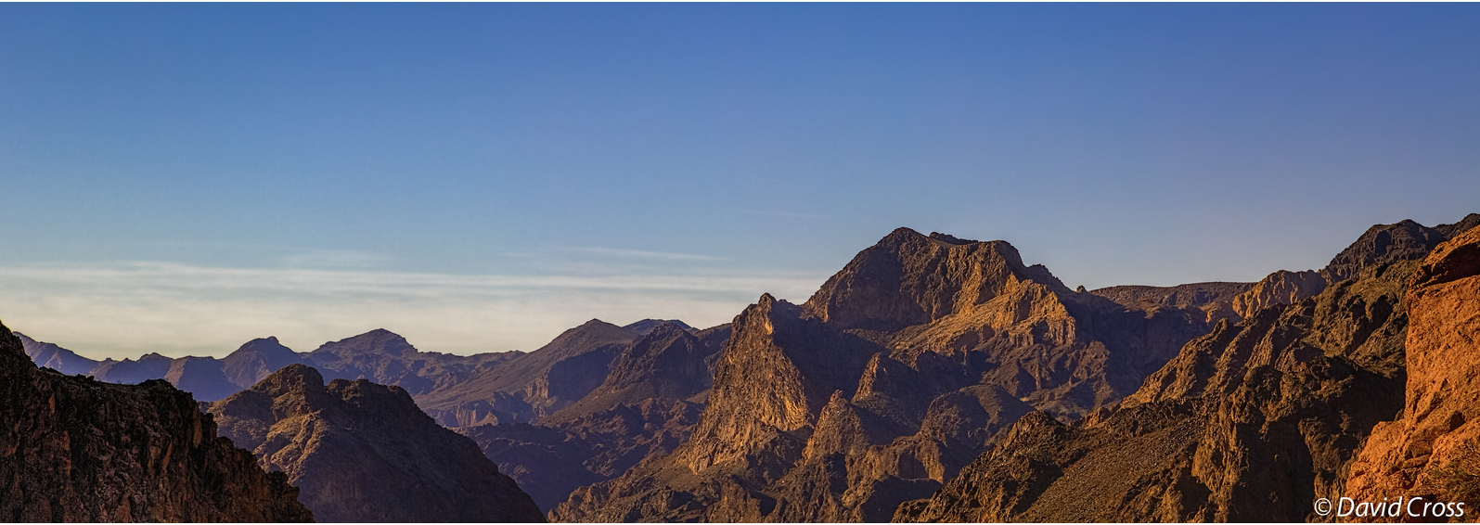

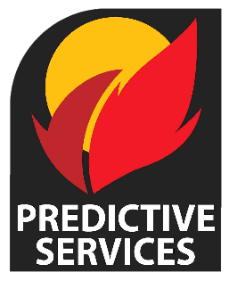
Great Basin
Seasonal Outlook
May – August 2024
Basil Newmerzhycky Shelby Law
Gina Palma

Slide 2
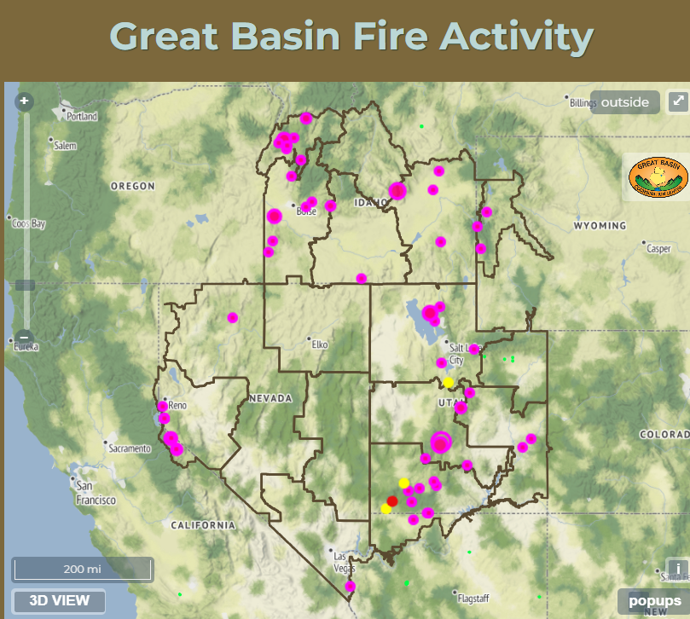
Still Lots of Prescribed Burning Around the Great Basin

Slide 3
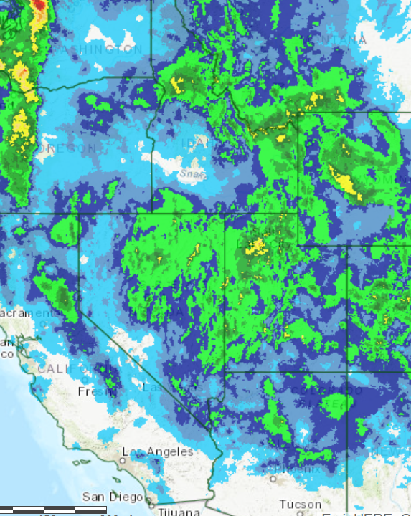
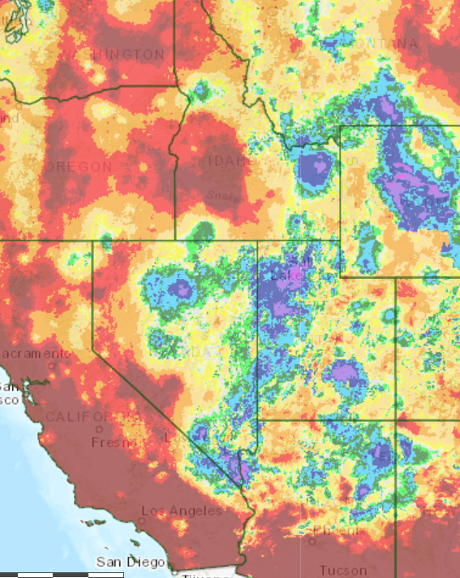


Precipitation: Past 7-14 days
Observed – Last Week of April
Percent of Normal – Last 2 Weeks of April

Slide 4
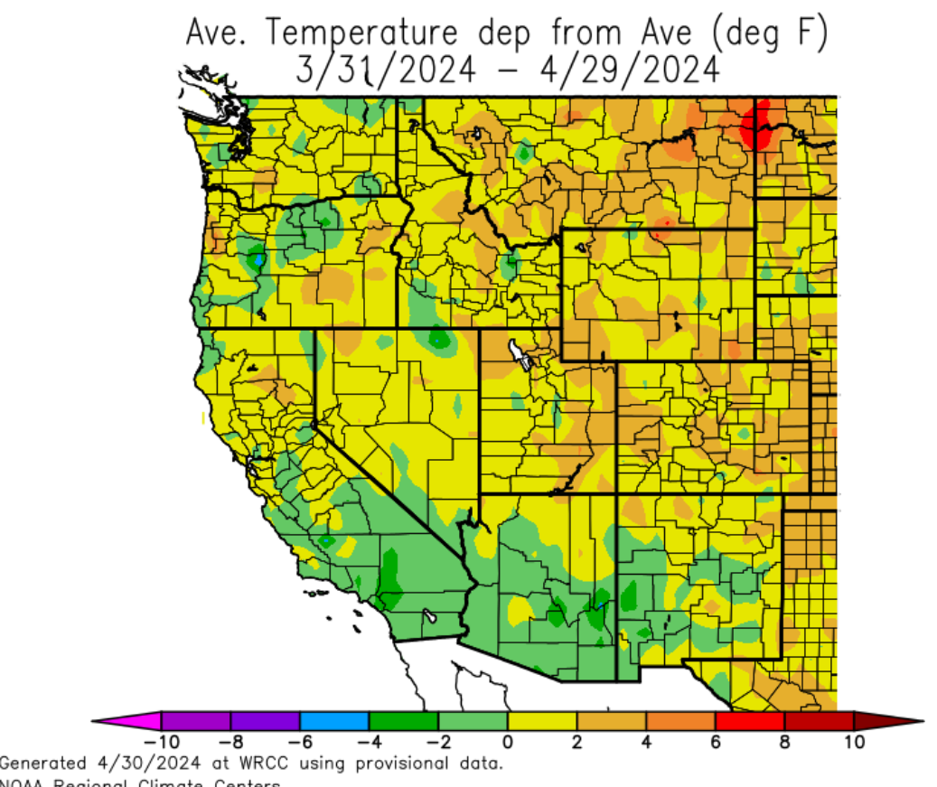
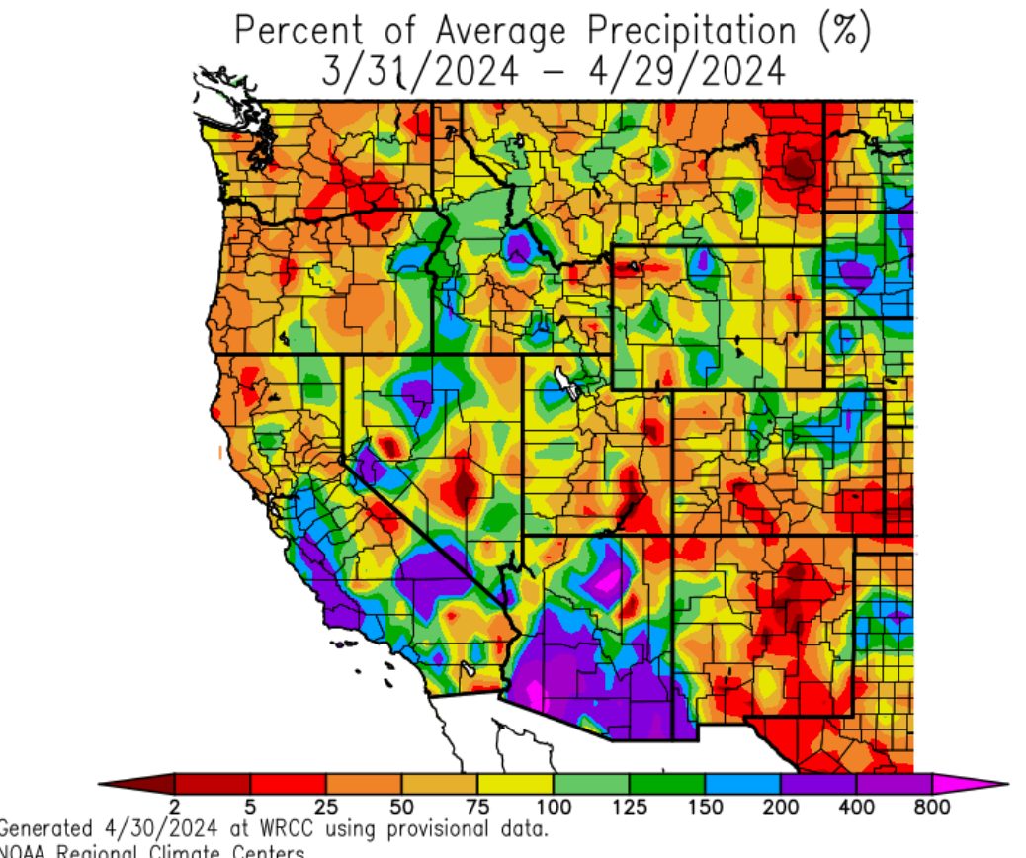
Temperature & Precipitation
Last 30 Days
Temperature
Precipitation

Slide 5
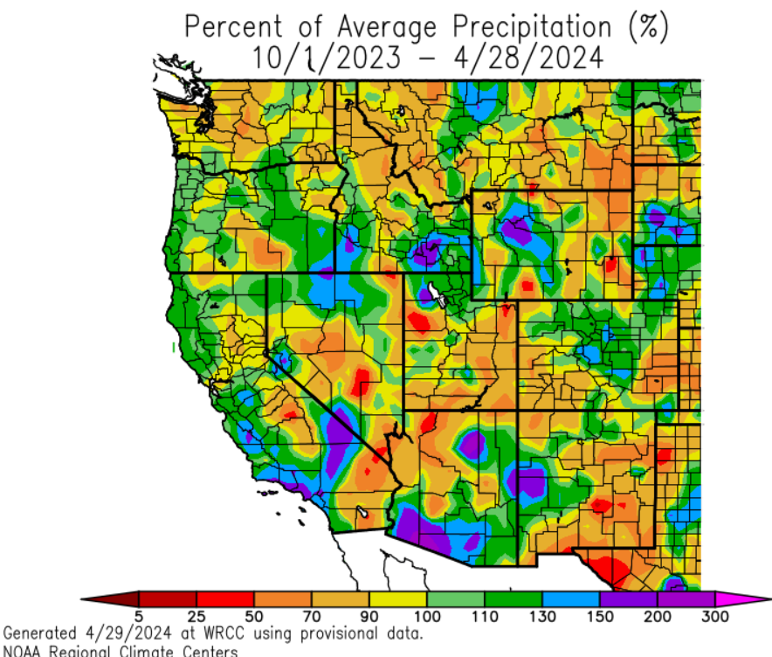
Precipitation: Since Oct 1, 2023

Slide 6
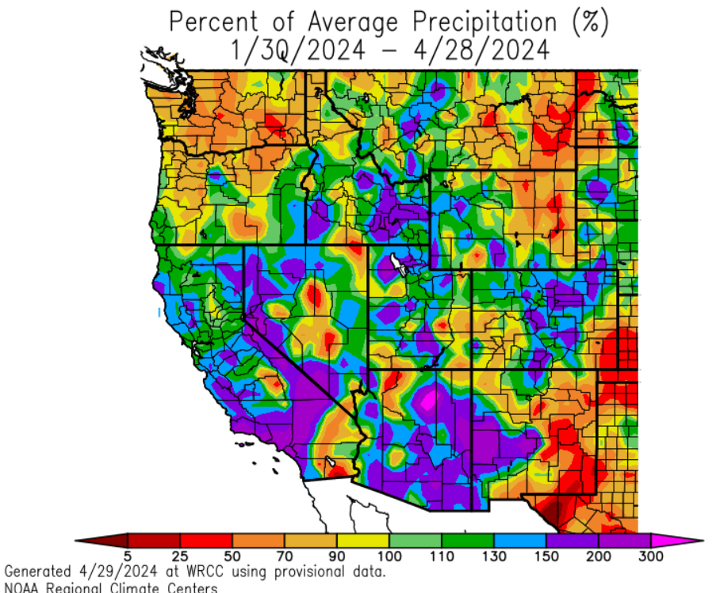
Precipitation: Since January 30, 2024

Slide 7
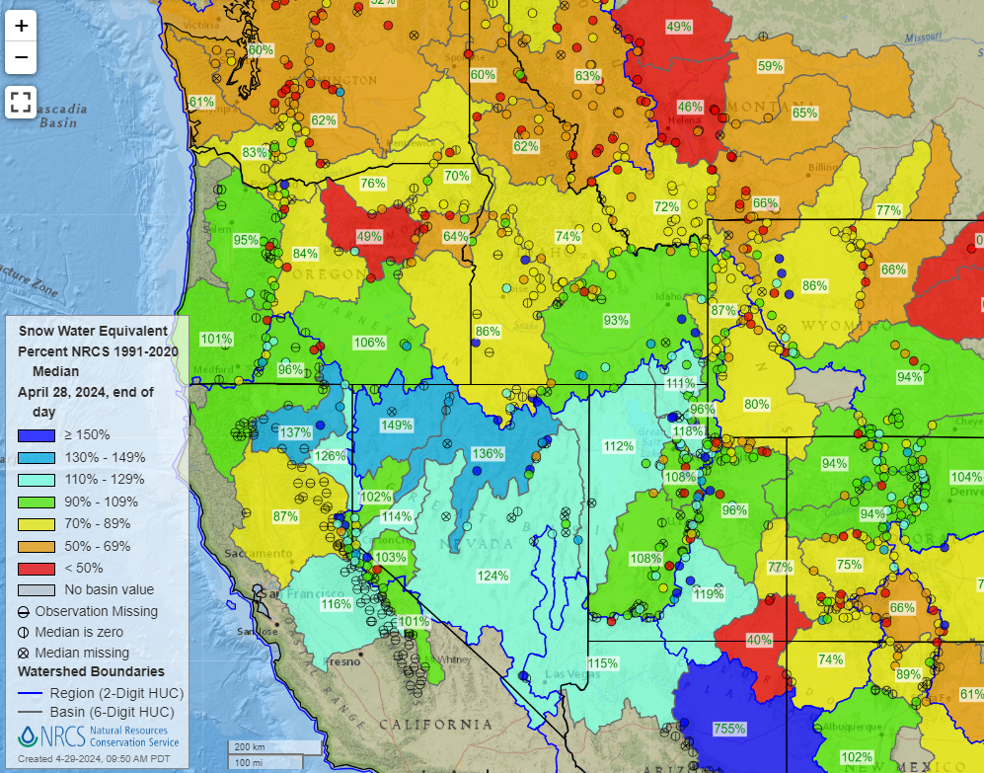
Current Snowpack

Slide 8
What about 2 winters ago?

Slide 9
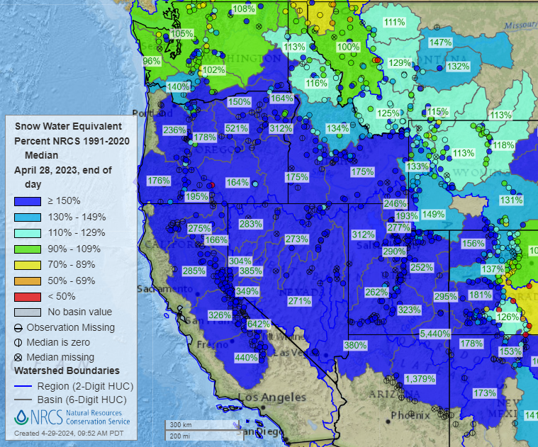
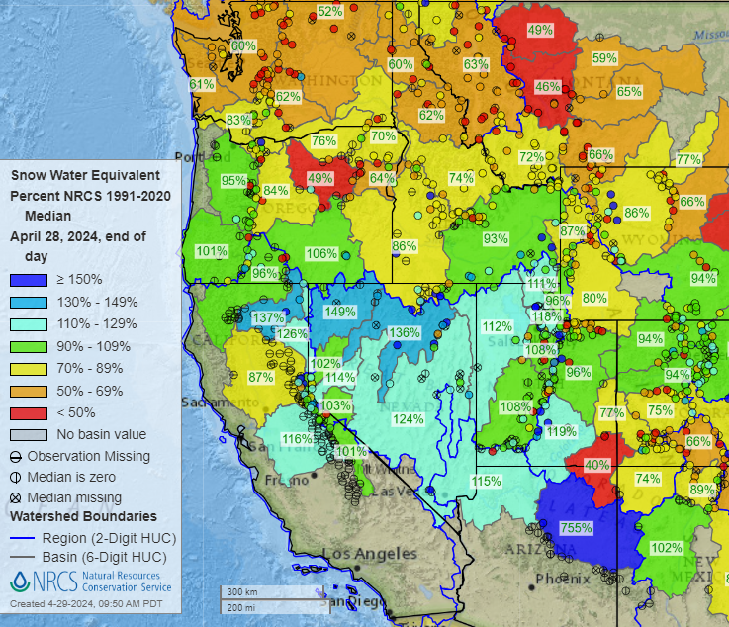
Very High Snowpack 2022/23 Followed by “Normal-Just Above Normal” Snowpack 2023/24
April 2024
April 2023
Notes:
2 years of high snow pack exists where it matters for nrn/ern/srn NV, srn ID, nrn/wrn UT
High snowpack in 2022/23 for most of GB, especially NV, UT, AZ
Normal to just above normal snowpack 2023/24 for NV/UT/AZ/srn ID
Winter/spring precipitation matters most for fine fuel growth in srn ID, northern and western NV, northwest UT

Slide 10
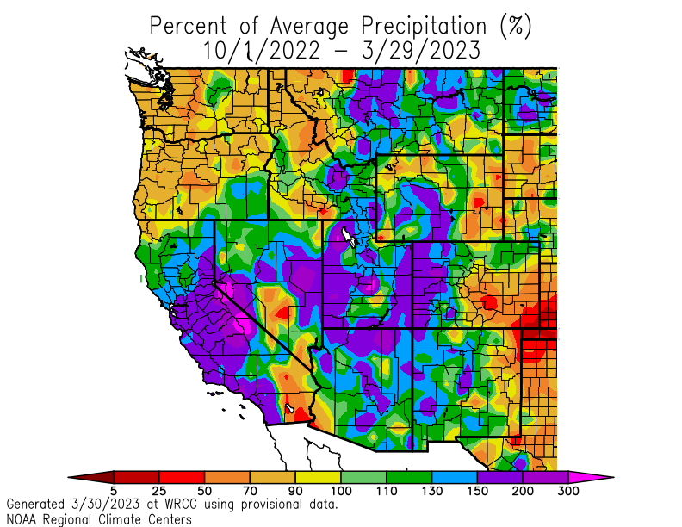
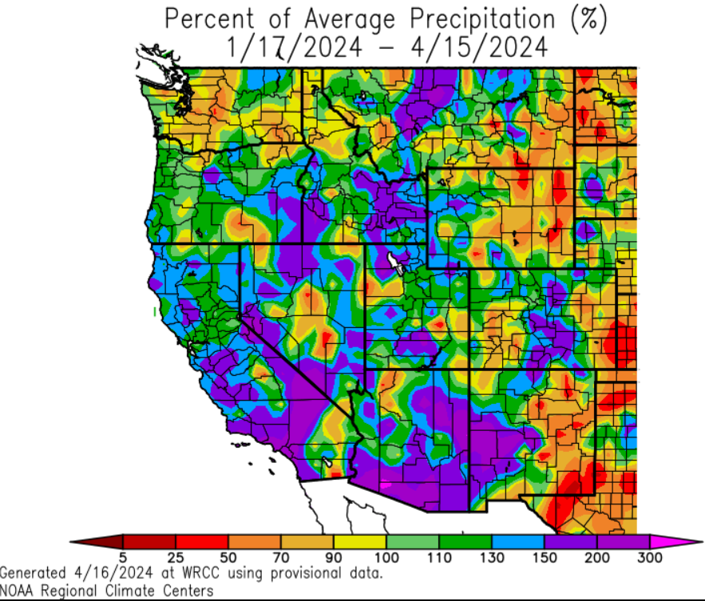
Wet Winter 2022/23 Followed by “Wet” Winter 2023/24
2023-2024
2022-2023
Notes:
2 wet winters back to back exist for parts of southern ID, nrn NV, nrn UT
Wet winter in 2022/23 for most of GB, especially NV, UT, AZ, eastern ID
Normal to just above normal winter 2023/24 for nrn NV/nrn UT/srn ID
Winter/spring precipitation matters most for fine fuel growth in srn ID, northern and western NV, northwest UT

Slide 11
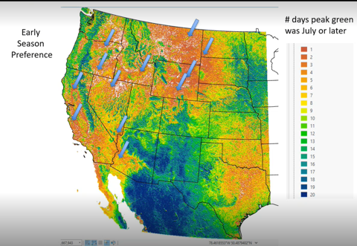

Precipitation for Fine Fuel Growth Western and Northern Great Basin
Where Winter/Spring Rains Matter
Where Precipitation Occurred in 2023-24 Winter/Spring

Slide 12
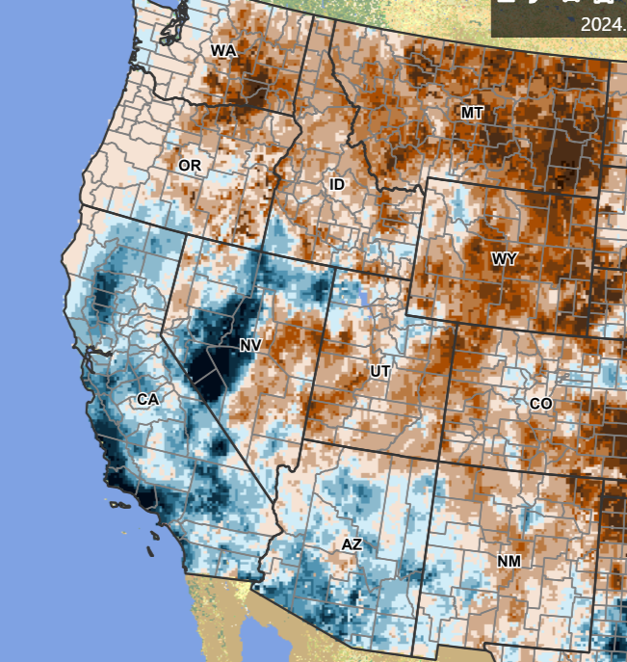
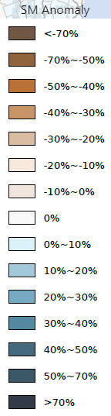
Soil Moisture – April 25th, 2024

Slide 13
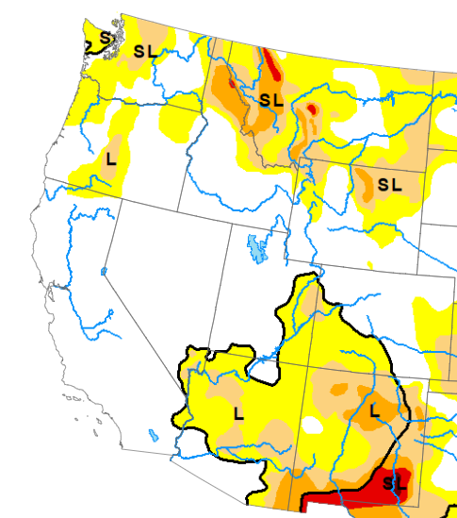
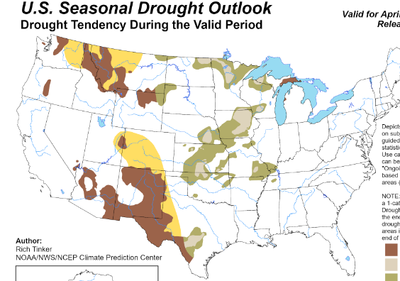
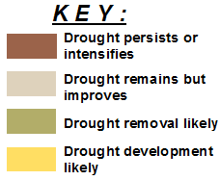
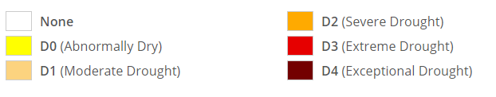
Drought Monitor and Outlook
Drought Monitor
Drought Outlook
April 23rd, 2024
April 18th – July 31st, 2024

Slide 14
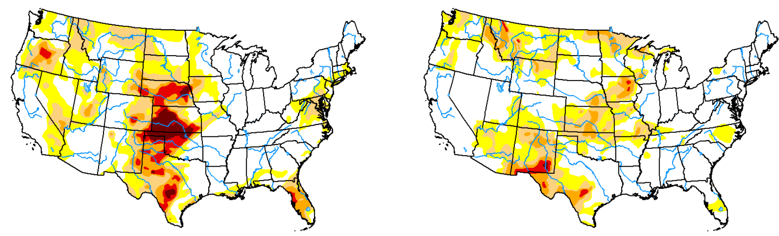
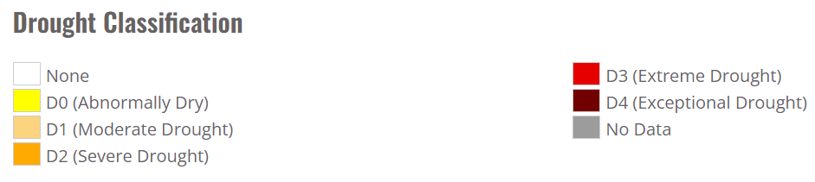
Drought Comparison 2024 vs 1 Year Ago
Drought Category improved by 1 to 2 “Levels” past 12 months
Late April 2023
Late April 2024

Slide 15
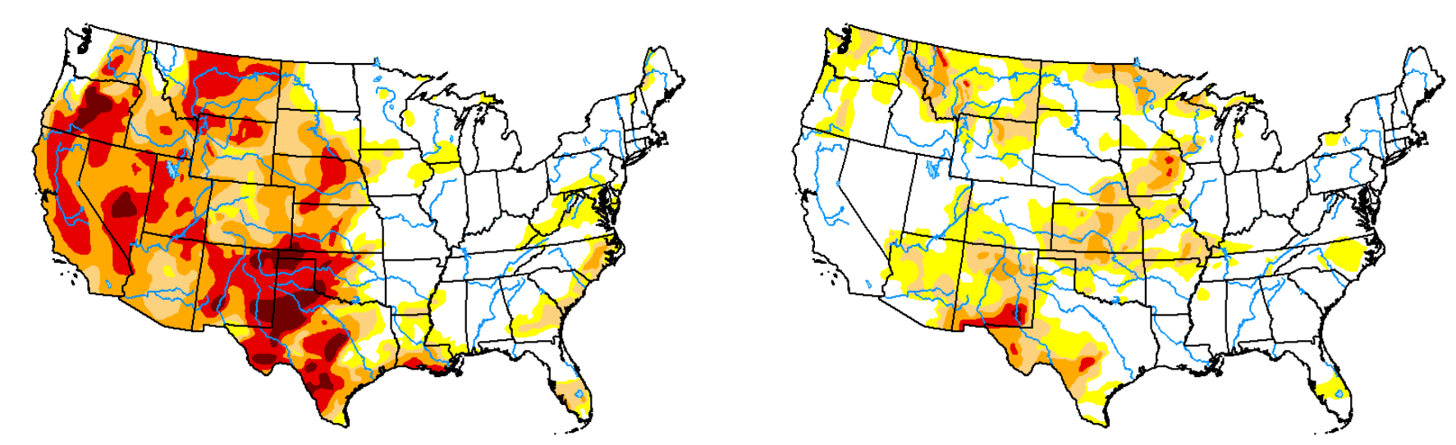
Drought Comparison 2024 vs 2 Year Ago
Drought Category improved by 3 to 4 “Levels” past 24 months
Late April 2022
Late April 2024

Slide 16
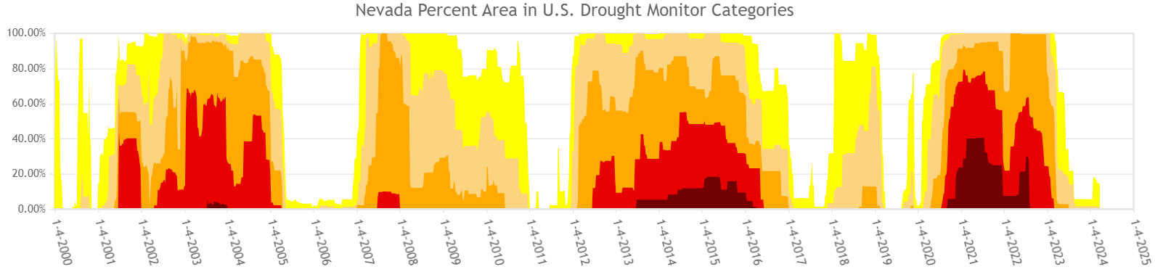
Nevada – Lower Elevations
2024
2020 was an ok year
Above median
2005 was only well above normal for Srn NV and Srn Ely
Season didn’t start until lightning bust in late September 2011

Slide 17

Nevada – Higher Elevations
Bigger Threat for Higher Elevation Fires in Drought Years
Black Box – Notable Forest Service / Higher Elevation Fires
Coming out of drought in 2024 would indicate a LOWER than normal likelihood of larger higher elevation fires.
Lost Cabin
2002
Slink
2020
Carpenter One
2013
Cherry
2019
Waterfall
2004
Caldor
Dixie
Tamarack
2021
Martis
2001
East Slide Rock Ridge
2008
Washington
2015
Notes:
Updated 4/2024

Slide 18
What areas are most at risk??

Slide 19
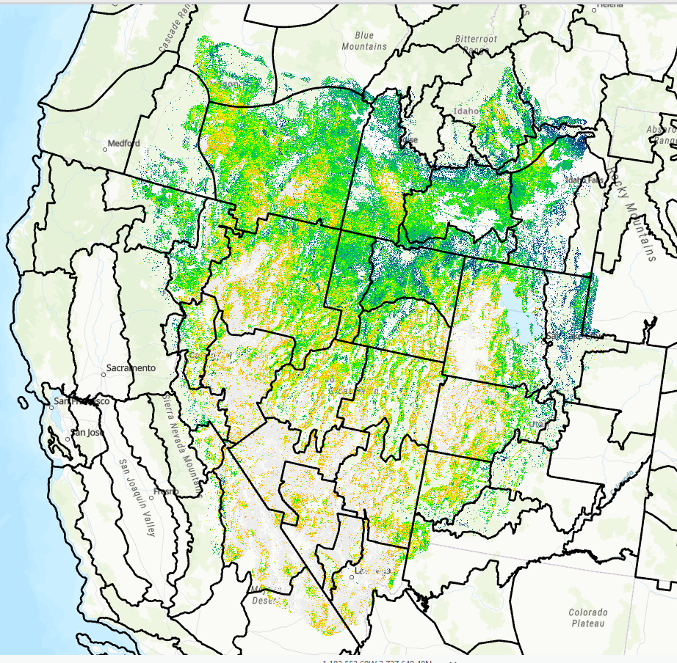
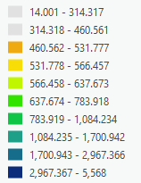
Fine Fuel Loading from 2023 - Carryover
2023
pounds per acre
Notes:
The north central spots of the Great Basin – northwest Nevada, Jarbidge, west Elko, Lahontan Basin, Upper Snake are the targets.

Slide 20
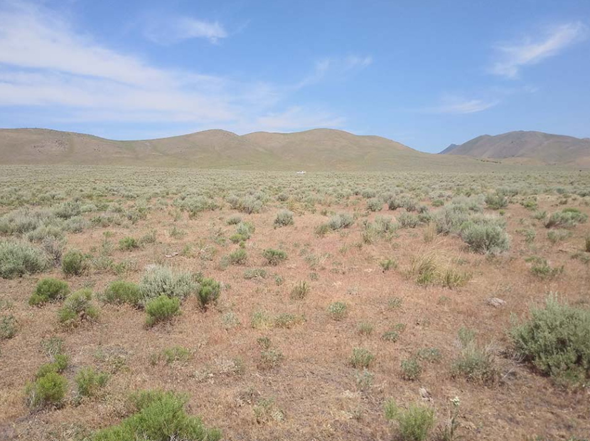
Fuels

Slide 21
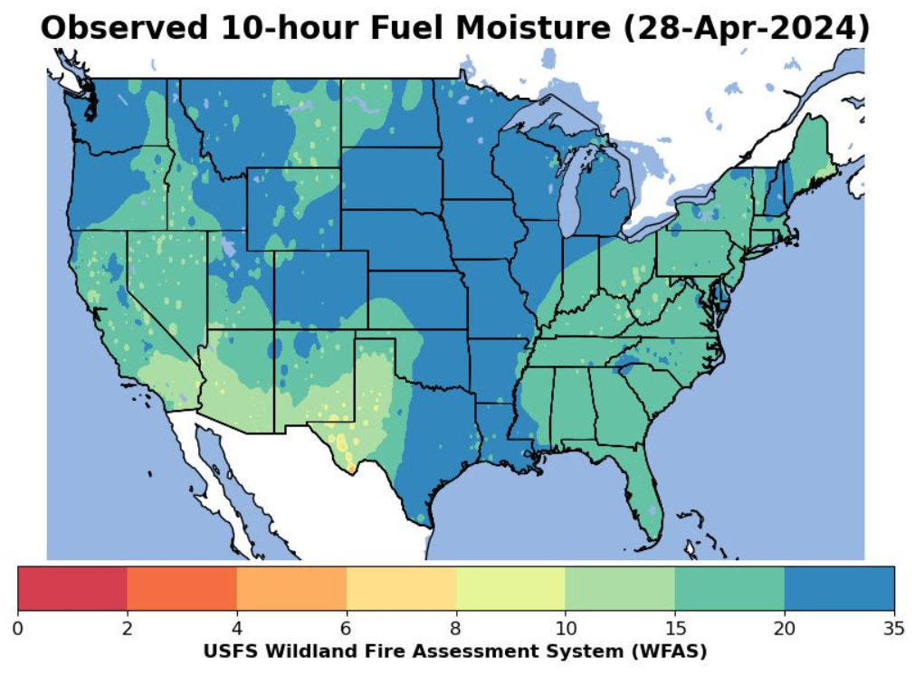
10 Hour Fuel Moisture

Slide 22
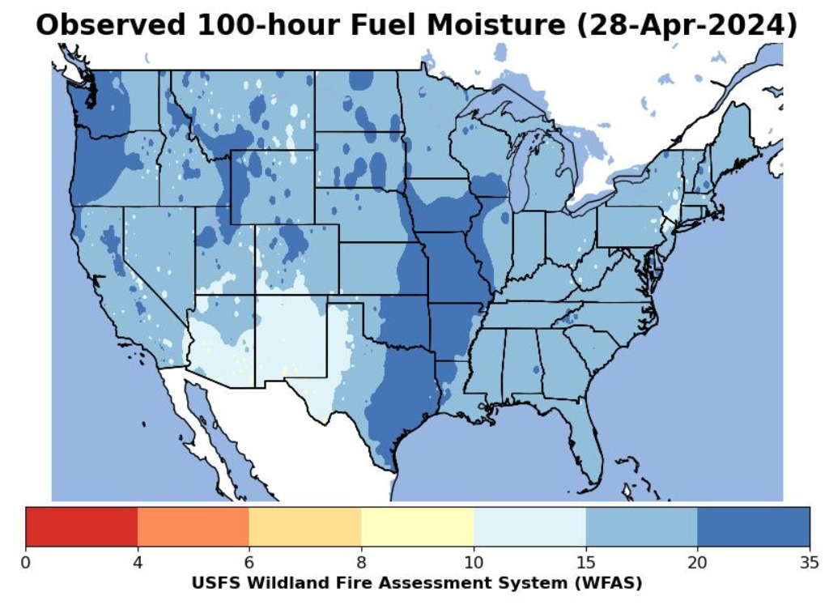
100 Hour Fuel Moisture

Slide 23
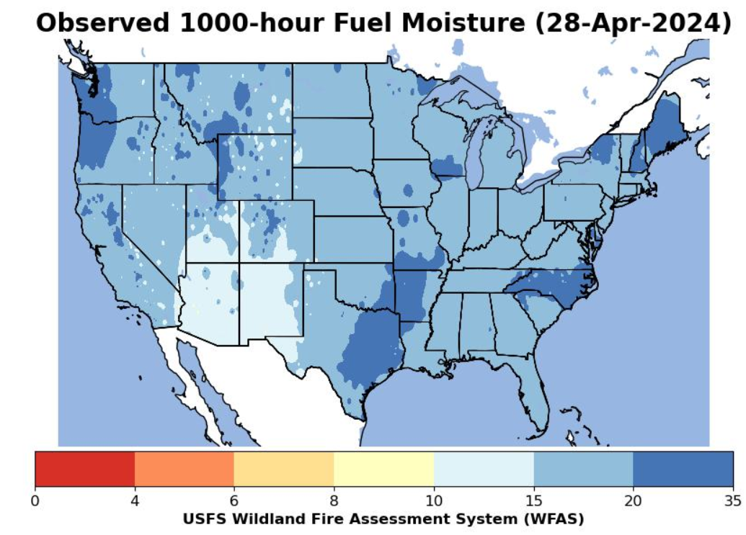
1000 Hour Fuel Moisture

Slide 24

Drought, Weather
Fuels, Snowpack:
What Happens
From Here?

Slide 25
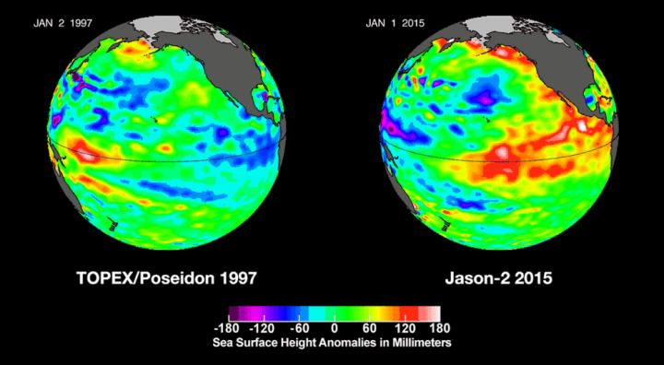
La Nina? El Nino? La Nada?
La Nina
El Nino

Slide 26
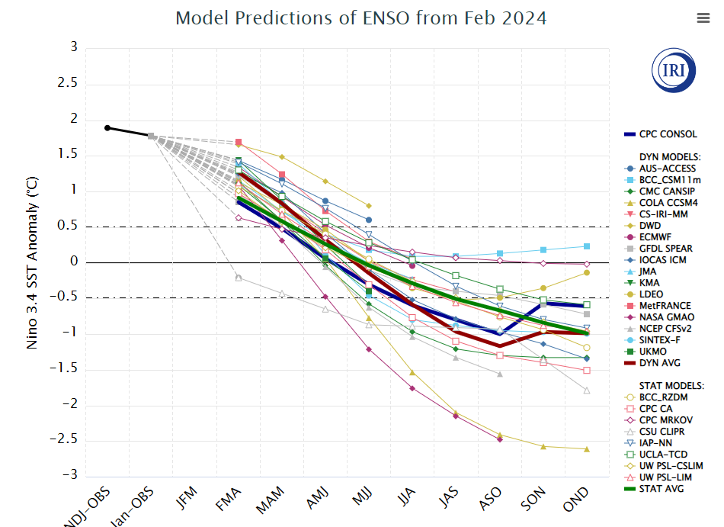
El Nino/Neutral/La Nina
Strong El Nino/La Nina
Moderate El Nino/La Nina
Weak El Nino/La Nina

Slide 27
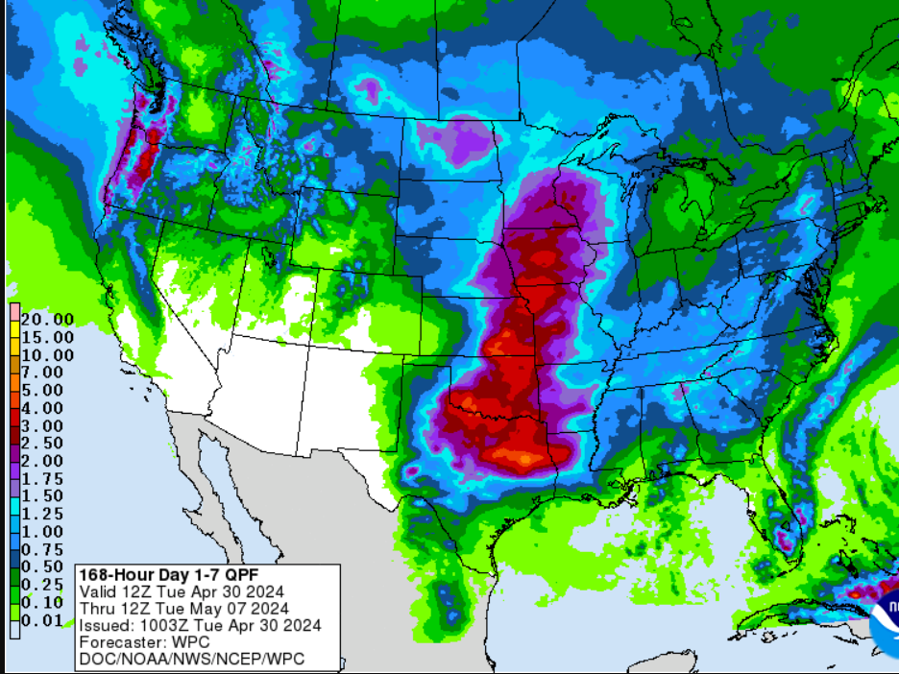
Upcoming Total Forecast Precipitation – April 30th – May 7th, 2024

Slide 28
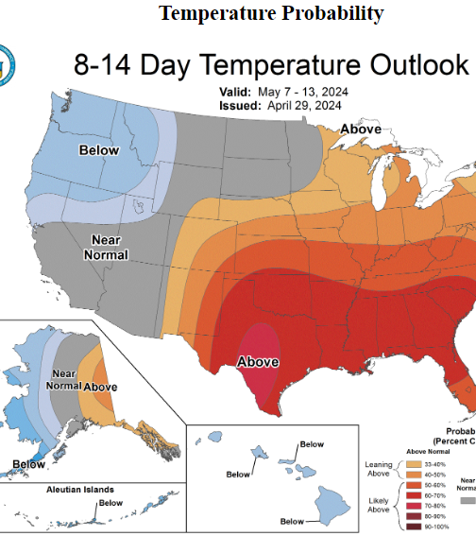
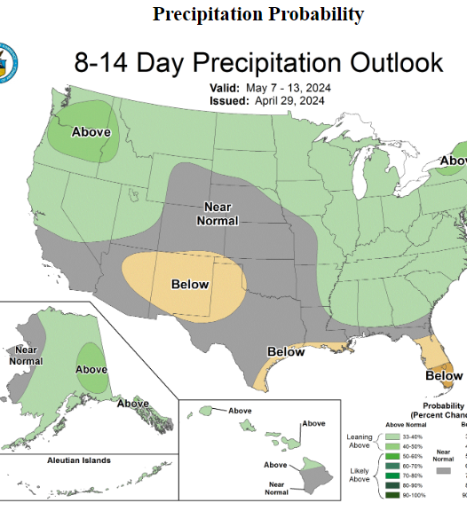
NOAA CPC 8-14 Day Outlook – May 7th – 13th, 2024
Temperature
Precipitation

Slide 29
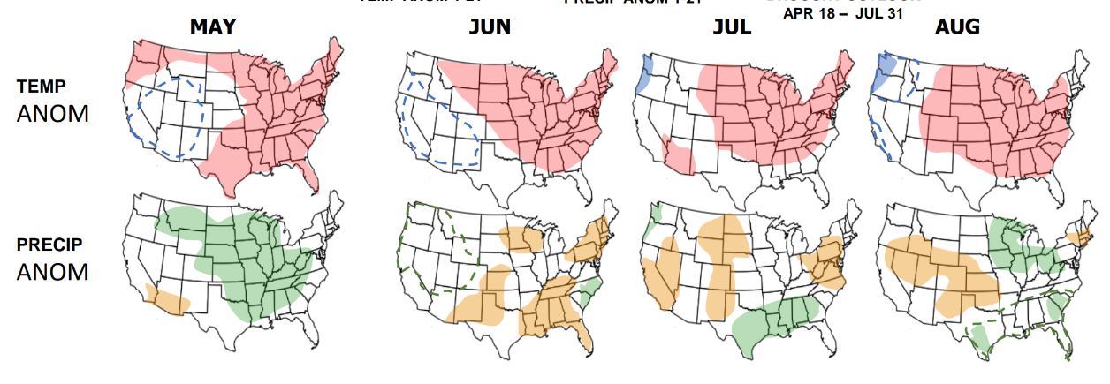
Predictive Services Outlook:
May – August 2024

Slide 30
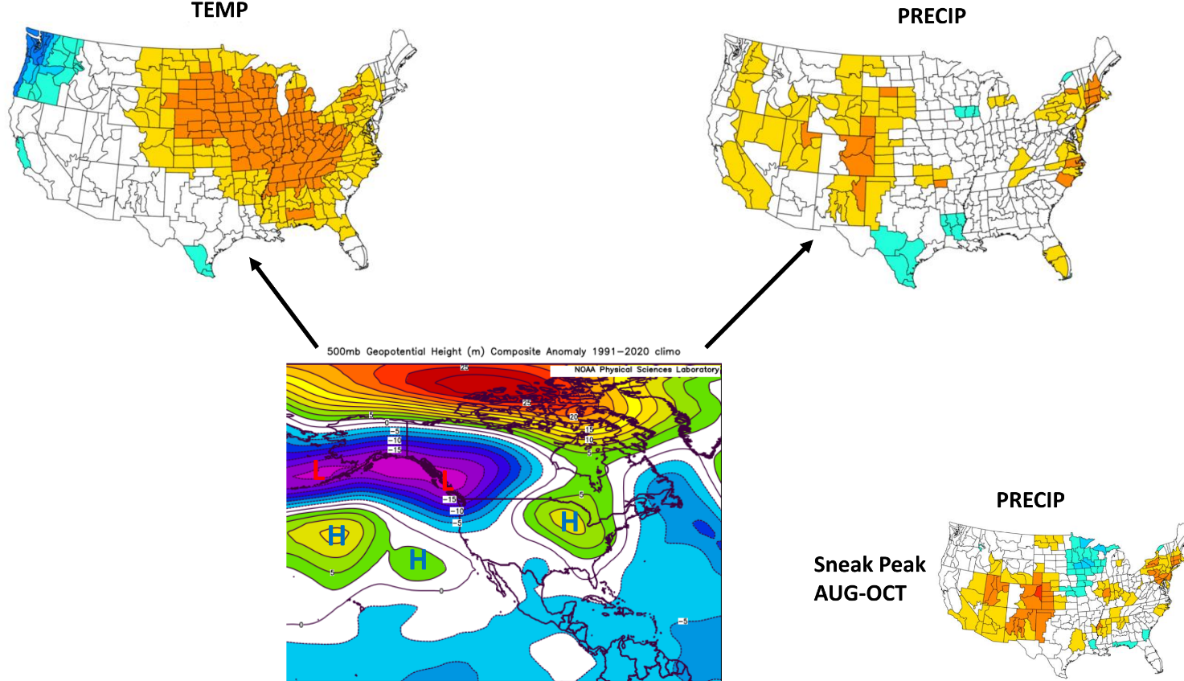
Predictive Services “Early” Monsoon Outlook:
July – August 2024

Slide 31

Putting the Pieces Together

Slide 32
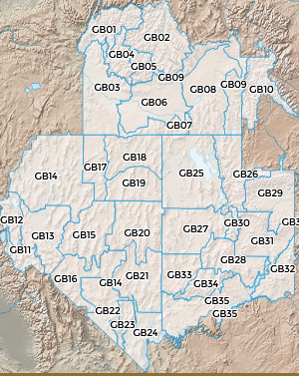
May 2024
Normal
Below Normal
Above Normal

Slide 33
June 2024
Normal
Below Normal
Above Normal

Slide 34
July 2024
Normal
Below Normal
Above Normal

Slide 35
August 2024
Normal
Below Normal
Above Normal

Slide 36
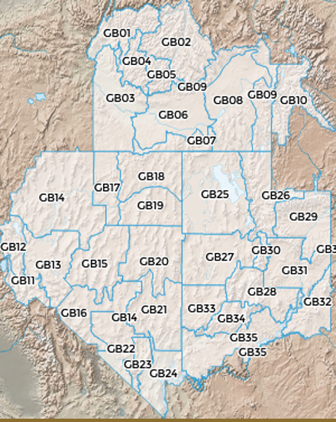
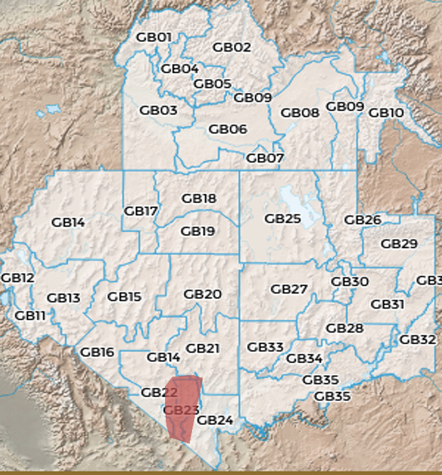
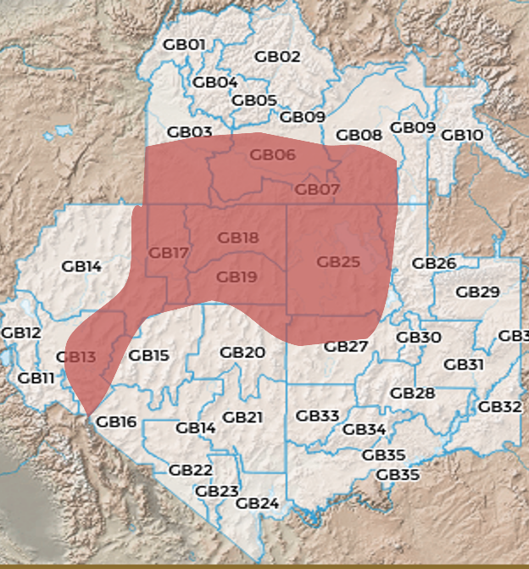
4-Month Outlook
Normal
May
June
Below Normal
Above Normal
July
August

Slide 37
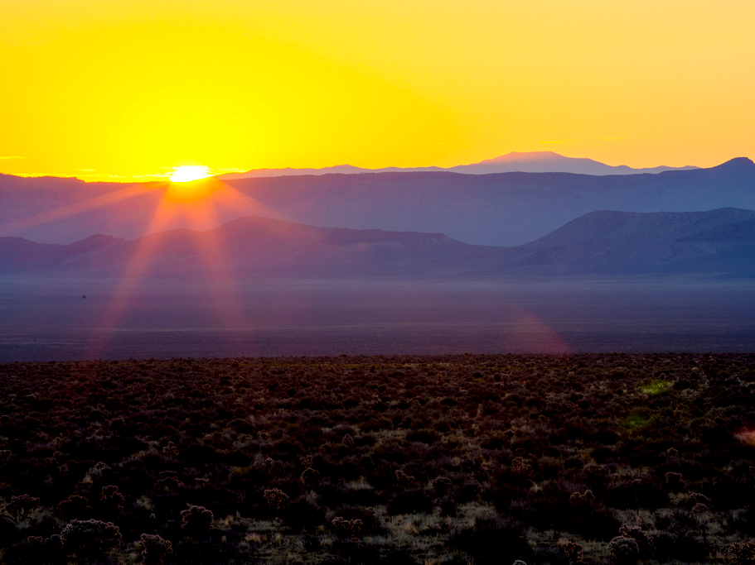

Questions?
Basil: bnewmerzhycky@blm.gov
Gina: gmcguire@blm.gov
Shelby: slaw@blm.gov
@GreatBasinCC

