Slide 1
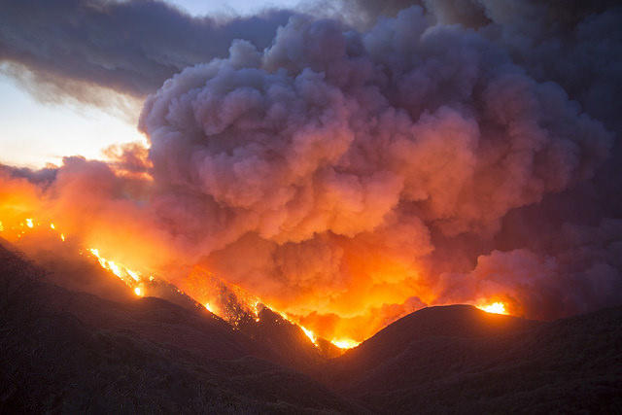
DAILY OUTLOOK Sunday July 8th, 2018

