Slide 1
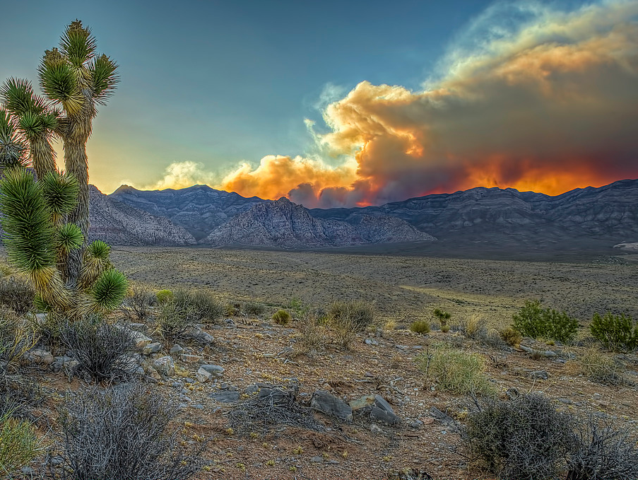
Great Basin Fire Potential Briefing (Date)
Basil Newmerzhycky Shelby Law
Nanette Hosenfeld Gina McGuire Palma

Slide 2
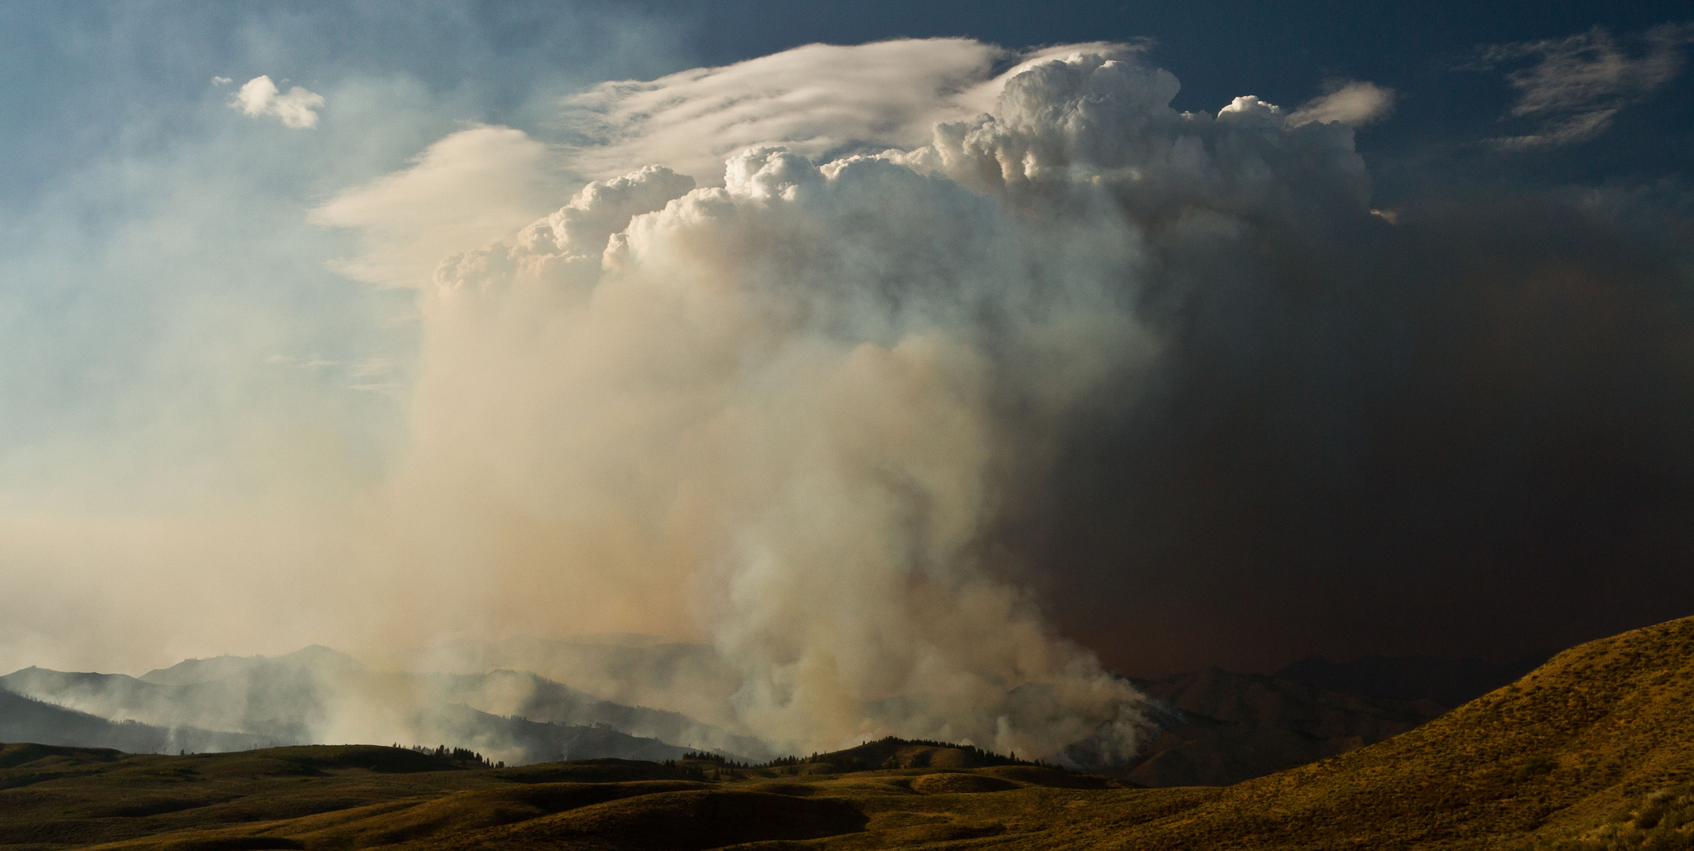
Great Basin Fire Potential Briefing (Date)
Basil Newmerzhycky Shelby Law
Nanette Hosenfeld Gina McGuire Palma

Slide 3
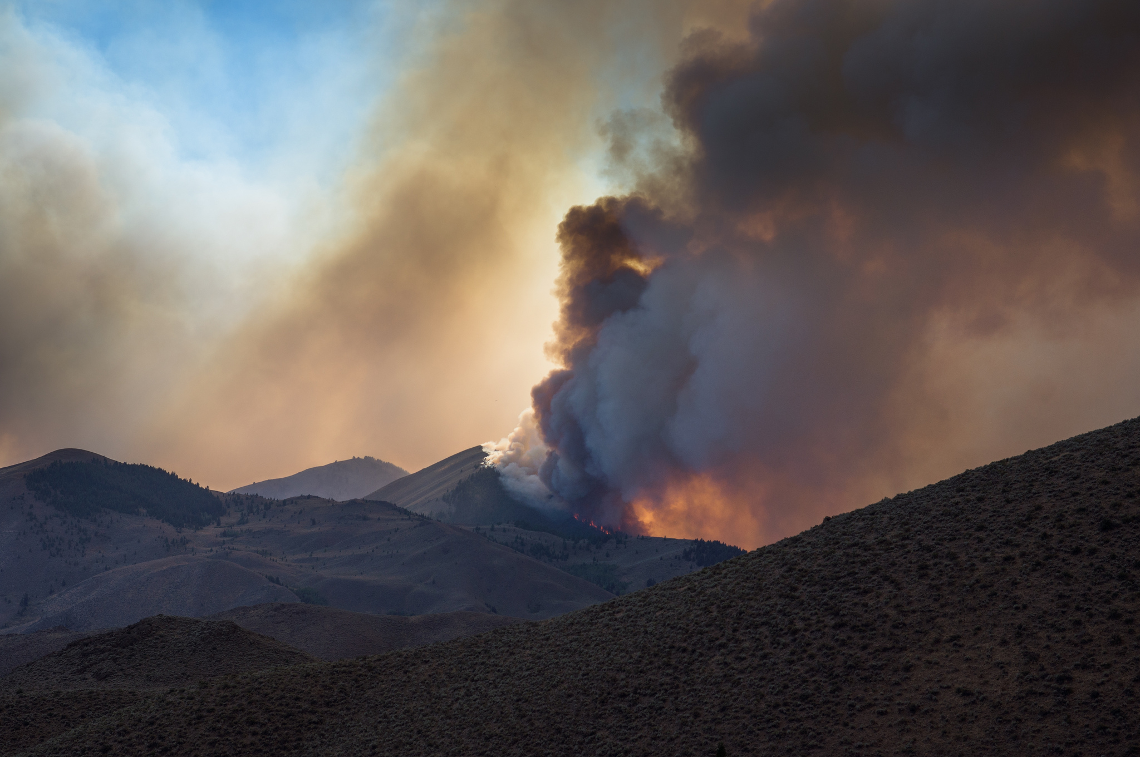
Great Basin Fire Potential Briefing (Date)
Basil Newmerzhycky Shelby Law
Nanette Hosenfeld Gina McGuire Palma

Slide 4
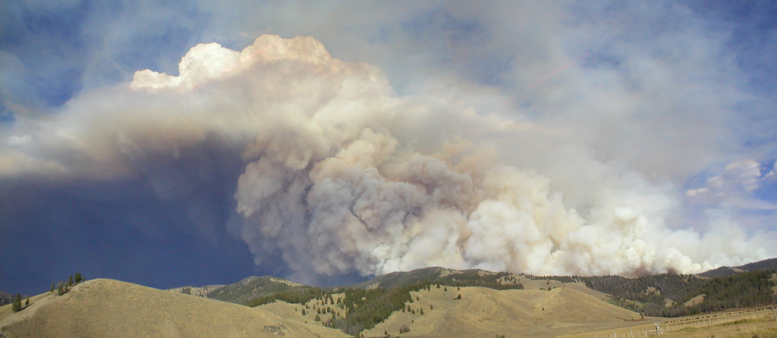
Great Basin Fire Potential Briefing (Date)
Basil Newmerzhycky Shelby Law
Nanette Hosenfeld Gina McGuire Palma

Slide 5
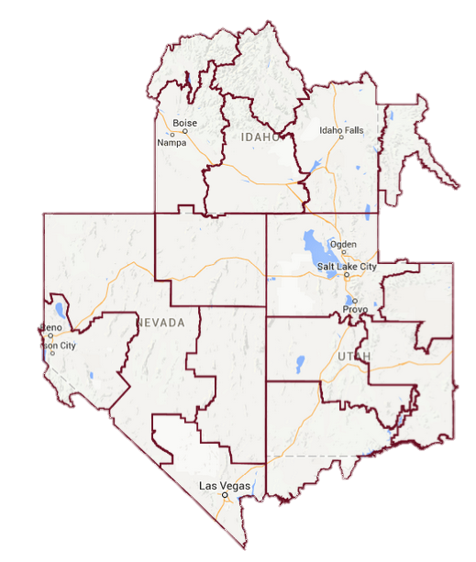
Fire Potential Impacts
Outline impacted areas on map below using the button. You can right click on the outline and select “Format Shape” to change outline properties. I usually change the transparency (under Fill option), get rid of the outline (under Line Color) and give it a soft edge of 2 or 3 (under ‘Glow and Soft Edges’)
Threat 1
Short description
Threat 2
Short description

Slide 6
No Significant Impacts
Lightning
Gusty Winds and Low RH
Rain
Cool Temperatures
Weekday
Weekday
Descriptive Text
Map created (date)

Slide 7
Past 24 Hours
Precipitation
Lightning

Slide 8
Great Basin Fire Activity
New Fire (Past 24 hours)
Existing Fire
Team Fire
Prescribed Fire

Slide 9
Observed Precipitation:
Past 7 days
Past 30 days

Slide 10
Current Fuel Conditions: ERC

Slide 11
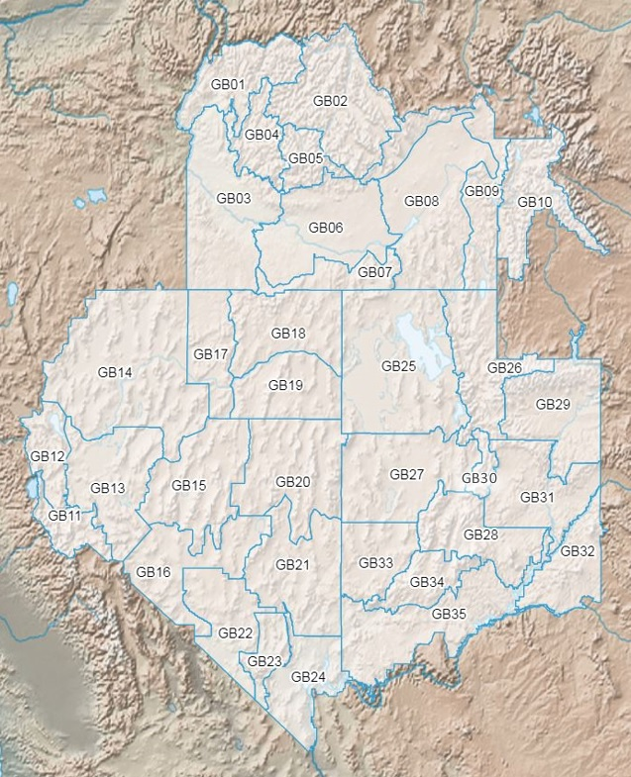
Current Fuel Conditions: ERC

Slide 12
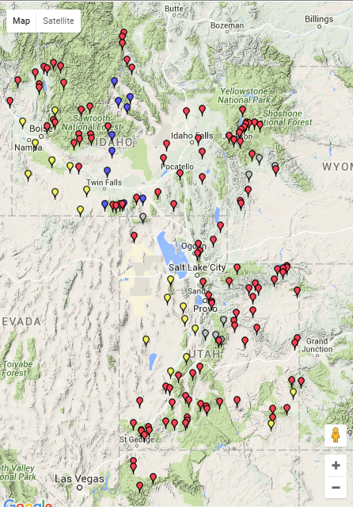
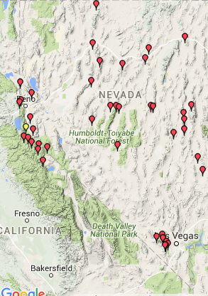
Current Fuel Conditions: Live Fuel Moisture

Slide 13
Satellite
(Date)

Slide 14
General Weather Pattern
Significant Fire Potential
0z GFS 500mb Height 700mb-300mb Wind and RH

Slide 15
Maximum Temperature Forecast
Minimum Temperature Forecast
Probability of Precipitation (%)
Weather
Relative Humidity (%)
Sky Cover (%)
Wind Speed (kts)
Wind Gust (kts)
Precipitation Amount (in)
Snow Amount (in)

Slide 17
General Weather Pattern
Significant Fire Potential
0z GFS 500mb Height 700mb-300mb Wind and RH

Slide 19
General Weather Pattern
Significant Fire Potential
0z GFS 500mb Height 700mb-300mb Wind and RH

Slide 21
3-Day Precipitation Accumulation

Slide 22
General Weather Pattern
Significant Fire Potential
0z GFS 500mb Height 700mb-300mb Wind and RH

Slide 23
General Weather Pattern
Significant Fire Potential
0z GFS 500mb Height 700mb-300mb Wind and RH

Slide 24
General Weather Pattern
Significant Fire Potential
0z GFS 500mb Height 700mb-300mb Wind and RH

Slide 25
General Weather Pattern
Significant Fire Potential
0z GFS 500mb Height 700mb-300mb Wind and RH

Slide 26
Precipitation Accumulation: 7 Day Total

Slide 27
NOAA CPC 8-14 Day Outlook
Temperature
Precipitation

Slide 28
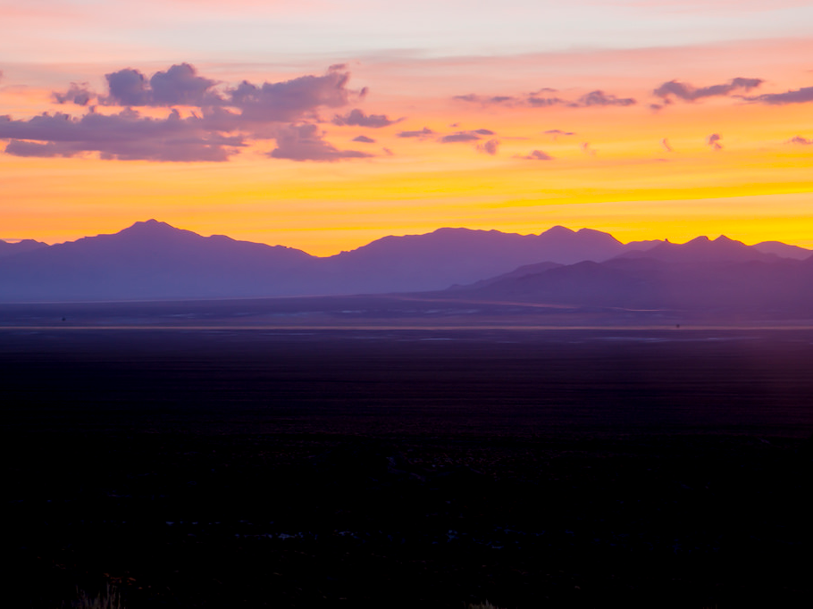
Questions?
Basil: bnewmerzhycky@fs.fed.us
Gina: gmcguire@blm.gov
Shelby: slaw@blm.gov
Nanette: nhosenfeld@blm.gov
@GreatBasinCC

Slide 29
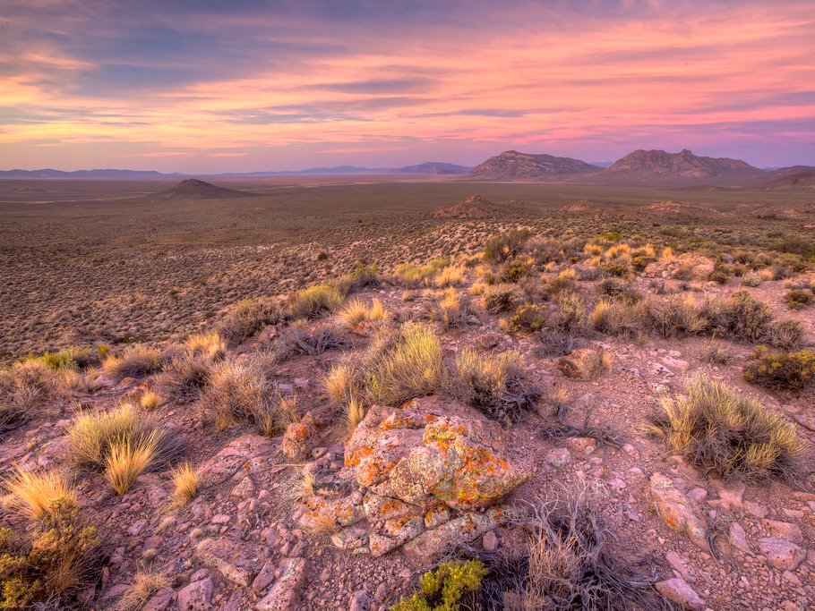
Questions?
Basil: bnewmerzhycky@fs.fed.us
Gina: gmcguire@blm.gov
Shelby: slaw@blm.gov
Nanette: nhosenfeld@blm.gov
@GreatBasinCC
@GreatBasinCC

Slide 30
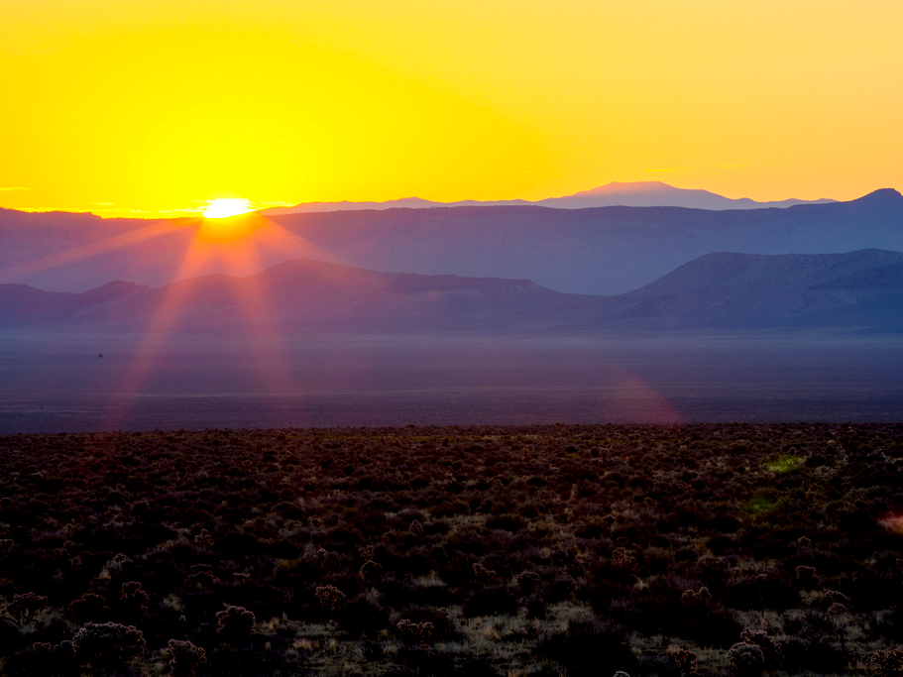
Questions?
Basil: bnewmerzhycky@fs.fed.us
Gina: gmcguire@blm.gov
Shelby: slaw@blm.gov
Nanette: nhosenfeld@blm.gov
@GreatBasinCC

Slide 31
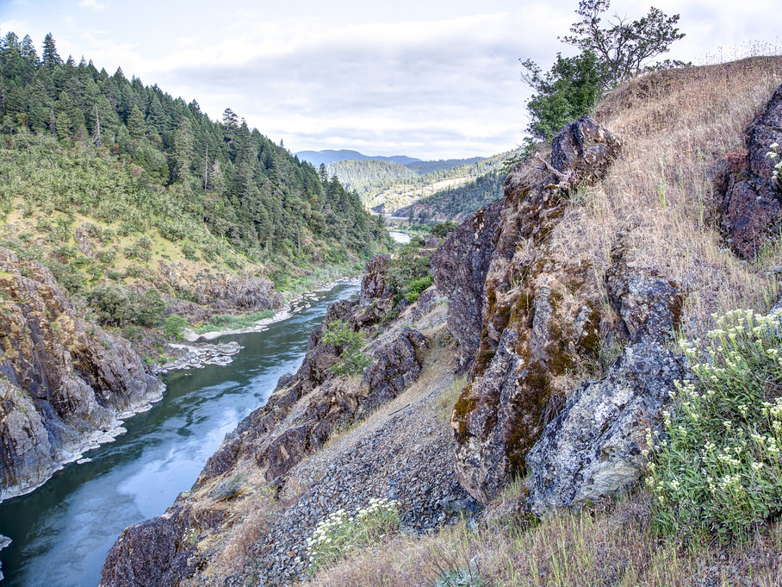
Questions?
Basil: bnewmerzhycky@fs.fed.us
Gina: gmcguire@blm.gov
Shelby: slaw@blm.gov
Nanette: nhosenfeld@blm.gov
@GreatBasinCC

Slide 32
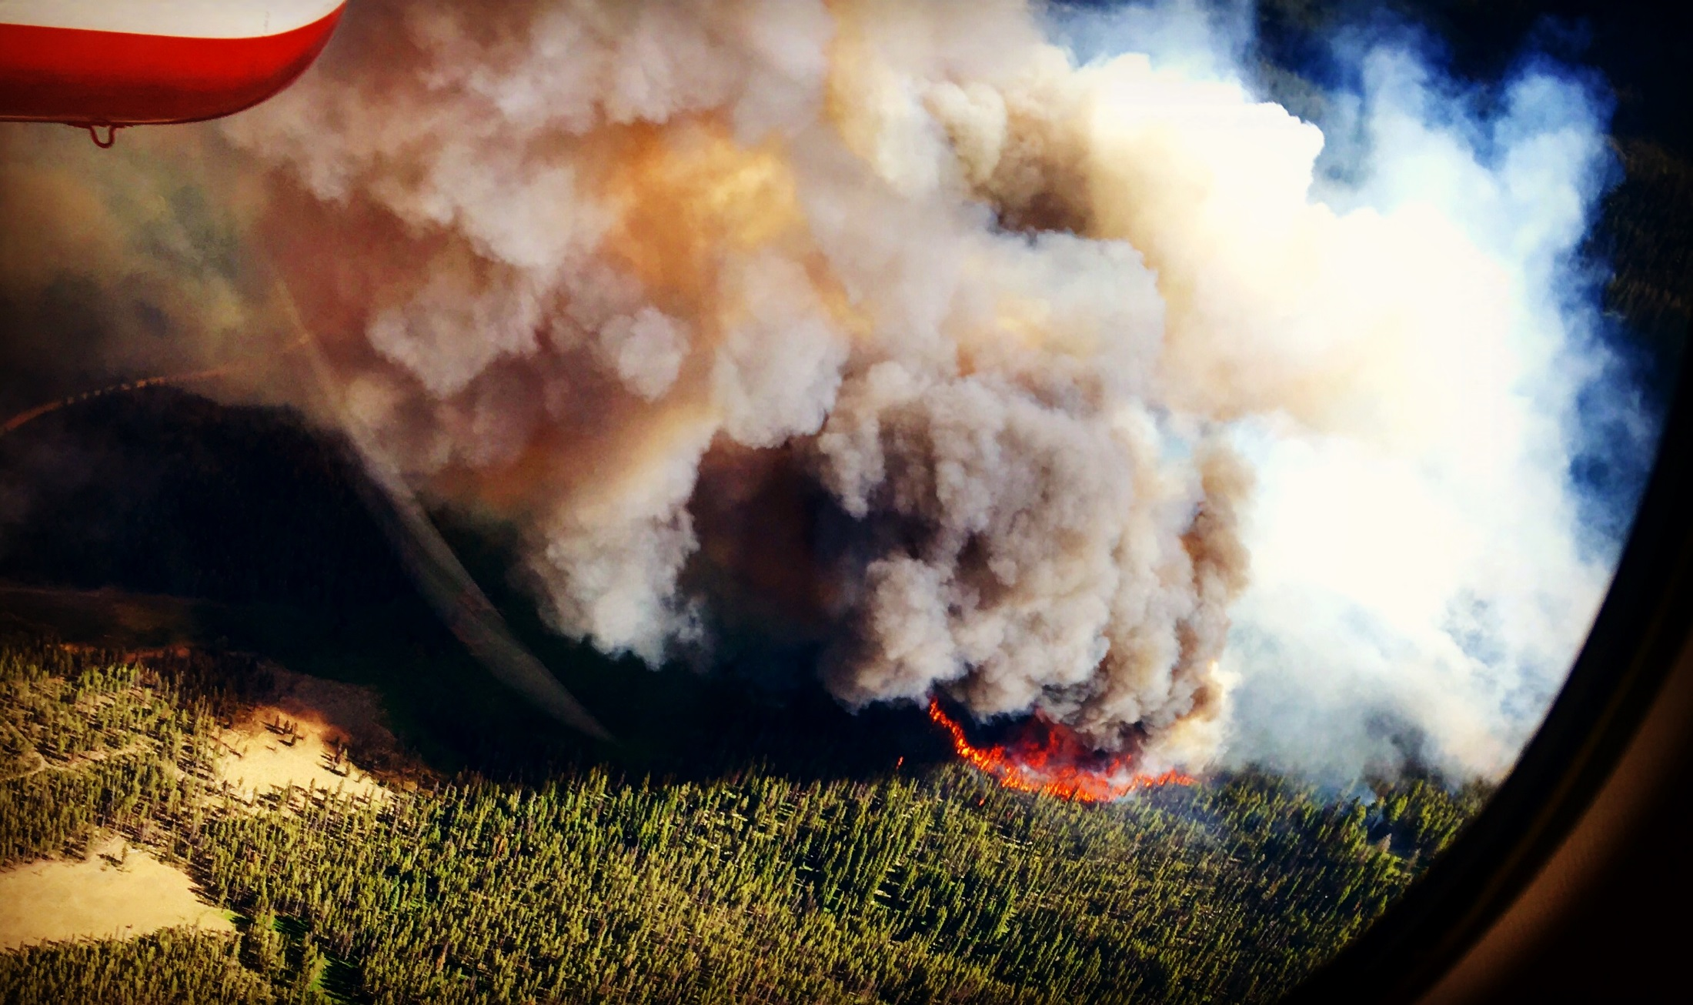
Questions?
Photo by C. Czinski
Basil: bnewmerzhycky@fs.fed.us
Gina: gmcguire@blm.gov
Shelby: slaw@blm.gov
Nanette: nhosenfeld@blm.gov
@GreatBasinCC

Slide 33
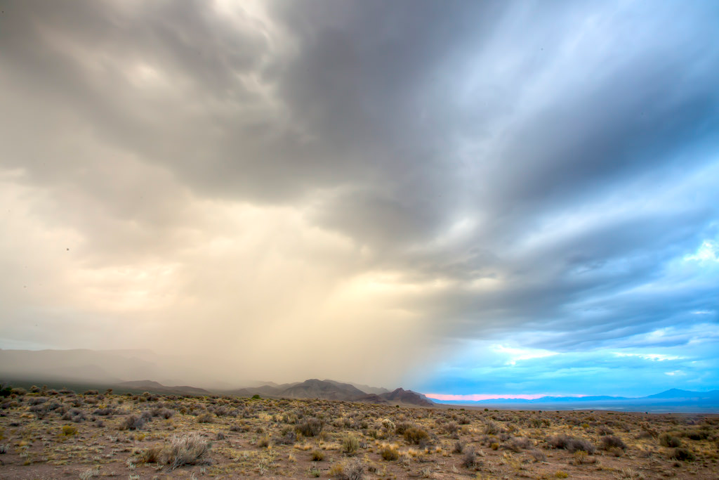
Questions?
Basil: bnewmerzhycky@fs.fed.us
Gina: gmcguire@blm.gov
Shelby: slaw@blm.gov
Nanette: nhosenfeld@blm.gov
@GreatBasinCC

Slide 34
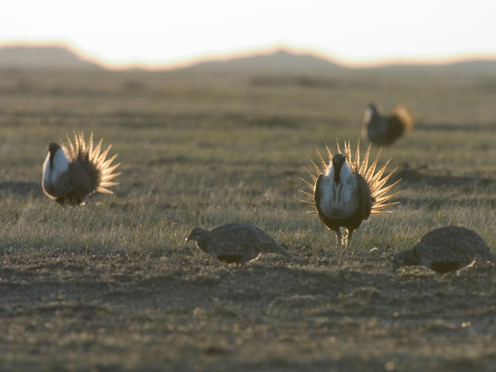
Questions?
Basil: bnewmerzhycky@fs.fed.us
Gina: gmcguire@blm.gov
Shelby: slaw@blm.gov
Nanette: nhosenfeld@blm.gov
@GreatBasinCC

