Slide 1
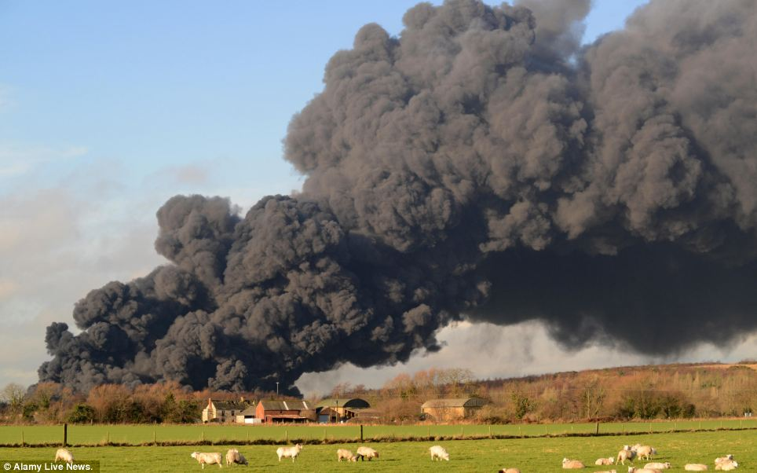
Smoke Dispersion Briefing
Monday Nov 9th, 2015

