Slide 1
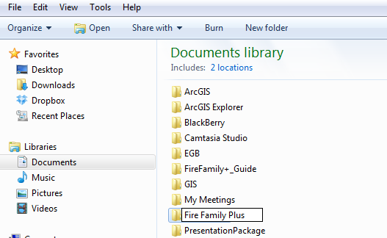
Create A new “fire family plus” folder on computer

Slide 2
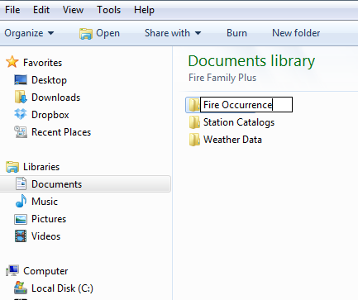
Create Sub Folders: Fire Occurrence Station Catalogs Weather Data

Slide 3
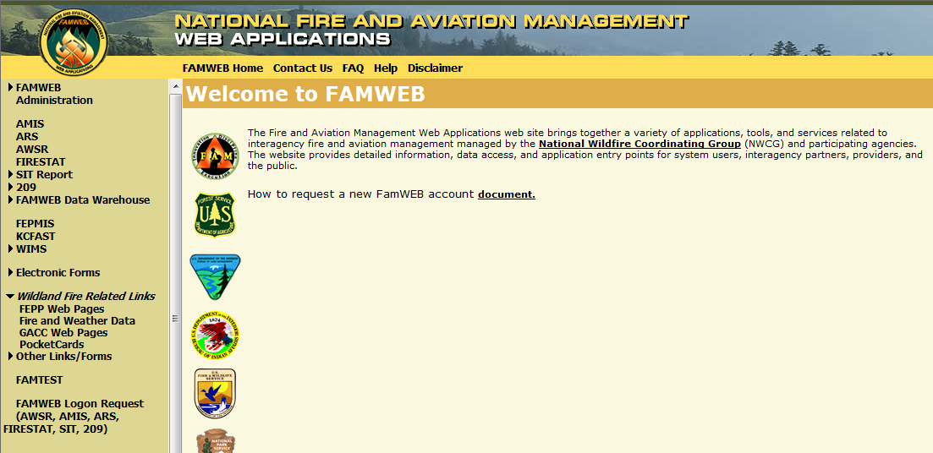
Navigate in web browser to: https://fam.nwcg.gov/fam-web/

Slide 4
Click on “Wildland fire related links” Then “Fire and weather data”

Slide 5
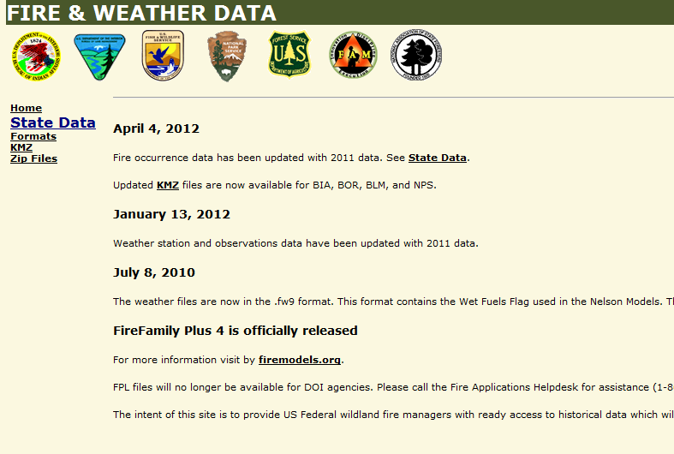
Click on “state data”

Slide 6
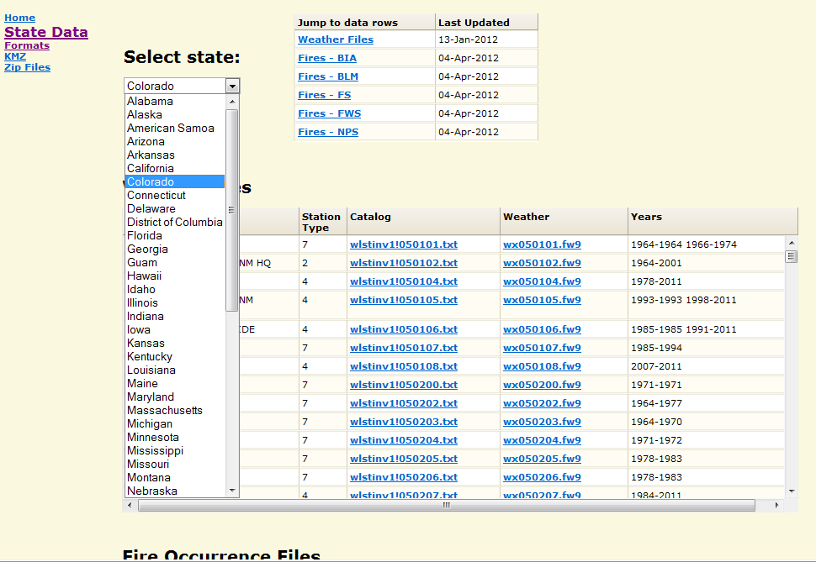
Choose a state from the drop down menu

Slide 7
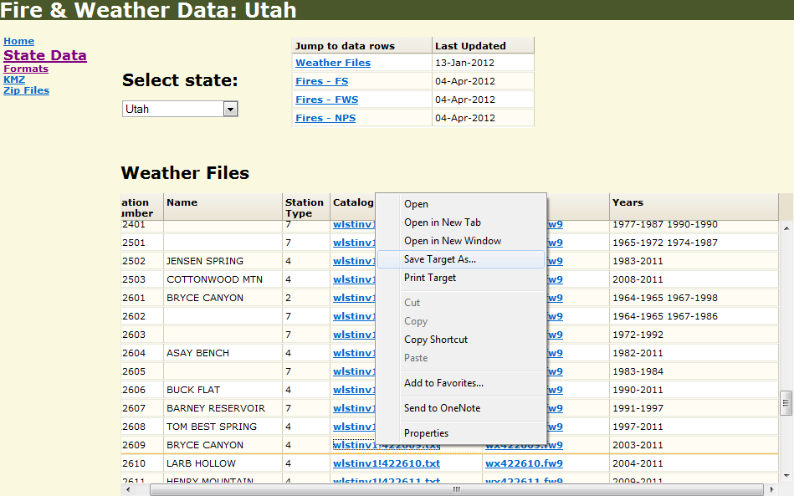
Right Click on a station catalog, Click on “Save Target As”

Slide 8
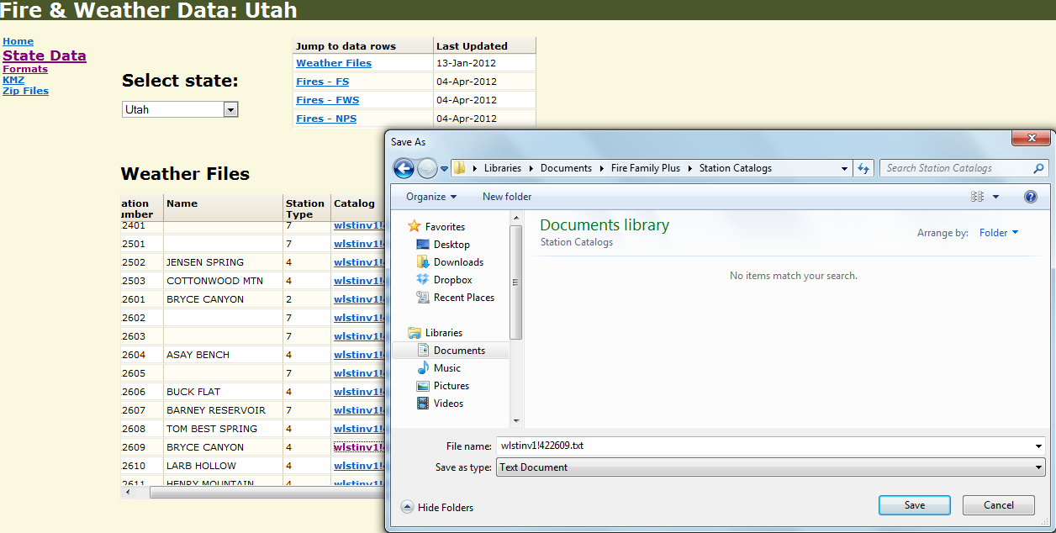
Save station catalog text file in the station catalog sub folder in the fire family plus Folder

Slide 9
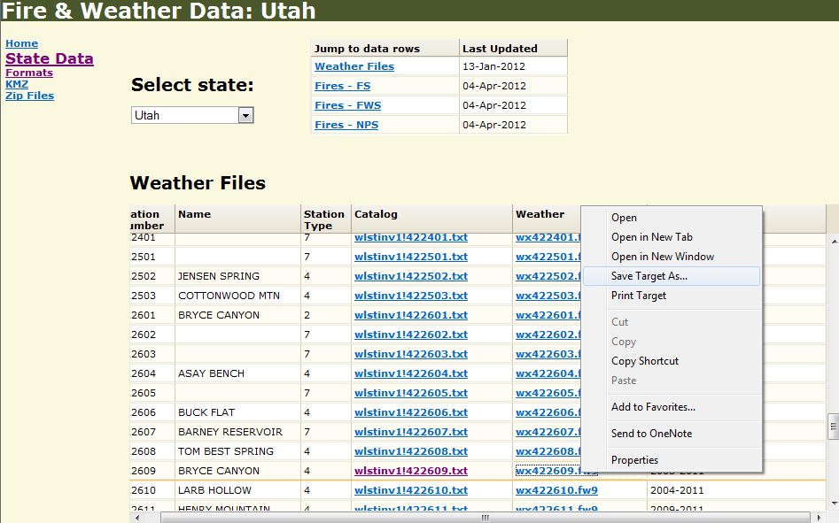
Right Click on Weather data file, Click on “Save Target As”

Slide 10
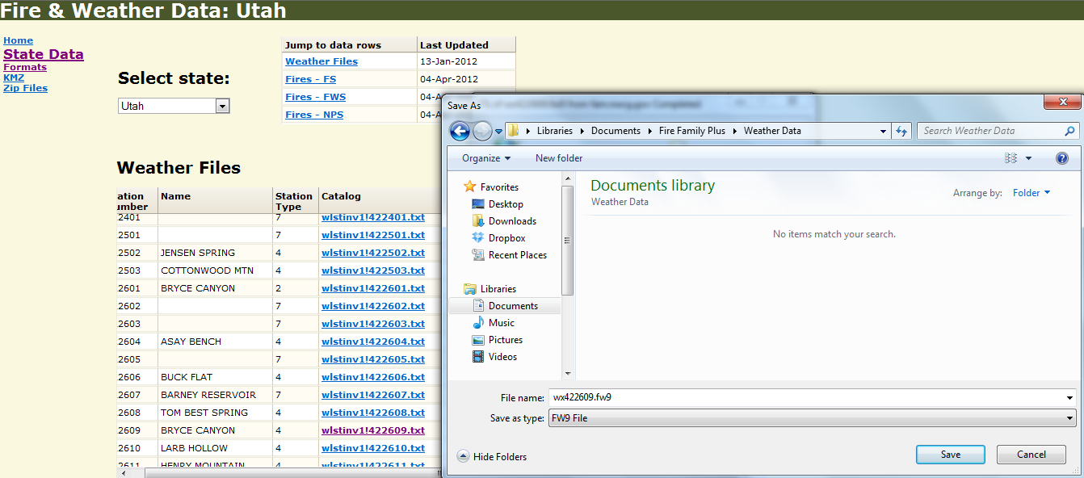
Save weather data .fwx file in the weather data sub folder in the fire family plus folder

Slide 11
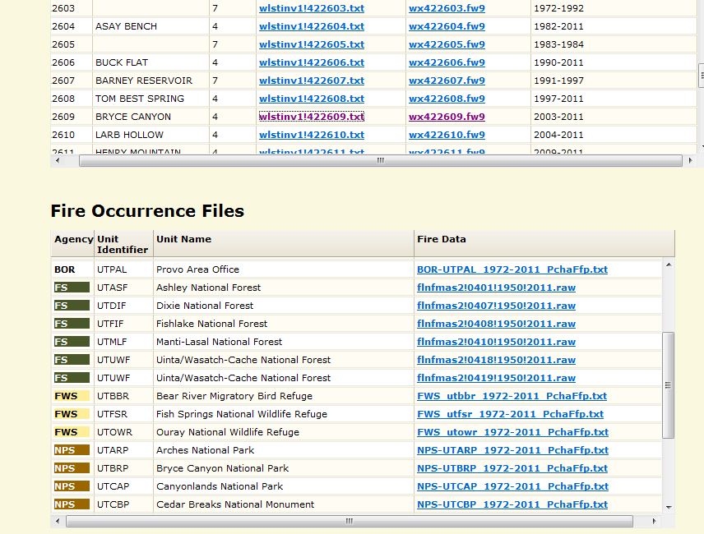
Scroll down to the fire occurrence files

Slide 12
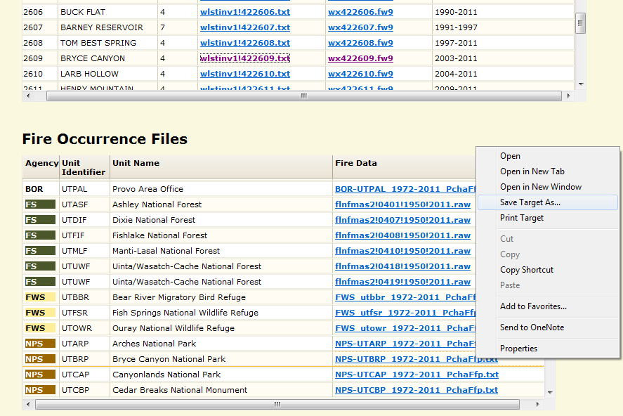
Right Click on Fire occurrence data file, Click on “Save Target As”

Slide 13
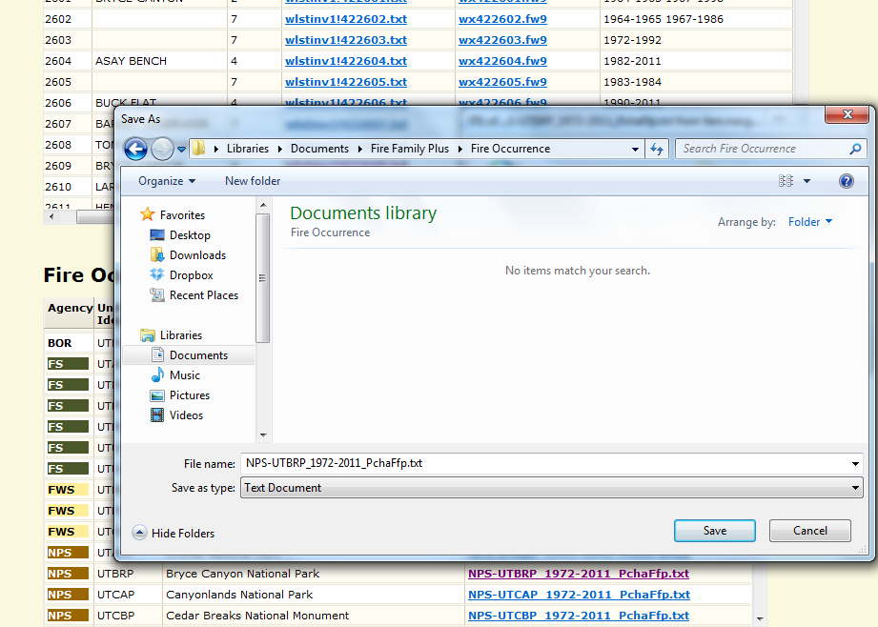
Save fire occurrence file in the fireoccurrence sub folder in the fire family plus folder

Slide 14
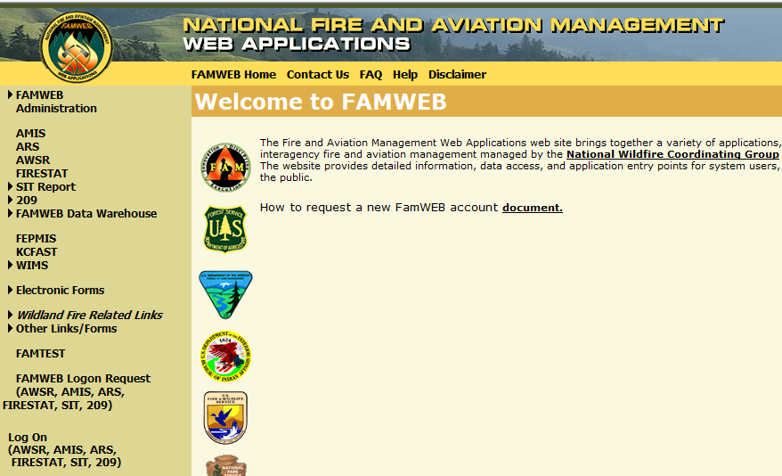
*Alternative Download option* KC FAst
Click “KC Fast”

Slide 15
Click Weather

Slide 16
Click station catalog

Slide 17
Click station information

Slide 18
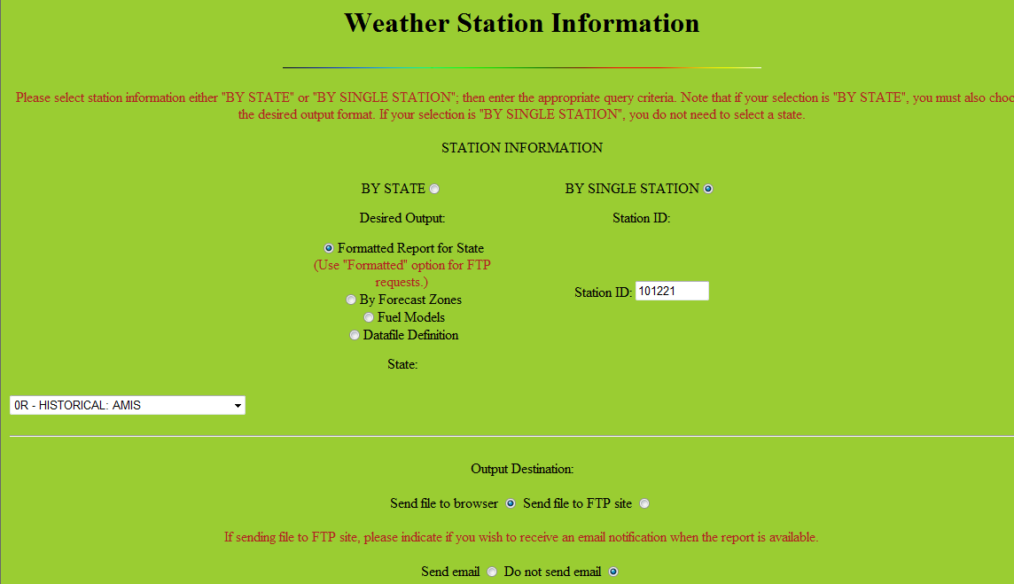
Click single station toggle

Slide 19
Type in WIMS station ID

Slide 20
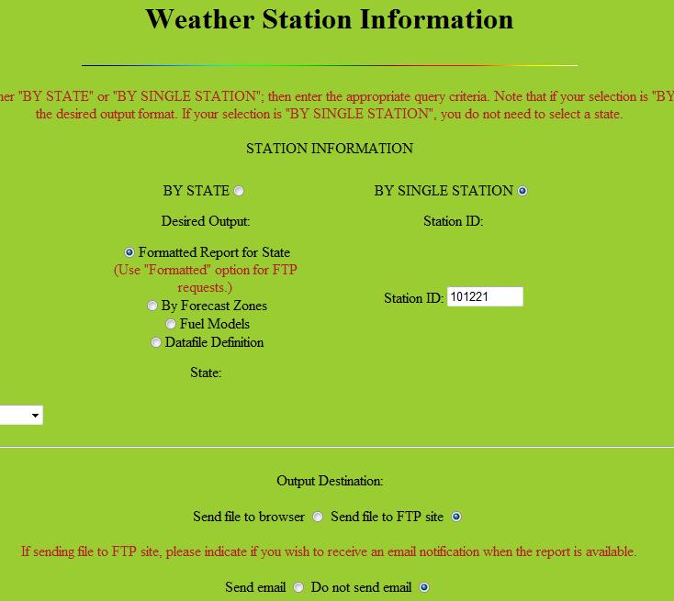
Click send file to ftp site toggle

Slide 21
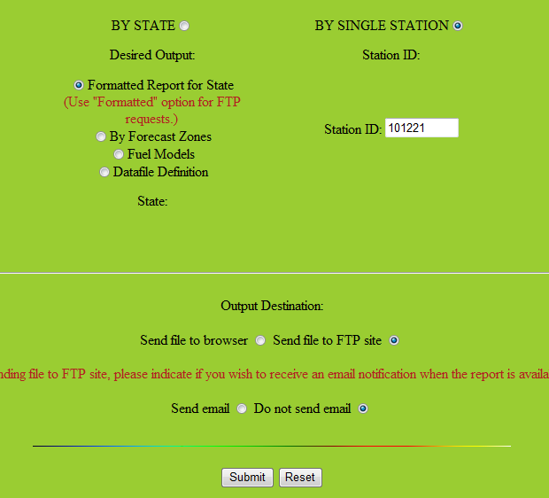
Click submit button

Slide 22
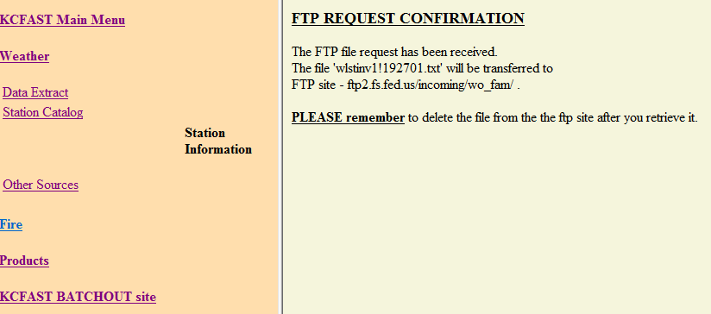
Requested file sent to KCFast batch out ftp site after a few minutes
Requested File Name
File transferred to KCFast “Batchout Site”

Slide 23
Requested Files sent to Batchout ftp site on KCFast Webpage
Click Here

Slide 24
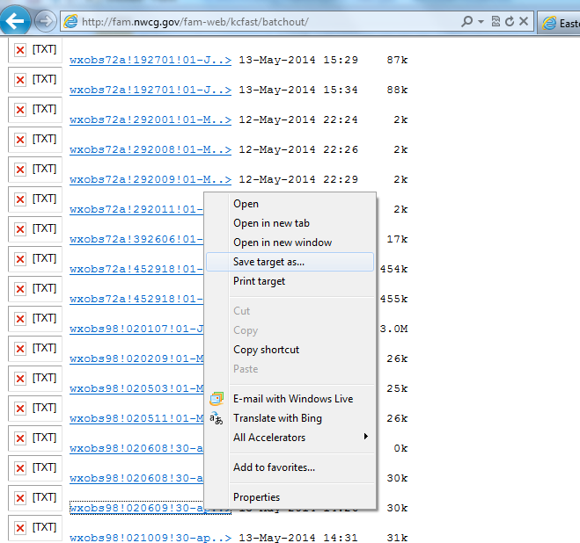
Scroll down, Right Click, and save the requested data file
Station Catalog file names contain the WIMS ID and end in .txt
Weather file names contain the WIMS ID and end in .fwx or .fw9
With your cursor right click on the file you wish to save, select “Save Target As” and then save the file in the proper Fire Family Plus folder.

Slide 25
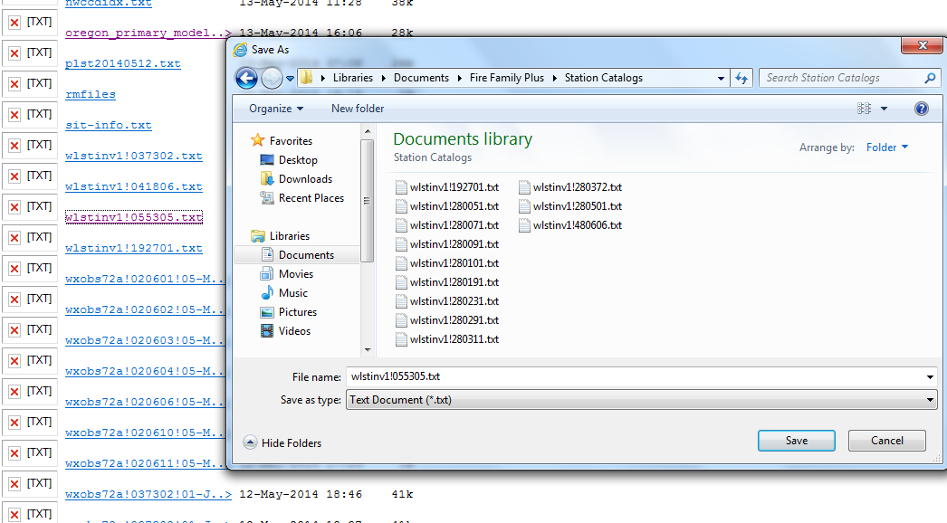
Save the Station Catalog .txt file in the Station catalog sub folder under the fire family plus folder

Slide 26
Weather data from kc fast: Click Weather

Slide 27
Click data extract

Slide 28
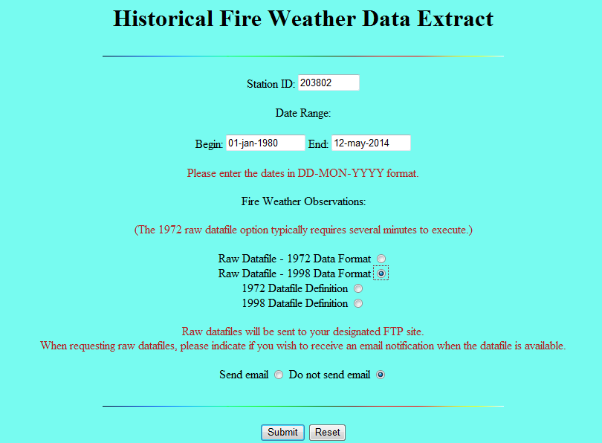
Submit weather data request
Station or WIMS ID
Date range
Selct Data format: Most of the time choose 1998 Raw Data Format (.fw9 file)
Click “Submit”

Slide 29
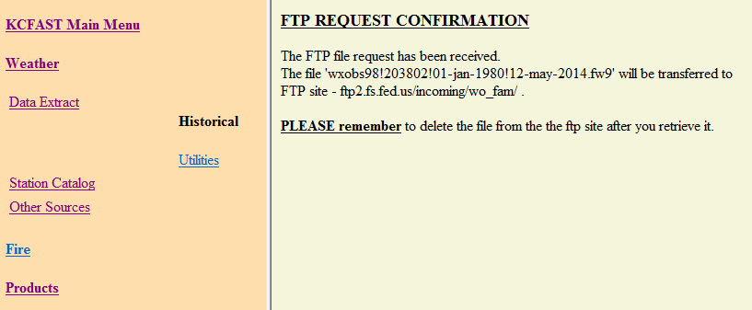
Note weather file name which will be sent to kcfast batchout site
Weather Data File Name
File transferred to KCFast “Batchout Site”

Slide 30
Scroll down, Right Click, and save the requested data file
Station Catalog file names contain the WIMS ID and end in .txt
Weather file names contain the WIMS ID and end in .fwx or .fw9
With your cursor right click on the file you wish to save, select “Save Target As” and then save the file in the proper Fire Family Plus folder.

Slide 31
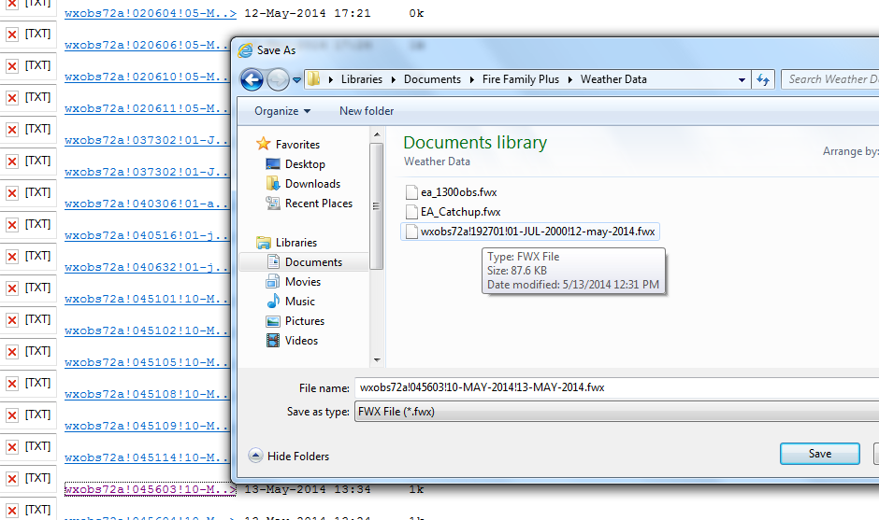
Save weather data file to weather data folder
Weather Data Folder

Slide 32
Downloading US Forest Service Fire occurrence data in KC Fast
Click “Fire” from KC Fast Main Menu

Slide 33
Select “standard extract”
Click “Standard Extract”

Slide 34
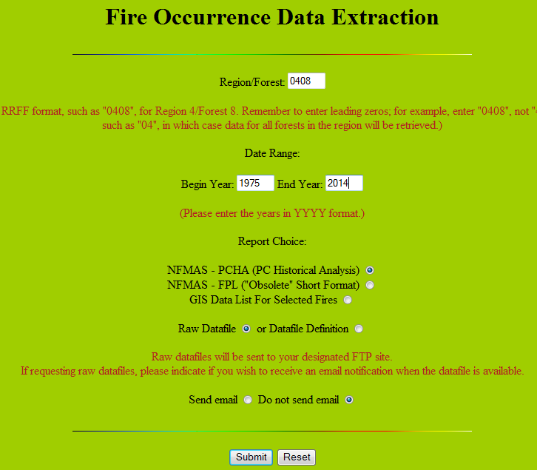
Make fire occurrence Selections
Enter Region and Forest Number
Enter Year Range
Select “PCHA” File Type
Select “RAW” File Type
Click “Submit”

Slide 35
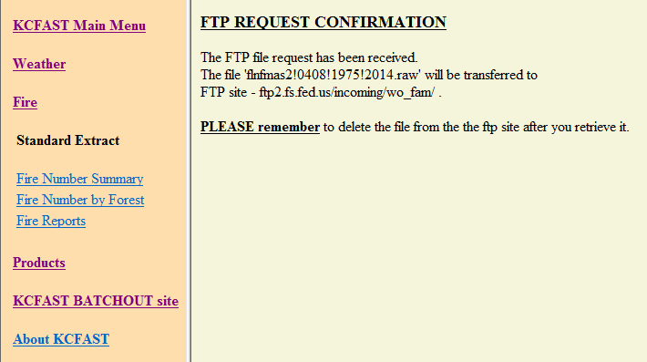
Note Fire occurrence file name which will be sent to kcfast batchout site
Fire Occurrence Data File Name
File transferred to KCFast “Batchout Site”

Slide 36
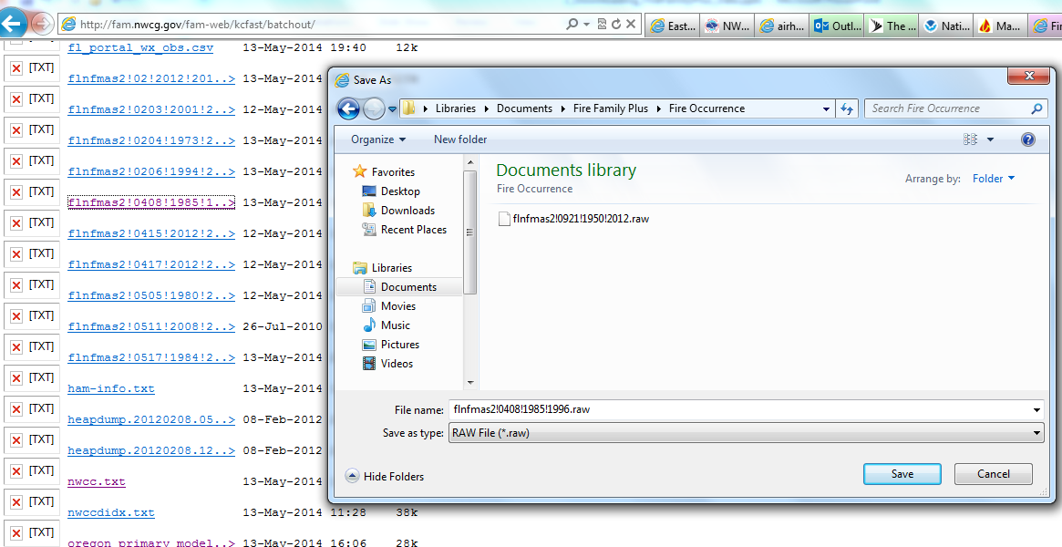
Save Fire Occurrence file to fire occurrence folder

